Slide 1
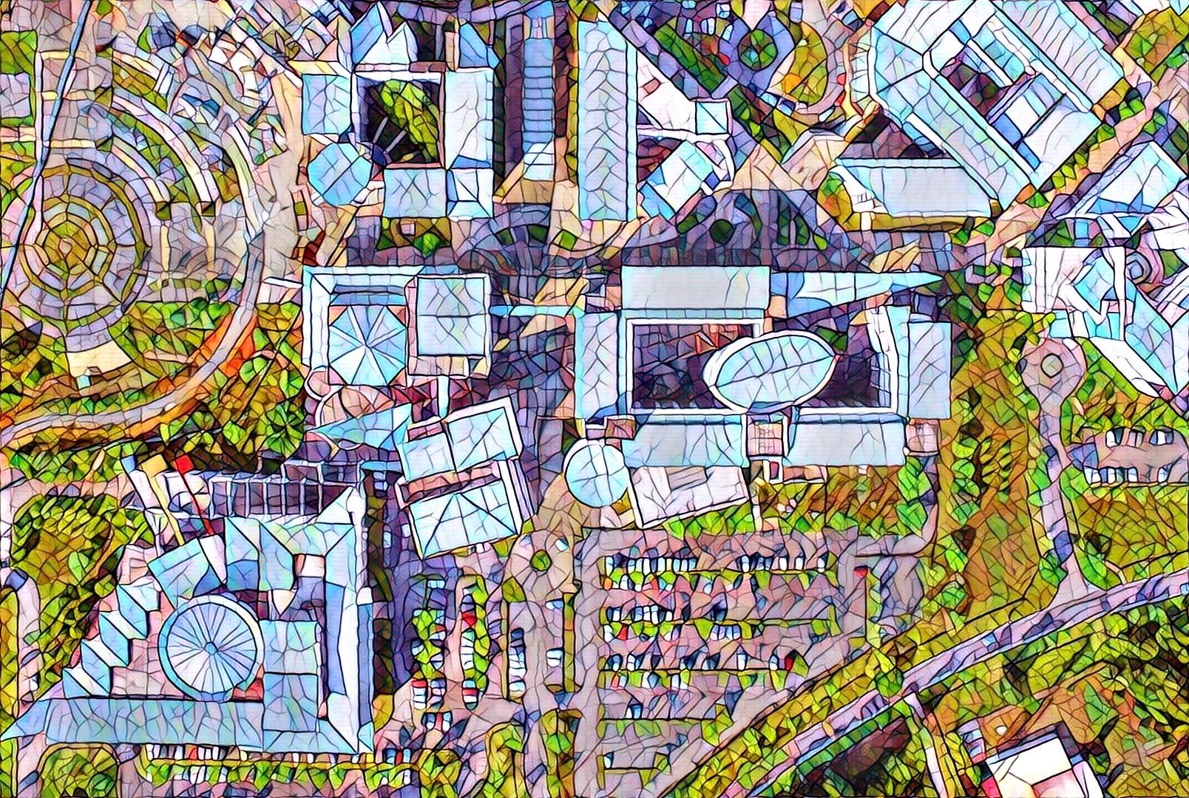


Introduction of Basic Photography
Digital Photography and Social Media Imaging

Slide 2
Camera
The camera is a box that controls the amount of light that reaches a piece of light sensitive film or other surface inside. The original cameras did not even have a glass lens.
The first cameras used a tiny hole in the front of the box to allow in light and to focus the image onto the viewing surface.
Today's cameras use glass lenses to focus and capture light much more quickly and to allow us to magnify images. Film is much more sensitive and finely detailed than the first film surfaces and now, digital sensors take the place of film.

Slide 3
Evolution
Development in technology has a great impact towards today’s photography equipment/ gears.
Now, camera comes in many forms such as:
Phones @ Smartphones
Action Cameras
360 Cameras
Digital Compact Cameras
Mirrorless Cameras
Digital SLR Cameras
Drone

Slide 4
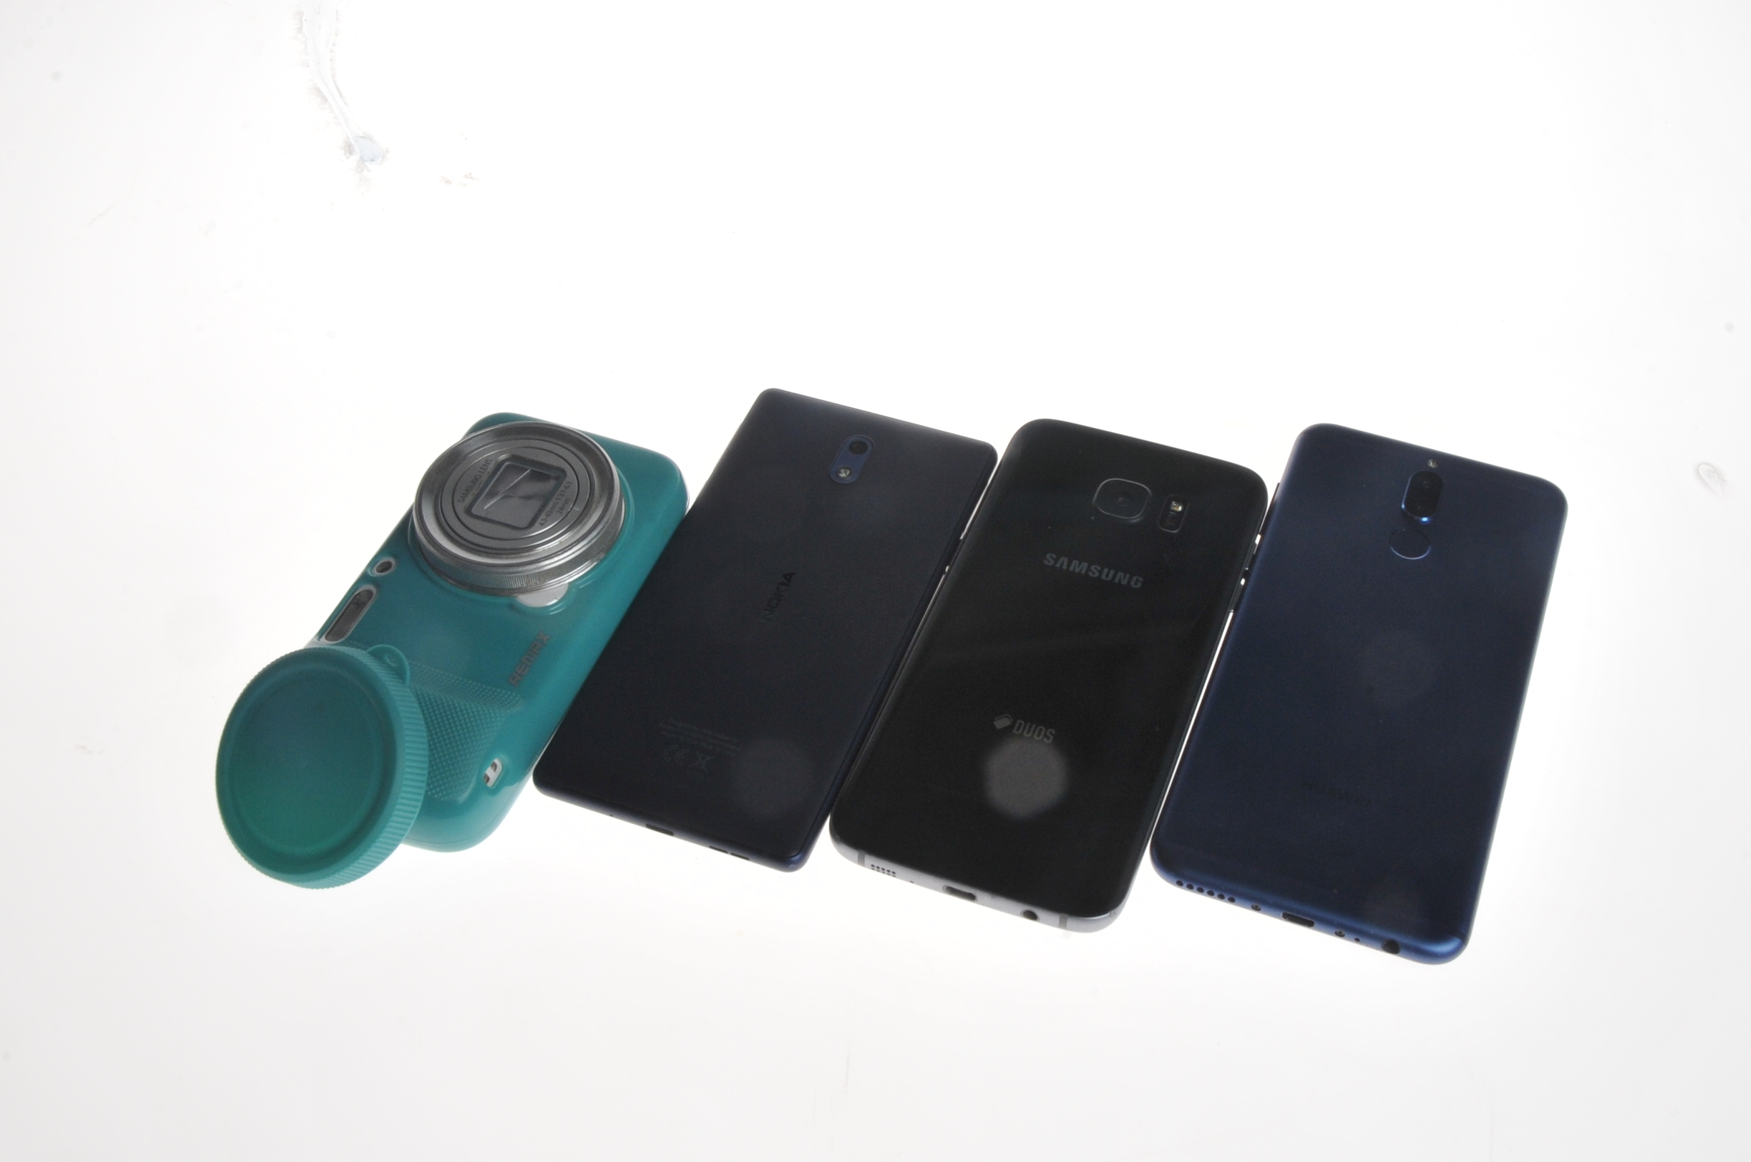
Phones @ Smartphones

Slide 5
Phones @ Smartphones
Mobile phone that has the capacity of running functions of a computer.
Most of the them, having a touchscreen interface (there are a few which as physical keyboards such as blackberry and others).
Having internet access through various telco companies (various speed depending the coverage and speed connectivity).
Having an operating system (iOS; Apple and Androids; Google Inc. and others, Kai, Android OS (Google Inc.) capable of running downloaded applications (apps).

Slide 6
Phones @ Smartphones
Pros:
Compact body factor
Control to settings (depending on phone model)
Apps enable (fine tuning, editing and sharing through various social media platform)
Cons:
Censor size
Limited control settings (depending on phone model)

Slide 7


Phones @ Smartphones

Slide 8
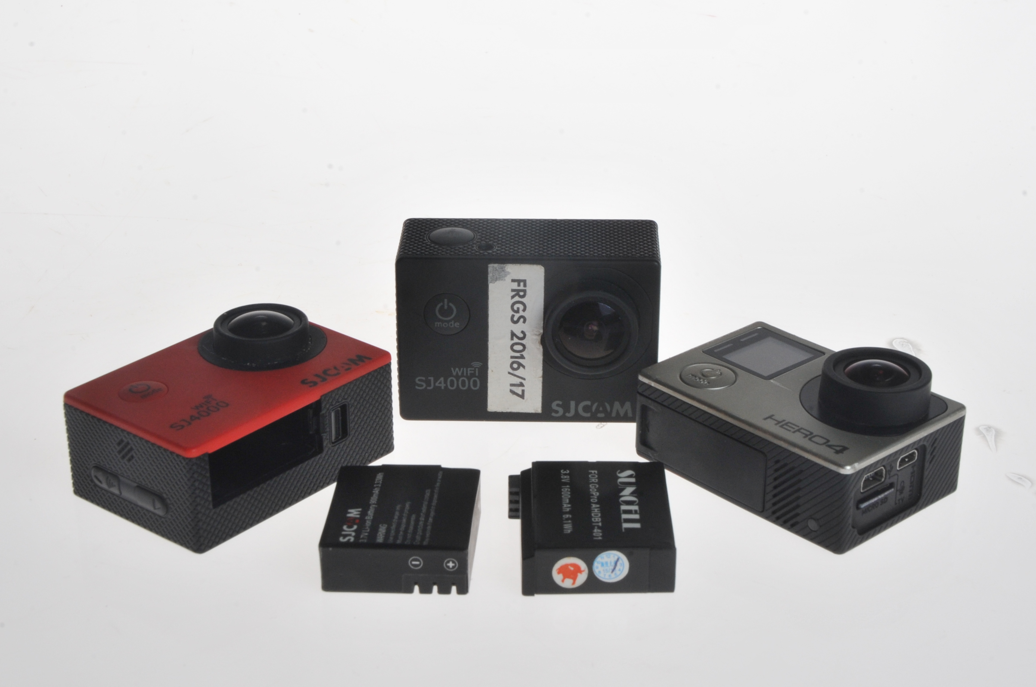
Action Cameras

Slide 9
Action Cameras
Action camera or action-cam is a digital camera records every user’s move.
The recording will give the immersive experience for the viewers from the user’s perspective.
Normally, action cameras are compact (small) and rugged.
Even, some are waterproof (some are not but comes with waterproof casing)

Slide 10
Action Cameras
Pros:
Rugged and compact
Lightweight
Versatile and mountable (with or without mount)
Remote view and shutter via smartphone or trigger
Cons:
Small viewfinder (some model are not available)
Exposure settings not fully customizable
Fixed focus
Distort view

Slide 11
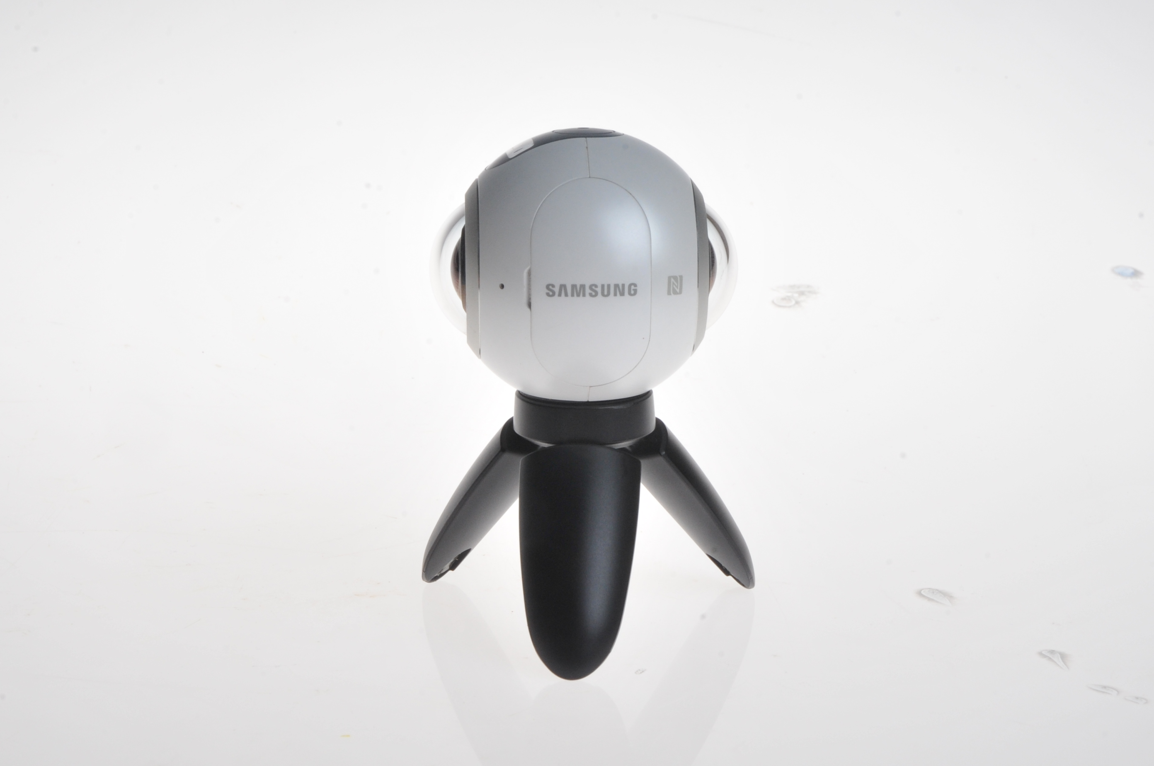
360 Camera

Slide 12
360 Camera
Similar to action camera or action-cam is a digital camera records every user’s move but in every angle.
The recording will give the immersive experience for the viewers from the user’s perspective (360 view where some are not within the sight of the users but can be access by the viewers later).
Normally, 360 cameras are compact (small) and rugged.
Even, some are waterproof (some are splashproof or comes with waterproof casing).

Slide 13
360 Camera
Pros:
Small and lightweight
Versatile and mountable (with or without mount)
Takes 360-degree photos and videos (depending on settings)
Remote view and shutter via smartphone or trigger
Cons:
Fixed focus
Low photo or video quality (depending on model)
Huge blind spot (depending on model)
For digital viewing

Slide 14
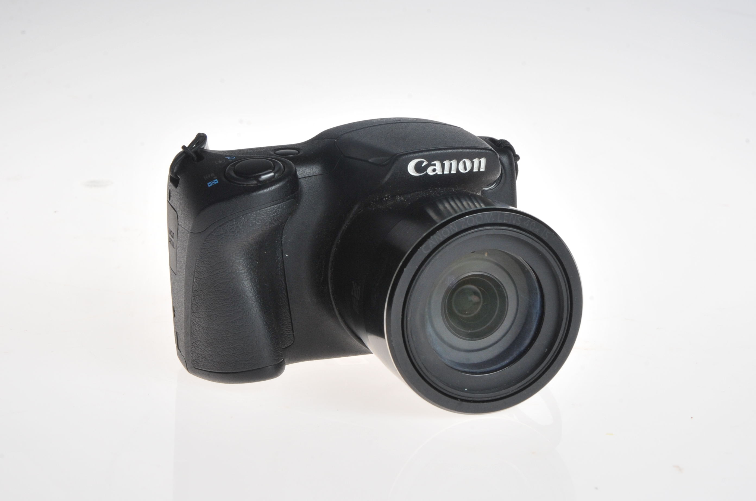
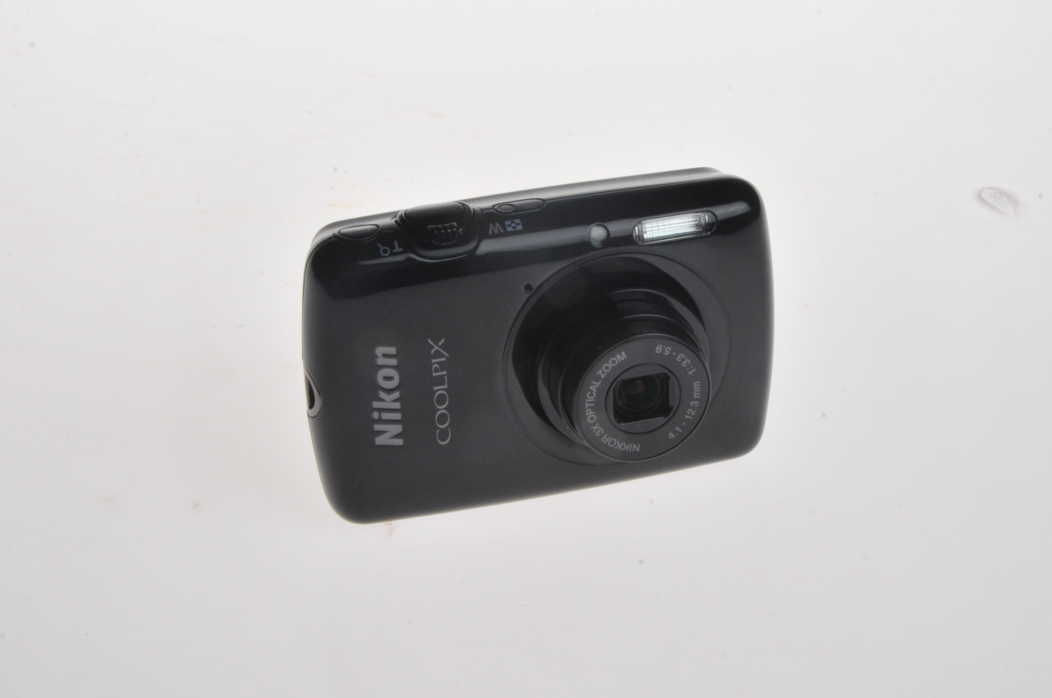
Digital Compact Cameras

Slide 15
Digital Compact Cameras
Digital compact camera is also known as point-and-shoot camera.
It can perform for still and video camera designed with the easiest operating for the users.
Some use focus free lenses or autofocus for focusing with zooming ability.
Most compact cameras has automatic configuration but manual are available for the pro-summers.

Slide 16
Digital Compact Cameras
Pros:
Very user-friendly
Lightweight and compact
No need extra lenses
Full auto mode or manual (depending on model)
Affordable
Cons:
Limited control on setting (depending on model)
More noise on photo or video due to smaller sensor
Low resolution (depending on model)
Slow focus (depending on model)

Slide 17

Digital Compact Cameras

Slide 18
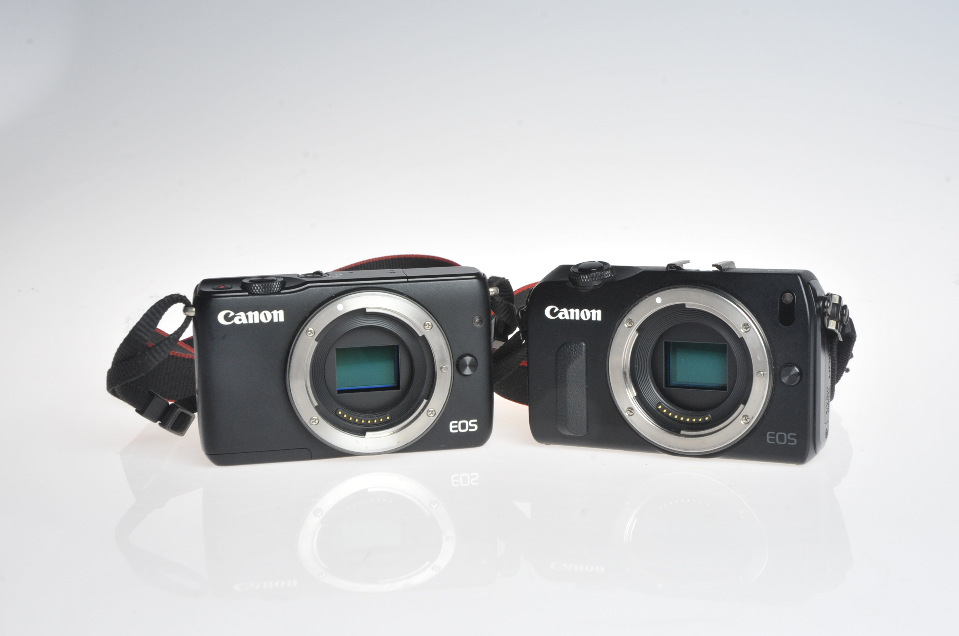
Mirrorless Cameras

Slide 19
Mirrorless Cameras
A digital camera that accepts different lenses. Also called a "mirrorless interchangeable-lens camera" (MILC), "hybrid camera" and "compact system camera" (CSC), the body is thinner than a digital SLR (DSLR) because it does not use a mechanical mirror to switch the scene between the optical viewfinder and image sensor.

Slide 20
Mirrorless Cameras
Pros:
Electronic viewfinder
Small and compact
Simpler operation and controls
Faster and better for video
Higher video quality even in lower-end models
Shoots more images at faster shutter speeds
Cons:
Shorter battery life
Slower autofocus
Fewer lenses and accessories (mount adapter for various lenses)

Slide 21


Mirrorless Cameras

Slide 22
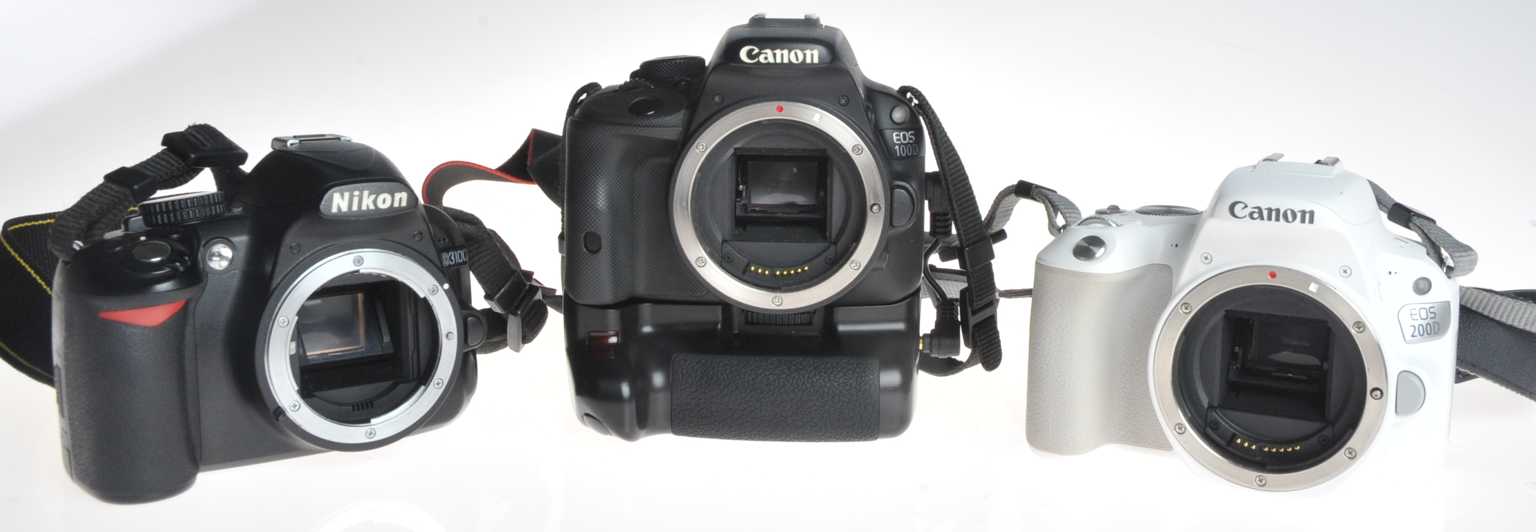
Digital SLR Cameras

Slide 23
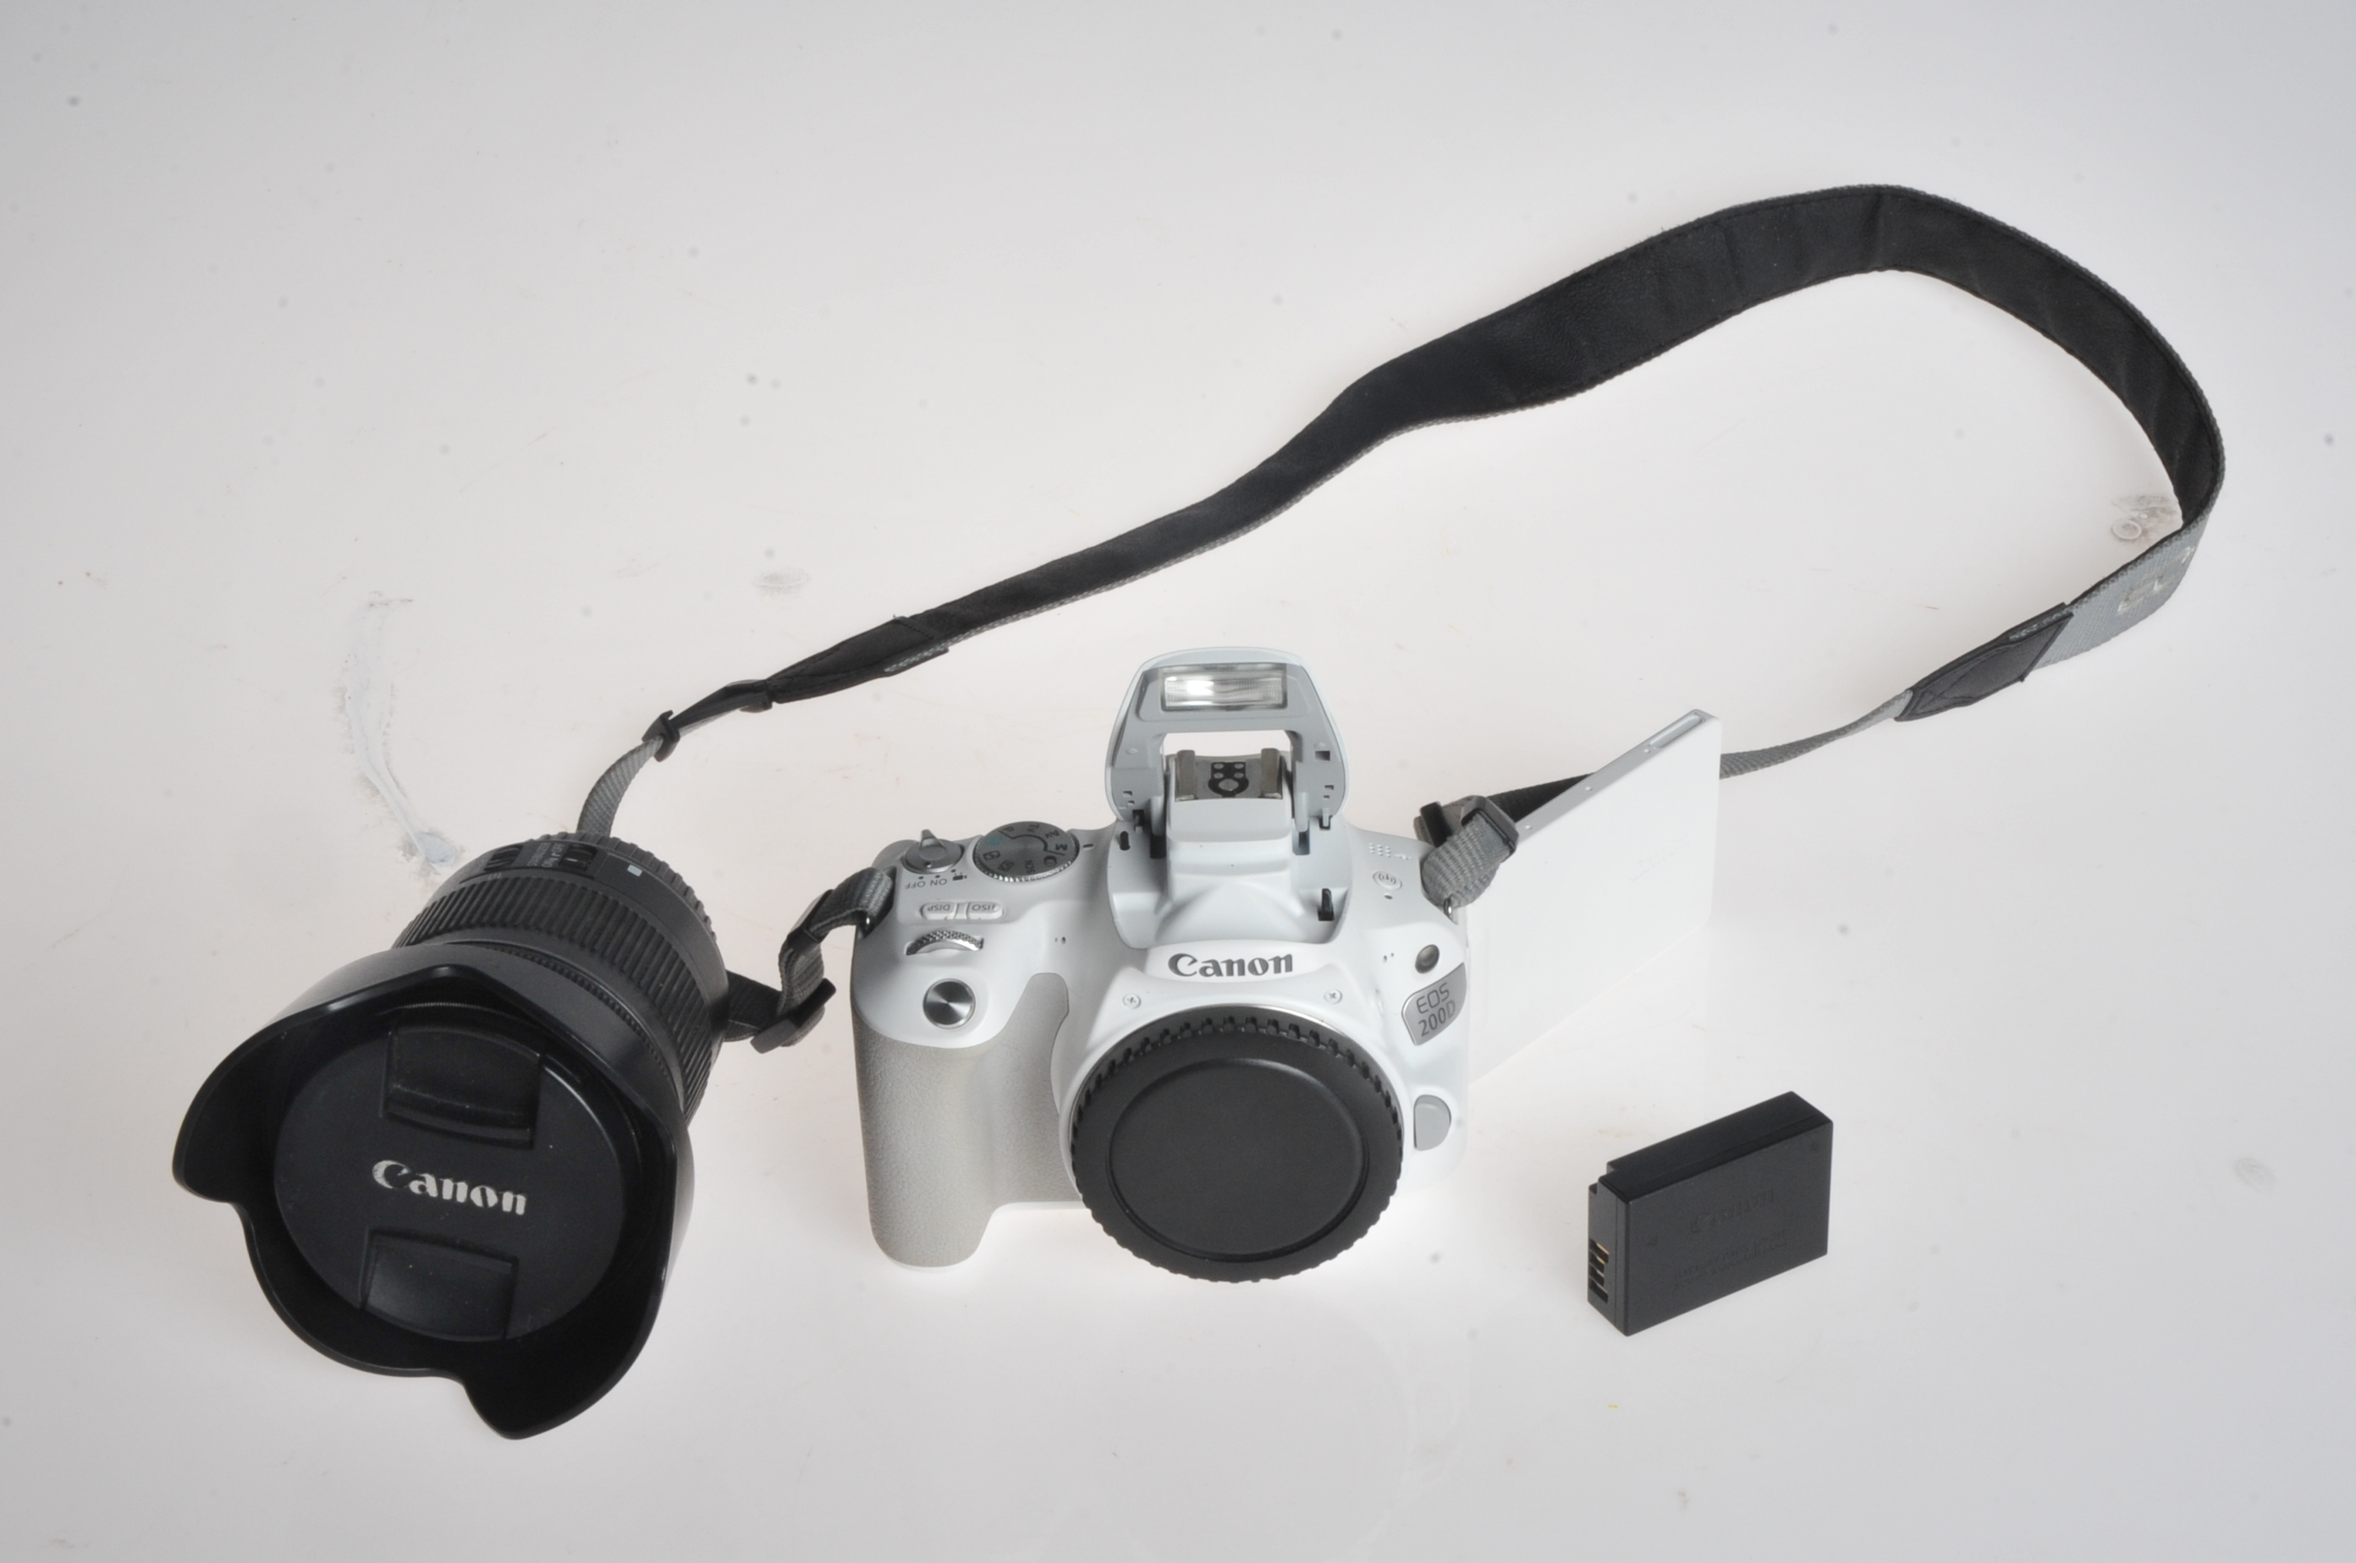
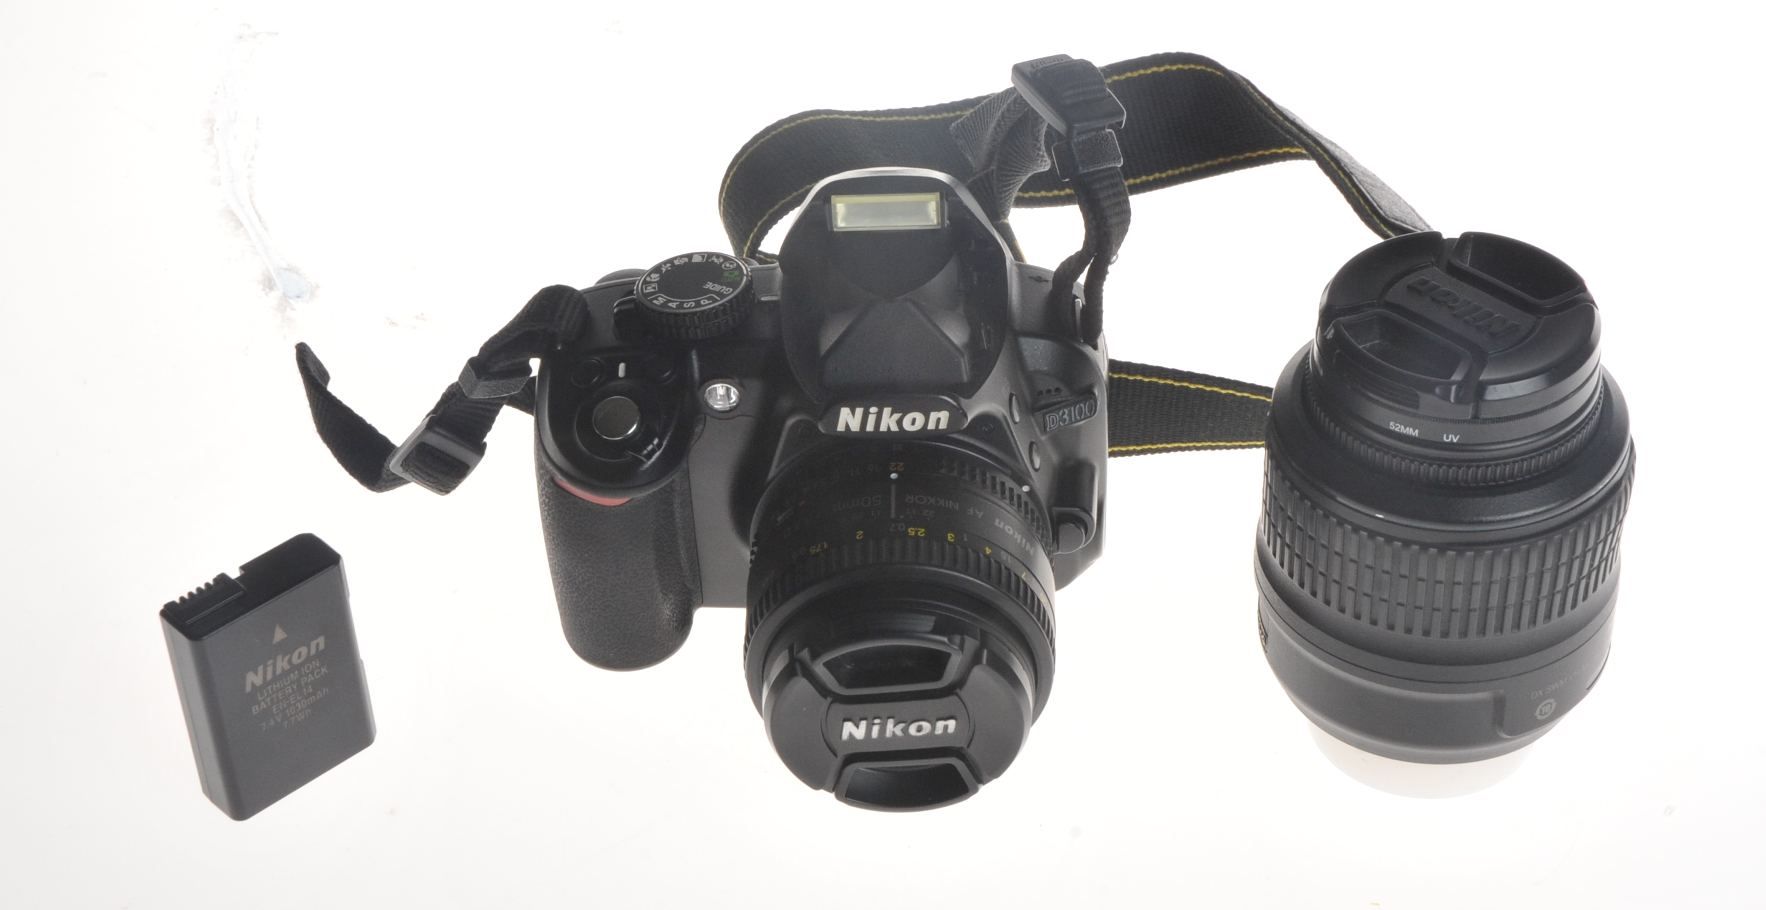
Digital SLR Cameras

Slide 24
Digital SLR Cameras
Digital SLR cameras also known as DSLR.
It has single-lens reflex mechanism.
It has a digital imaging sensor. (the opposite side of photographic film)
Lens on DSLR can be interchangeable.

Slide 25
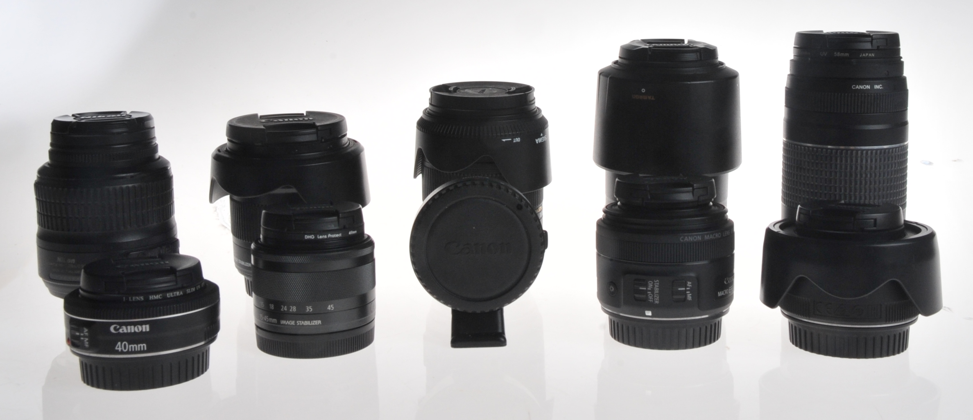
Digital SLR Cameras

Slide 26
Digital SLR Cameras
Pros:
Fully customizable settings
Large sensors for cleaner images
Optical viewfinder
High-resolution photo output
Full HD to UHD video output
Wide variety of camera body and lens choices
Cons:
Bigger and bulkier
Higher cost
Requires ample know-how

Slide 27

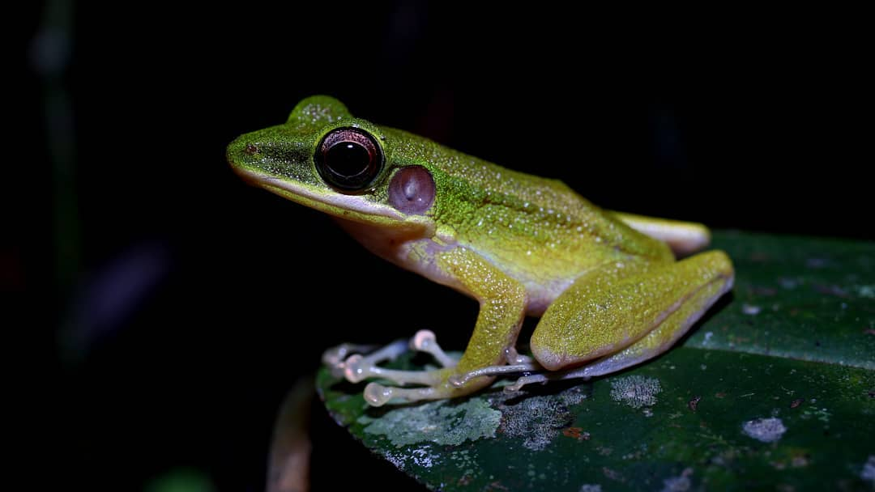
Digital SLR Cameras

Slide 28
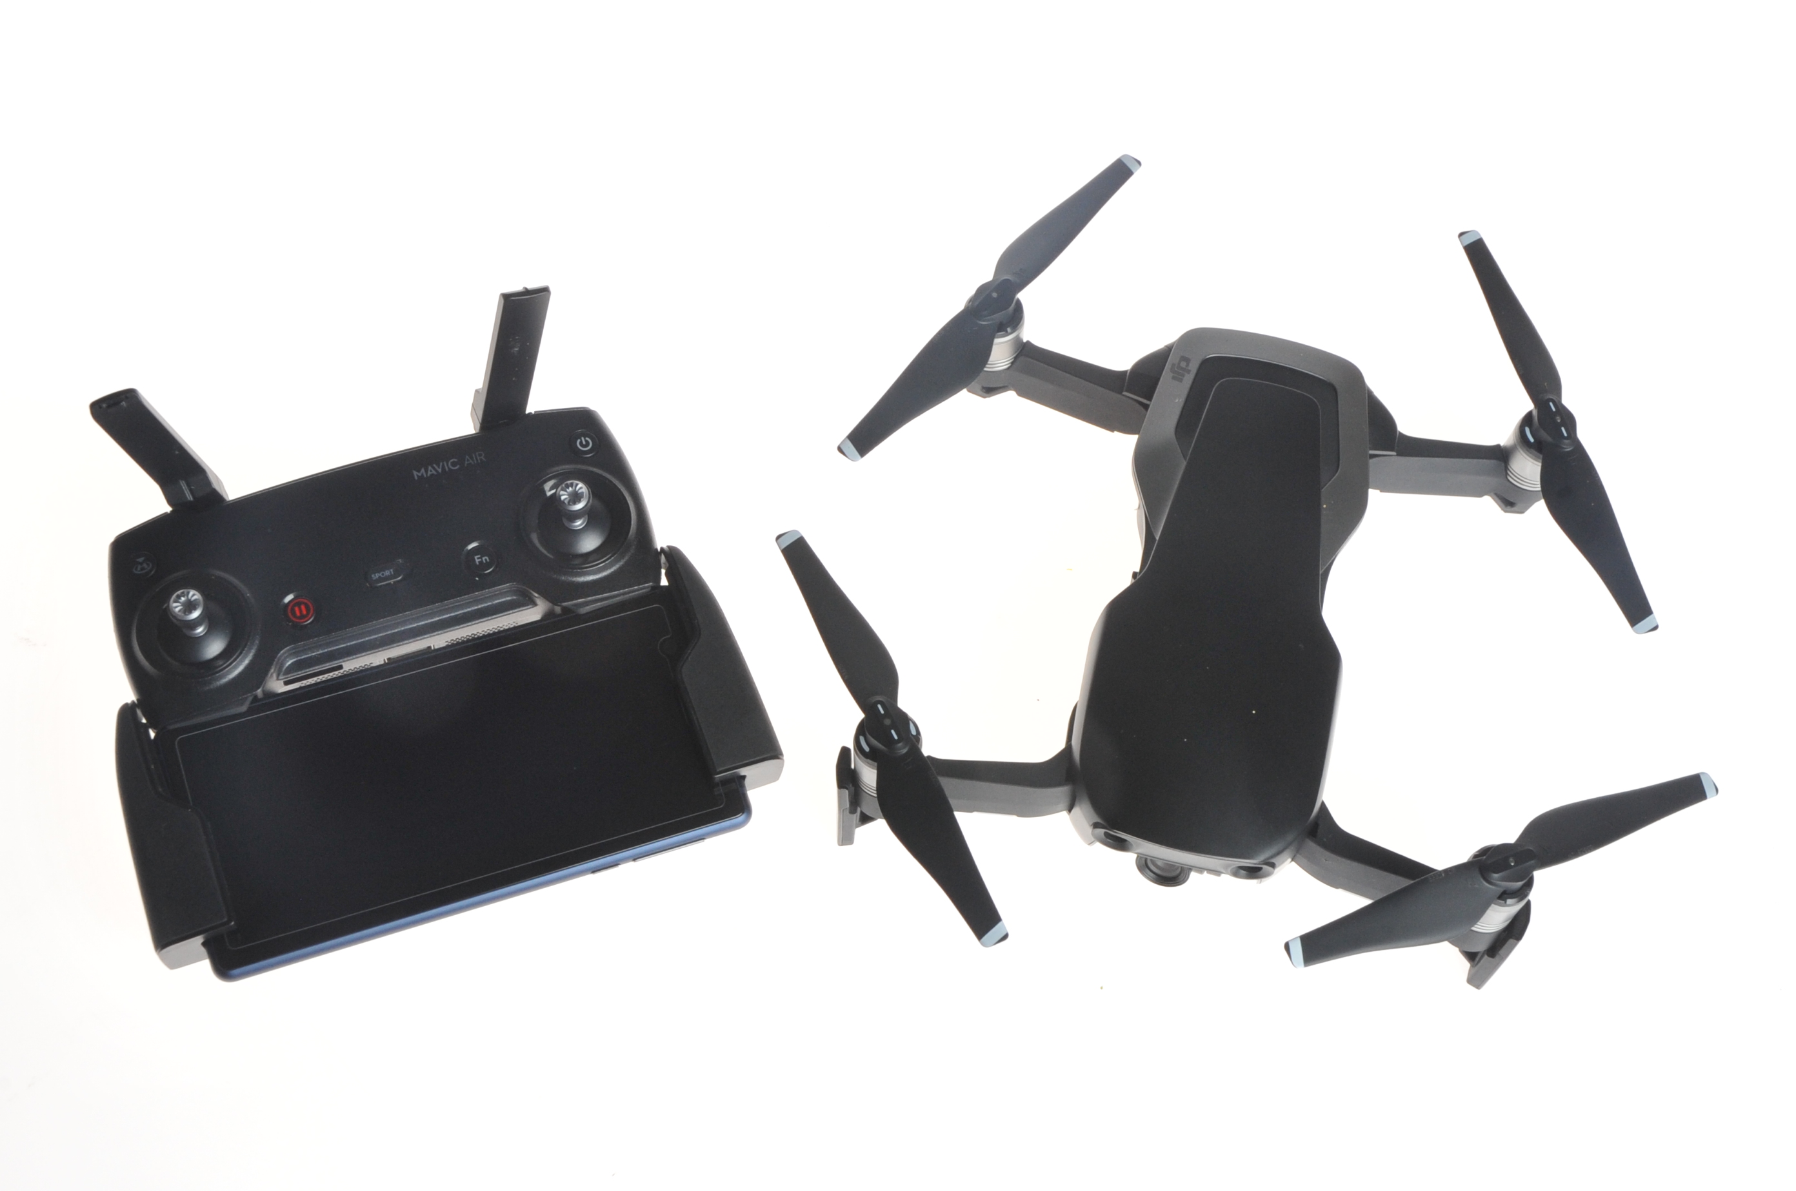
Drones

Slide 29
Drones
Unmanned aerial vehicle (UAV) also commonly known as drone.
It is an aircraft without a human pilot aboard. Pilot normally on platform such as ground or boat (water such as lake, river and sea)
The drones’ components are the aircraft, controller (sometimes can be more than 1) and display panel (can be on-board display panel or smartphone/ tablet).
The flight operation of the drone can be fully manual by the pilot, semi-auto or fully autonomous by the aircraft.

Slide 30
Drones
Pros:
Autonomous view (when the aircraft is set to fully auto)
Easy to change settings (either the picture or video)
Adds value to work (different perspective of the picture/ video)
Cons:
Limited flexibility. (most of the drone’s camera has limited manual settings control of the camera)
Requires practice, training and expertise to operate it.
Magnetic or radio interference.

Slide 31

Drones

Slide 32
Thank You
Digital Photography and Social Media Imaging

