Slide 1
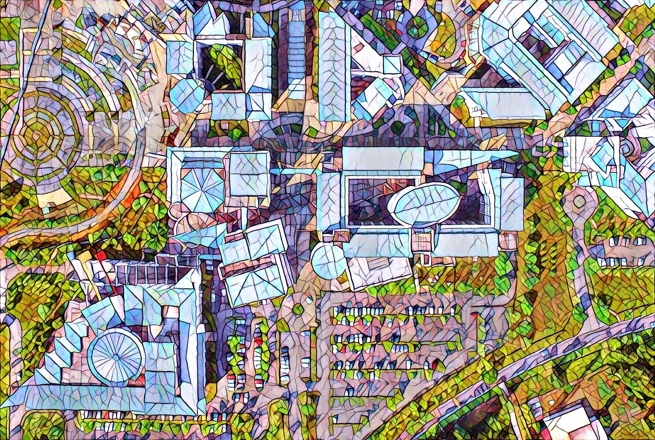


Visual Documentation Setup for Photography
Digital Photography and Social Media Imaging

Slide 2
Introduction
For this chapter, we will cover the setup of mini studio for visual documentation of objects such as artwork or product.
Not everyone has the luxury of having good and expensive equipment to take picture as desired.
With current and availability equipment owned, a setup of the mini studio can be experiment depending on the object.
The setup suggested later can always be improved to get the best result.

Slide 3
Equipment
Equipment listed below can be used for the visual documentation setup. The gears are
Phones @ Smartphones
Digital Compact cameras
Mirrorless Cameras
Digital SLR Cameras

Slide 4
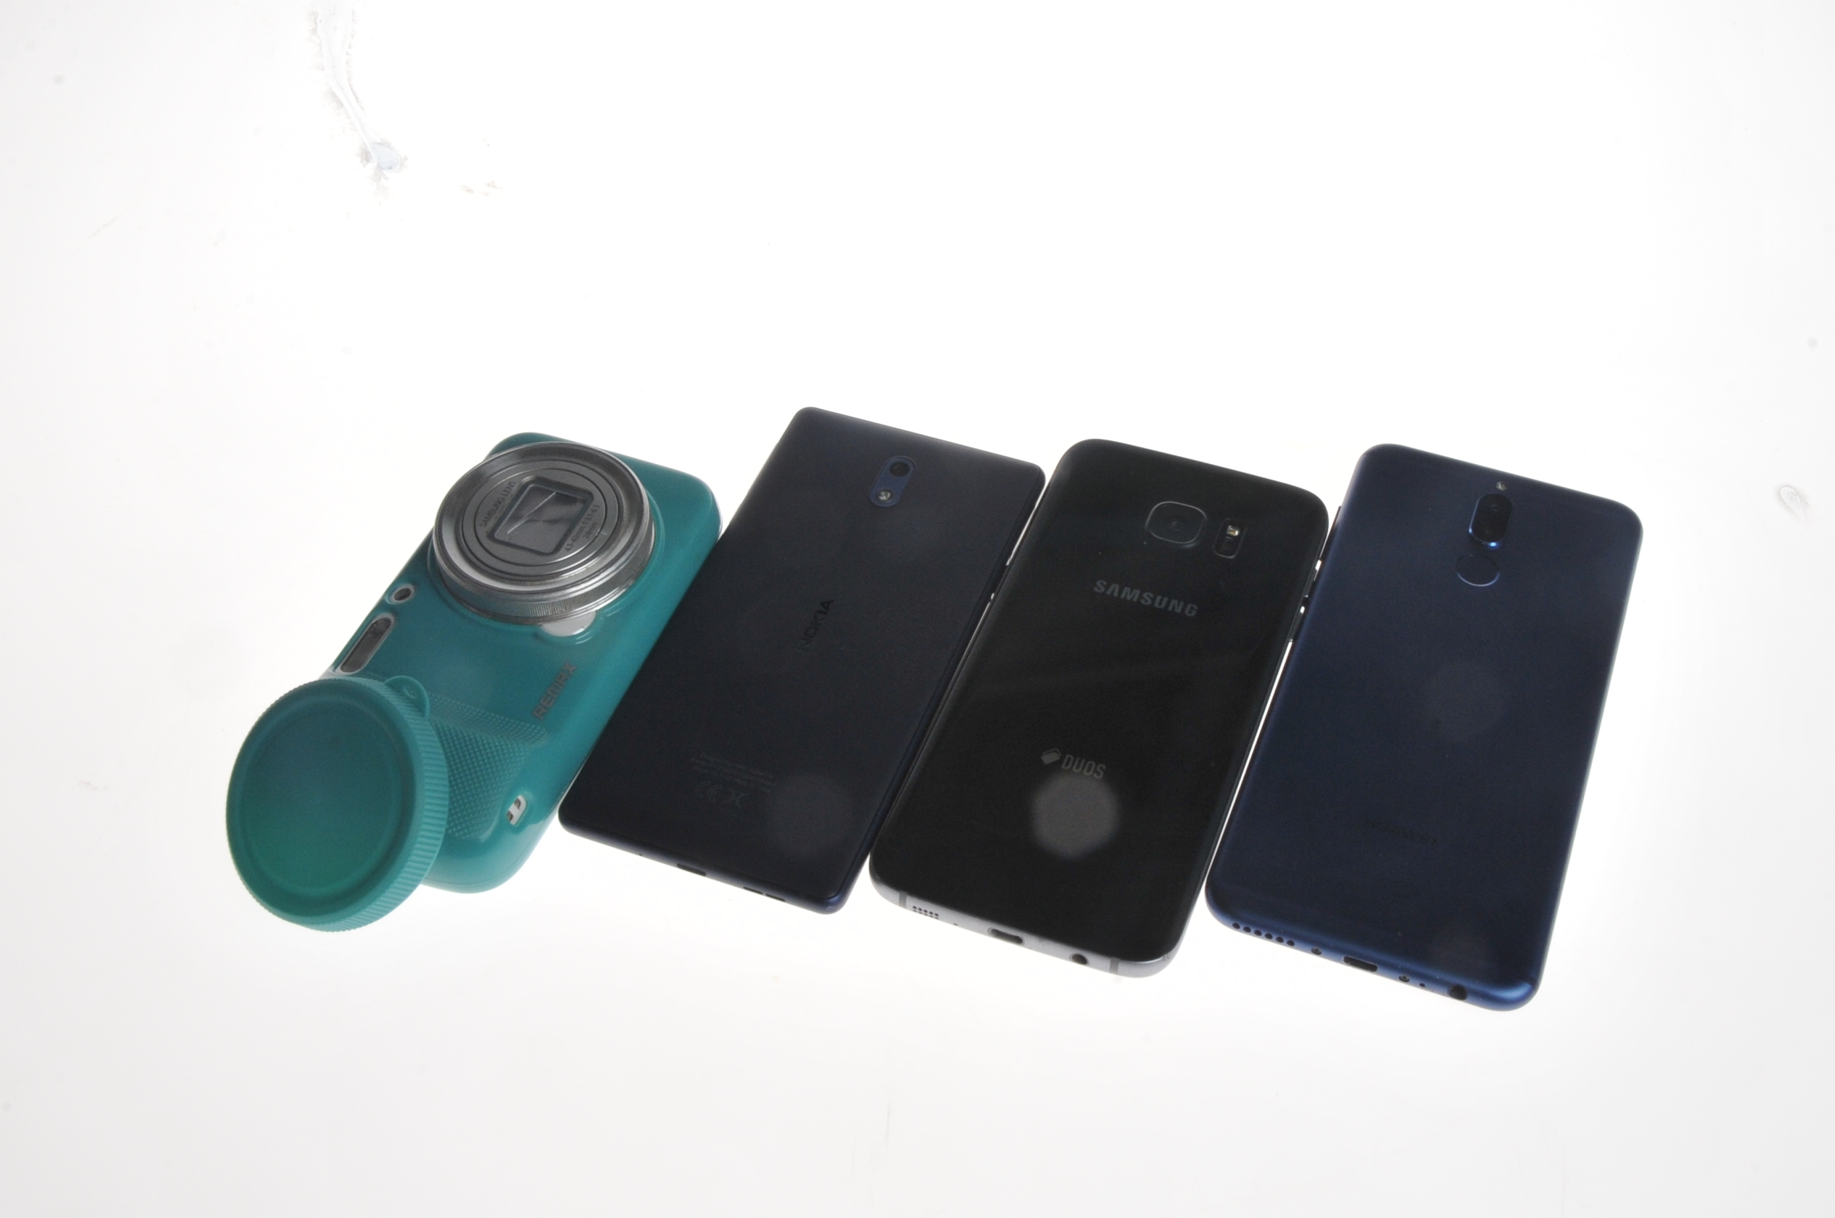
Phones @ Smartphones

Slide 5
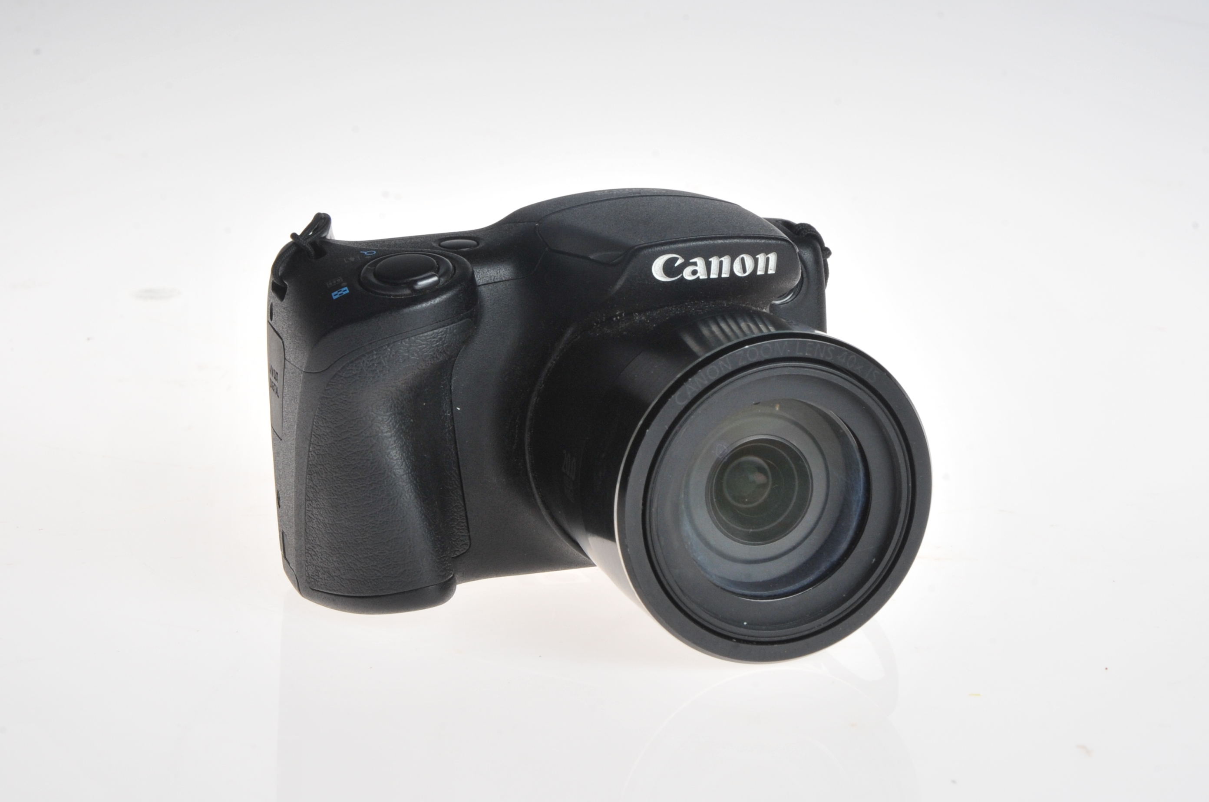
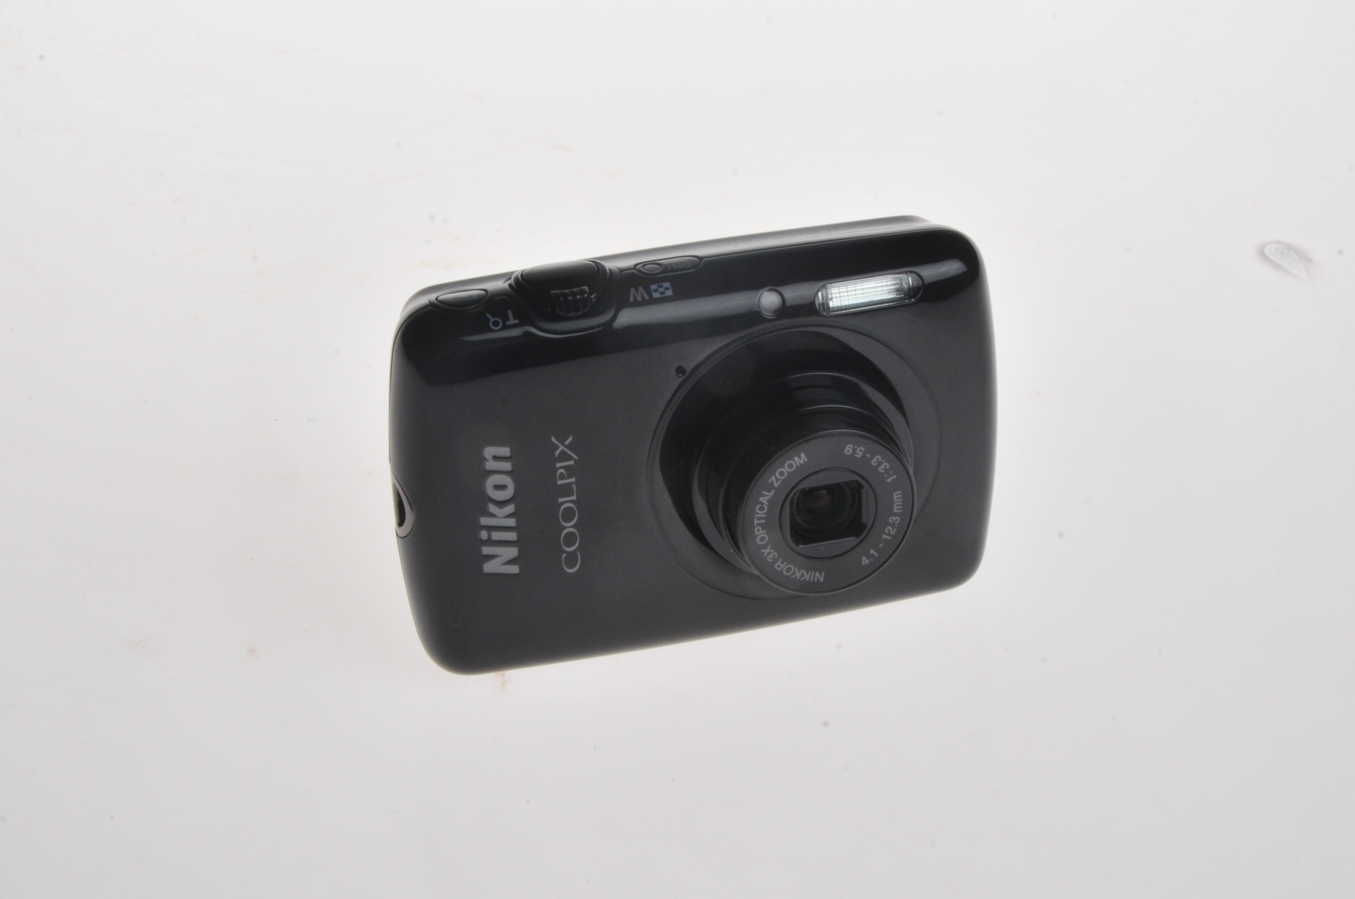
Digital Compact Cameras

Slide 6
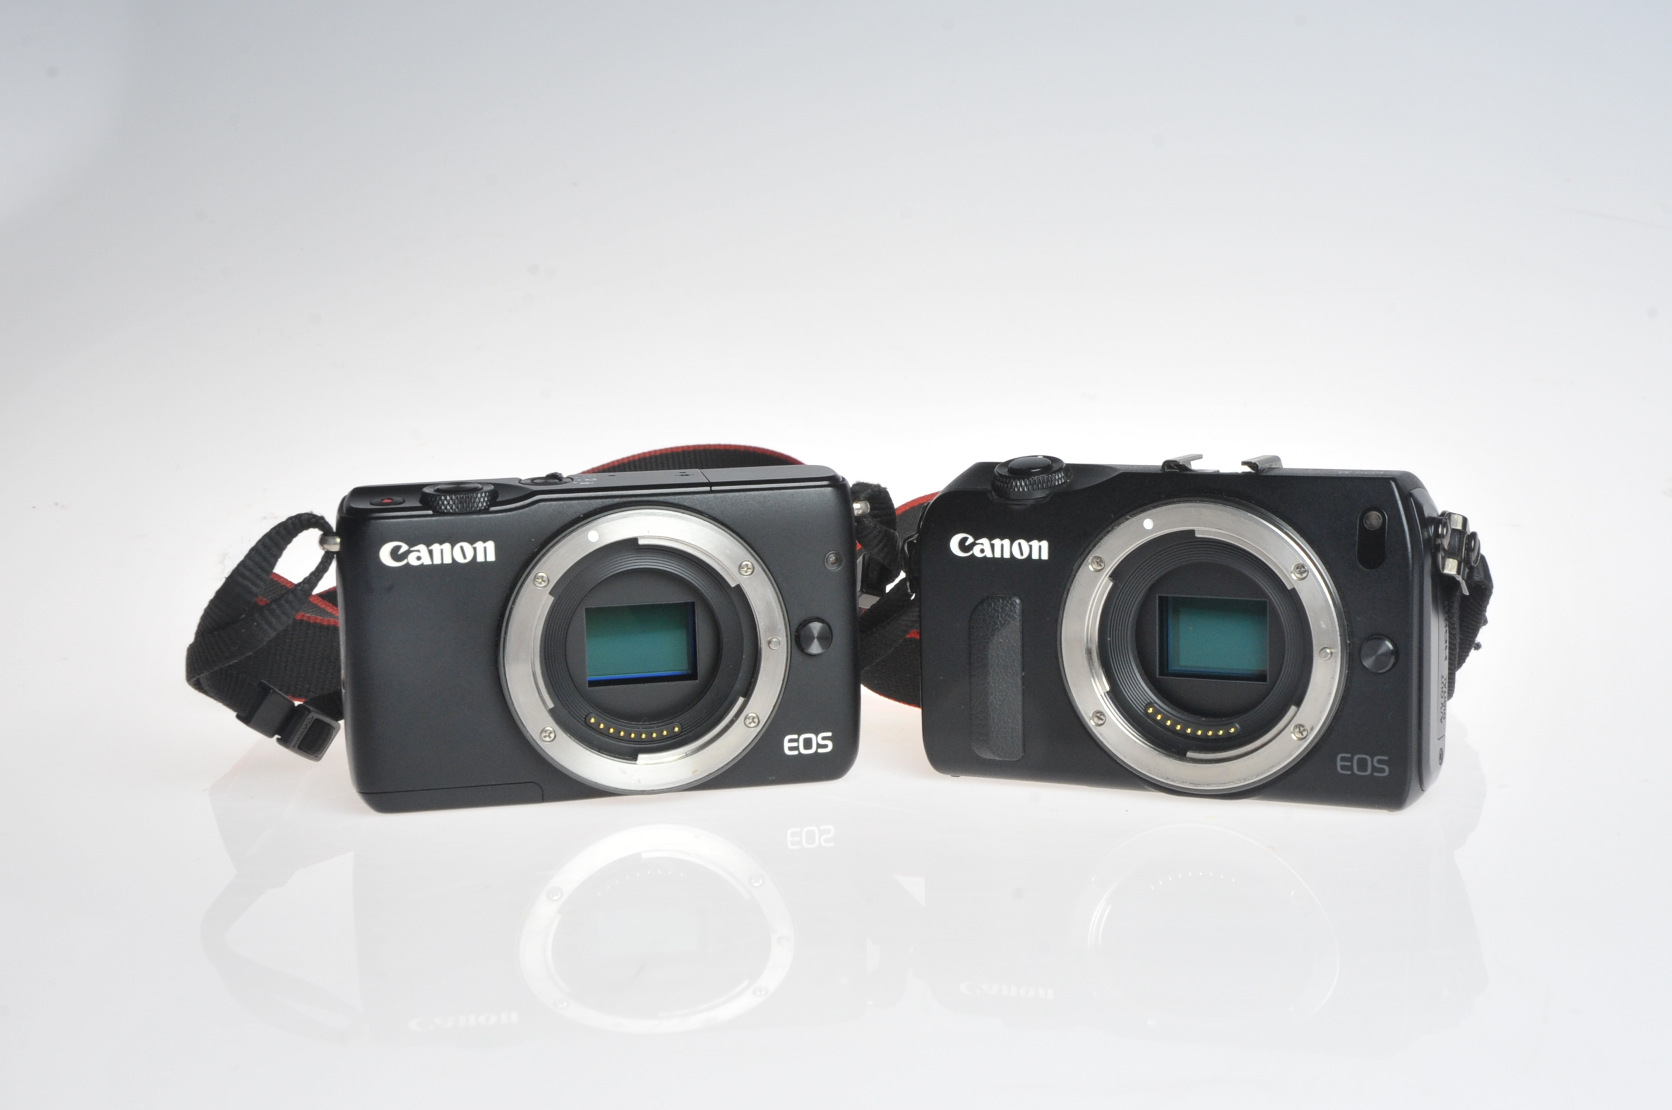
Mirrorless Cameras

Slide 7
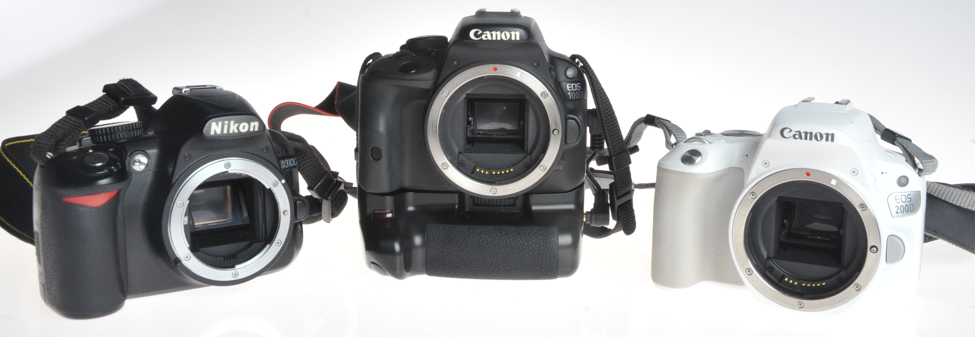
Digital SLR Cameras (DSLR)

Slide 8
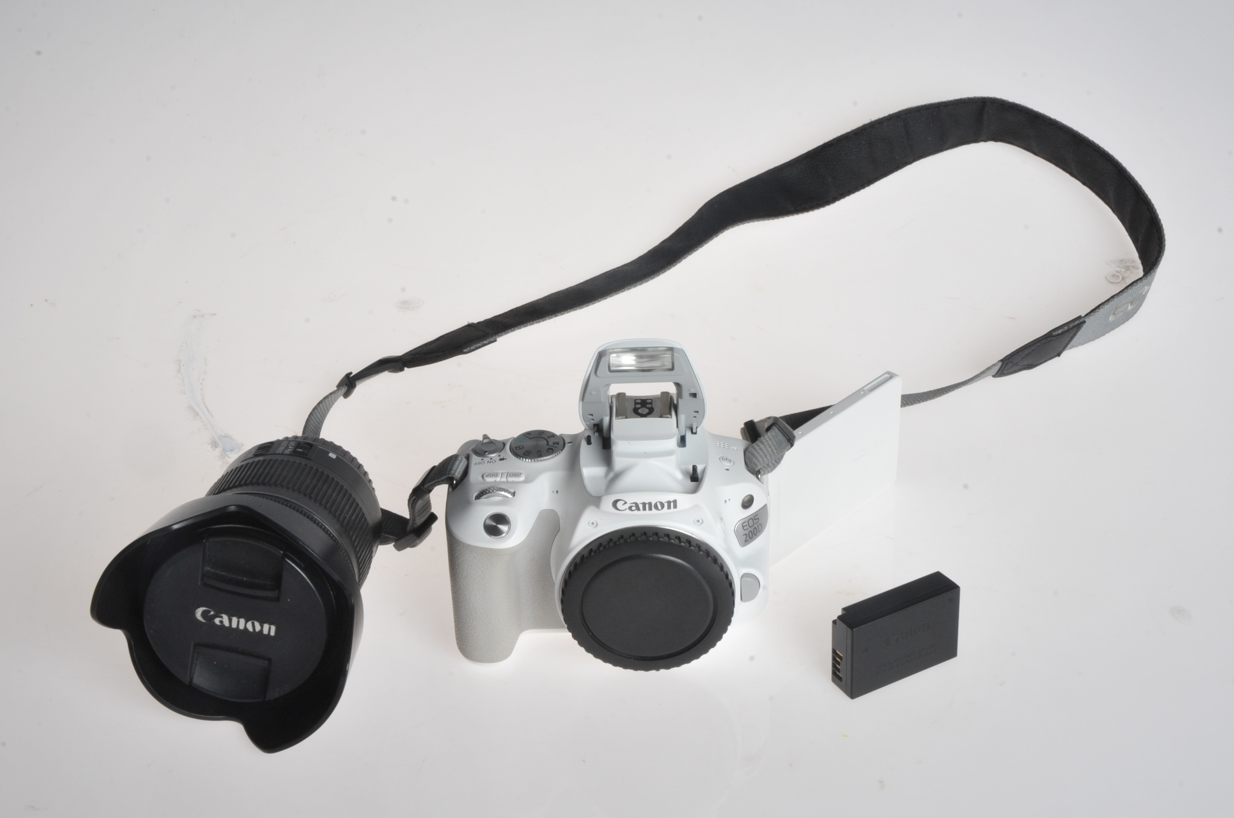
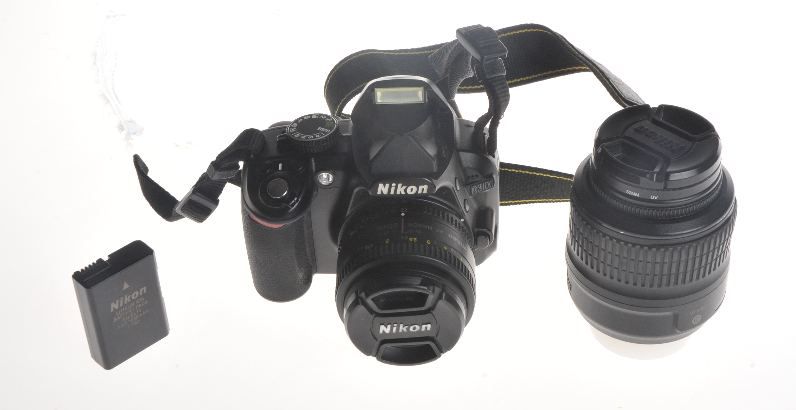
Digital SLR Cameras (DSLR)

Slide 9
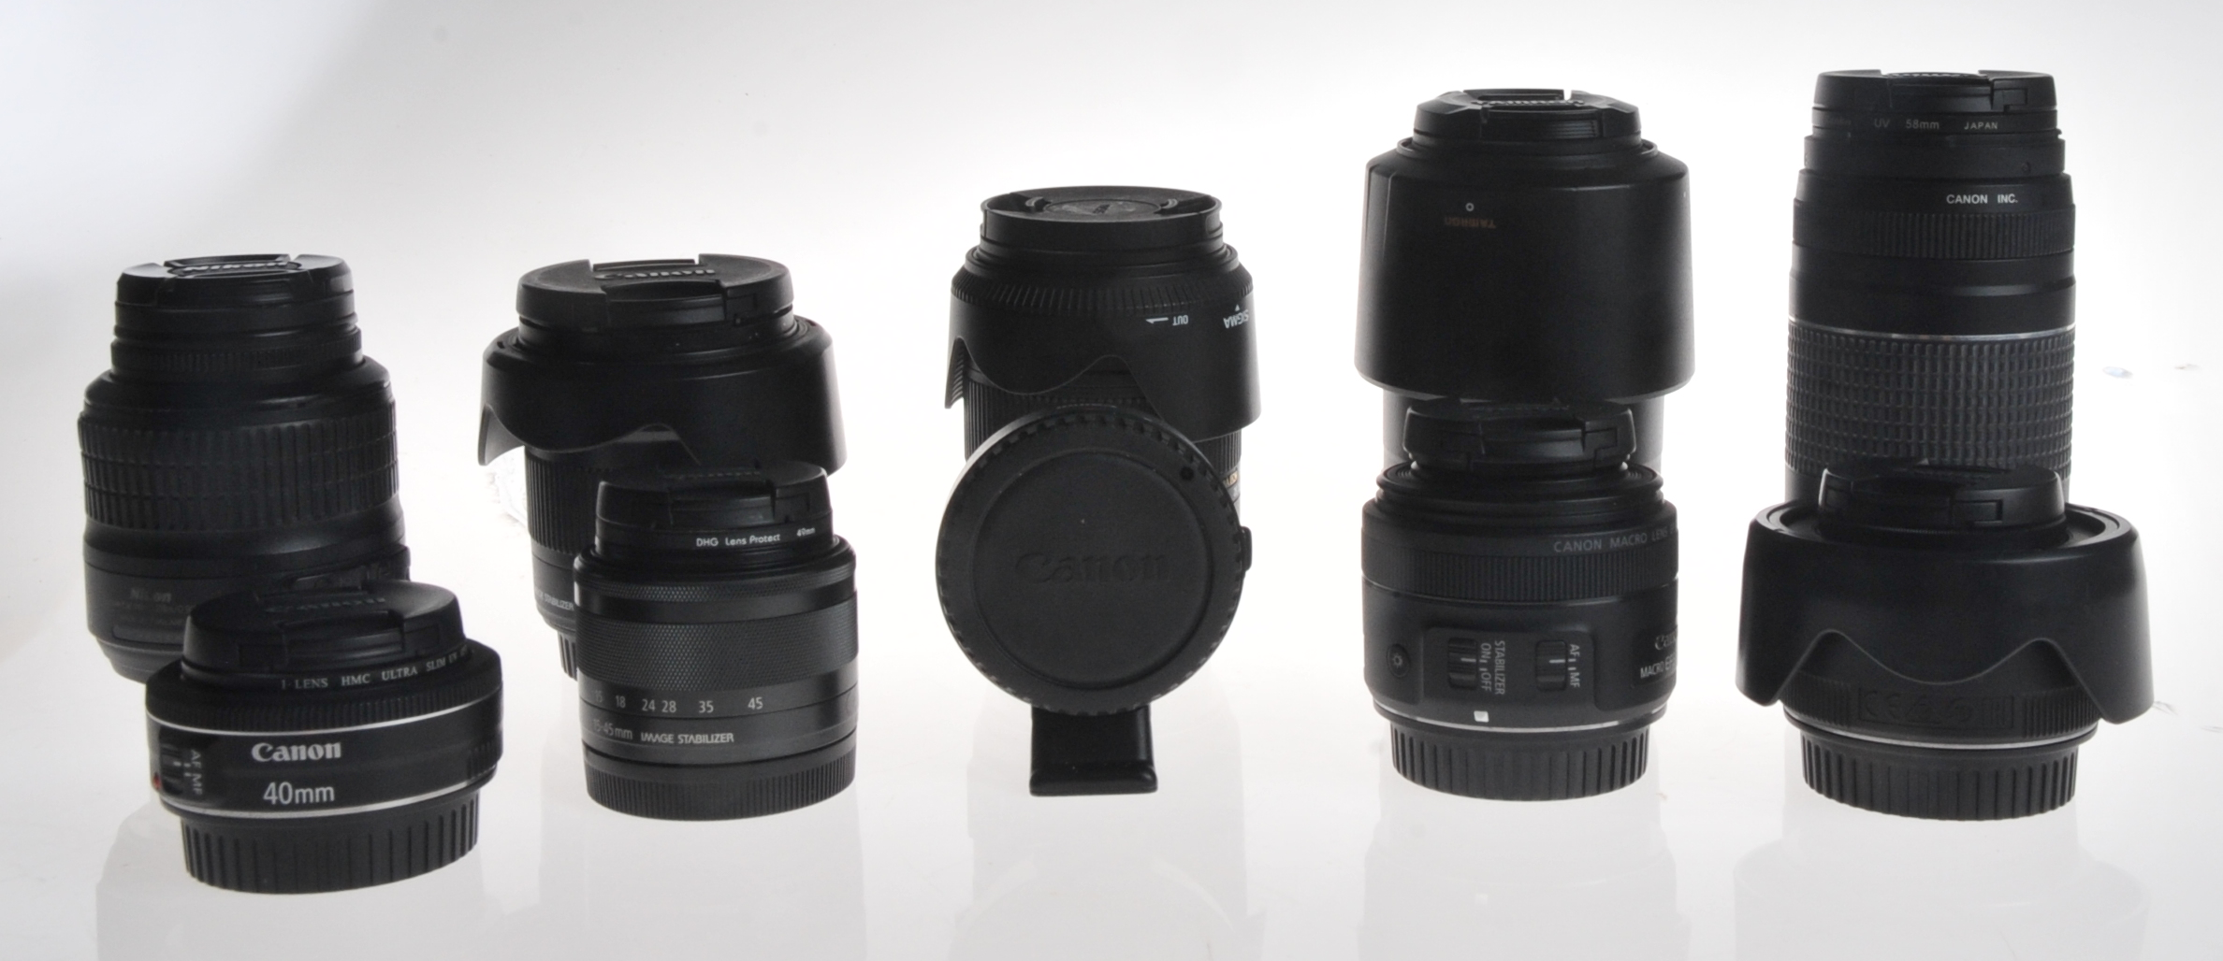
Digital SLR Cameras (DSLR)

Slide 10
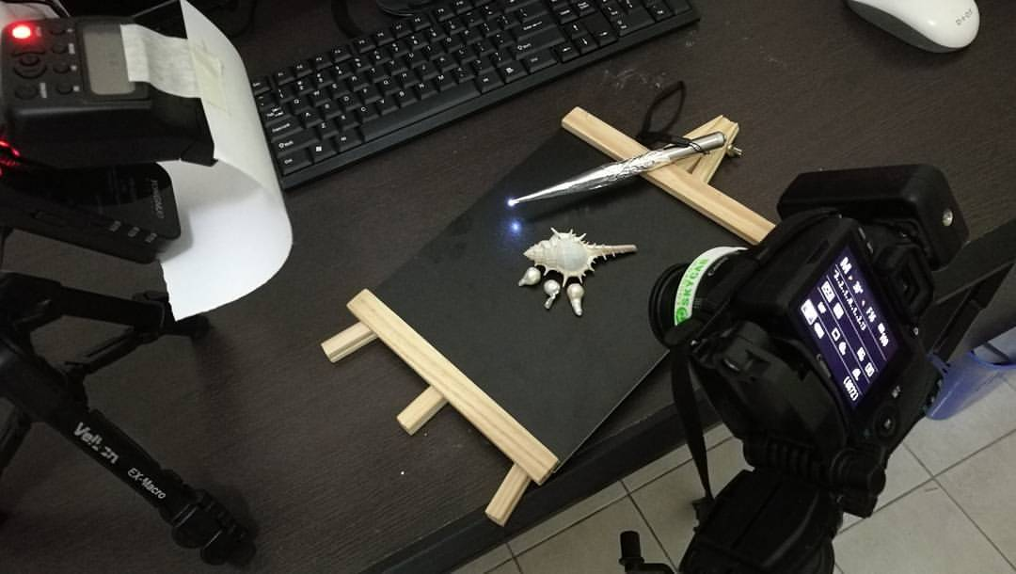
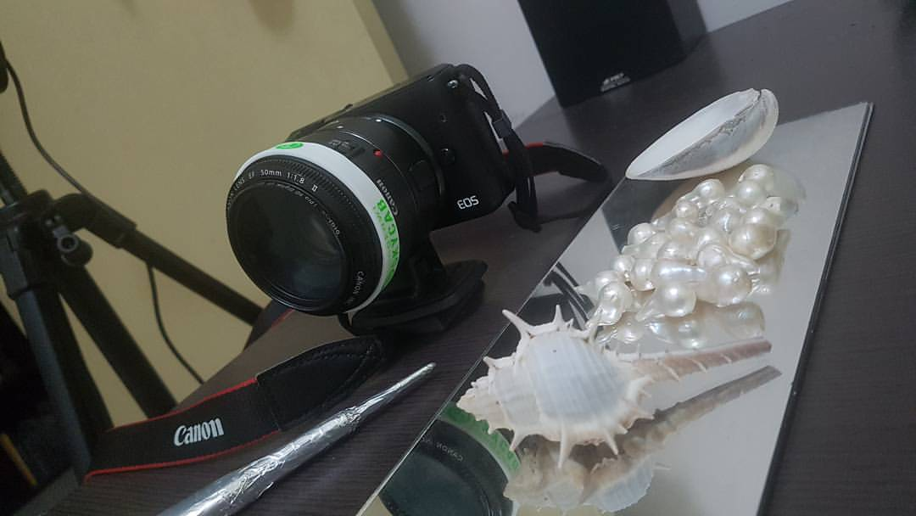
Setup

Slide 11
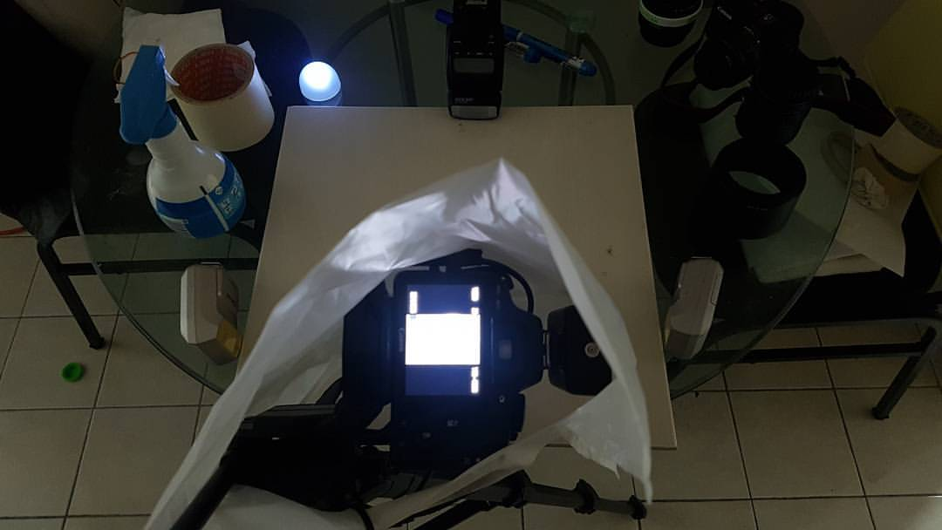
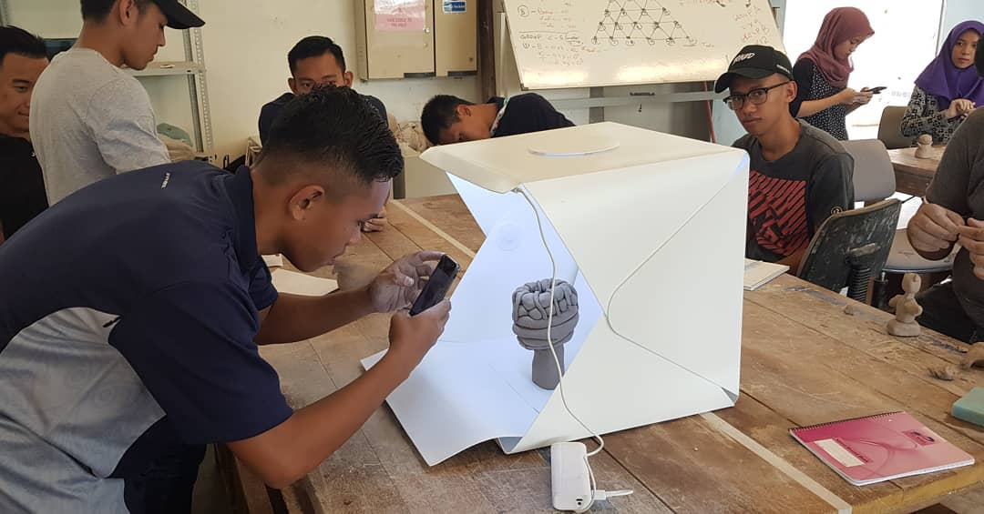
Setup

Slide 12
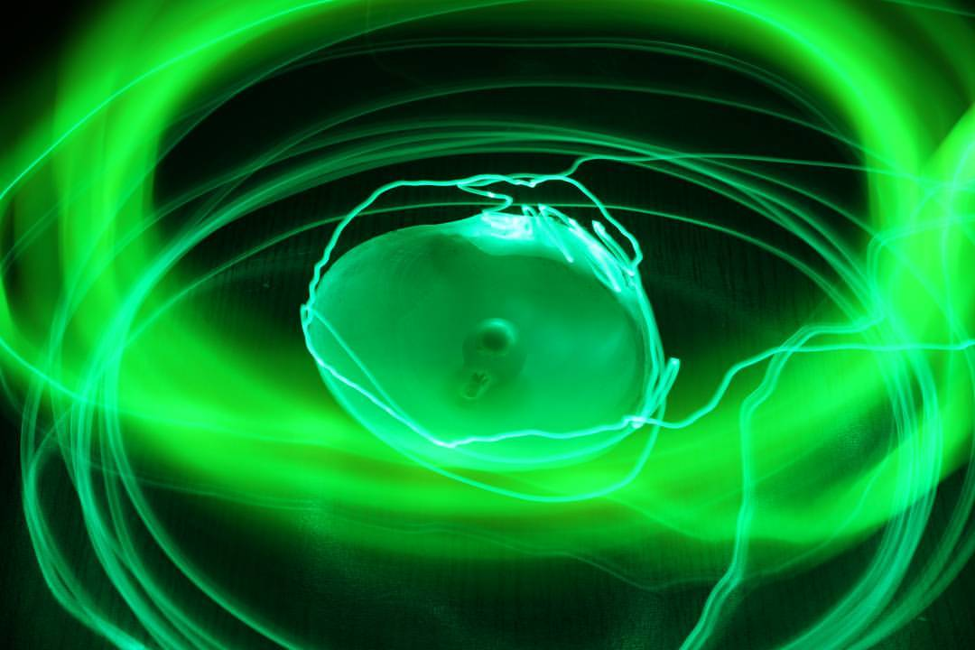

Results

Slide 13
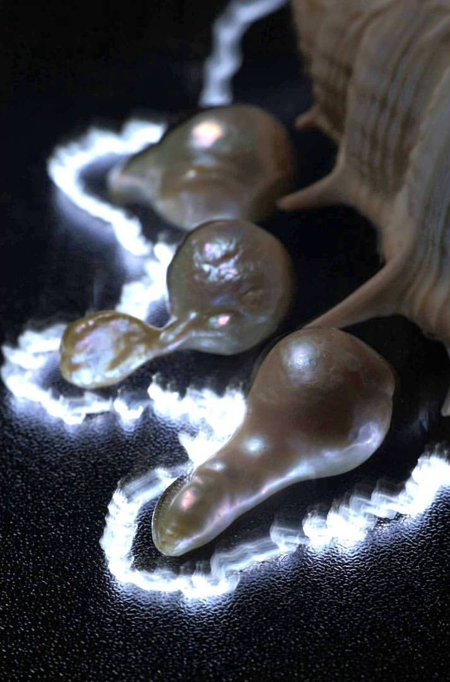
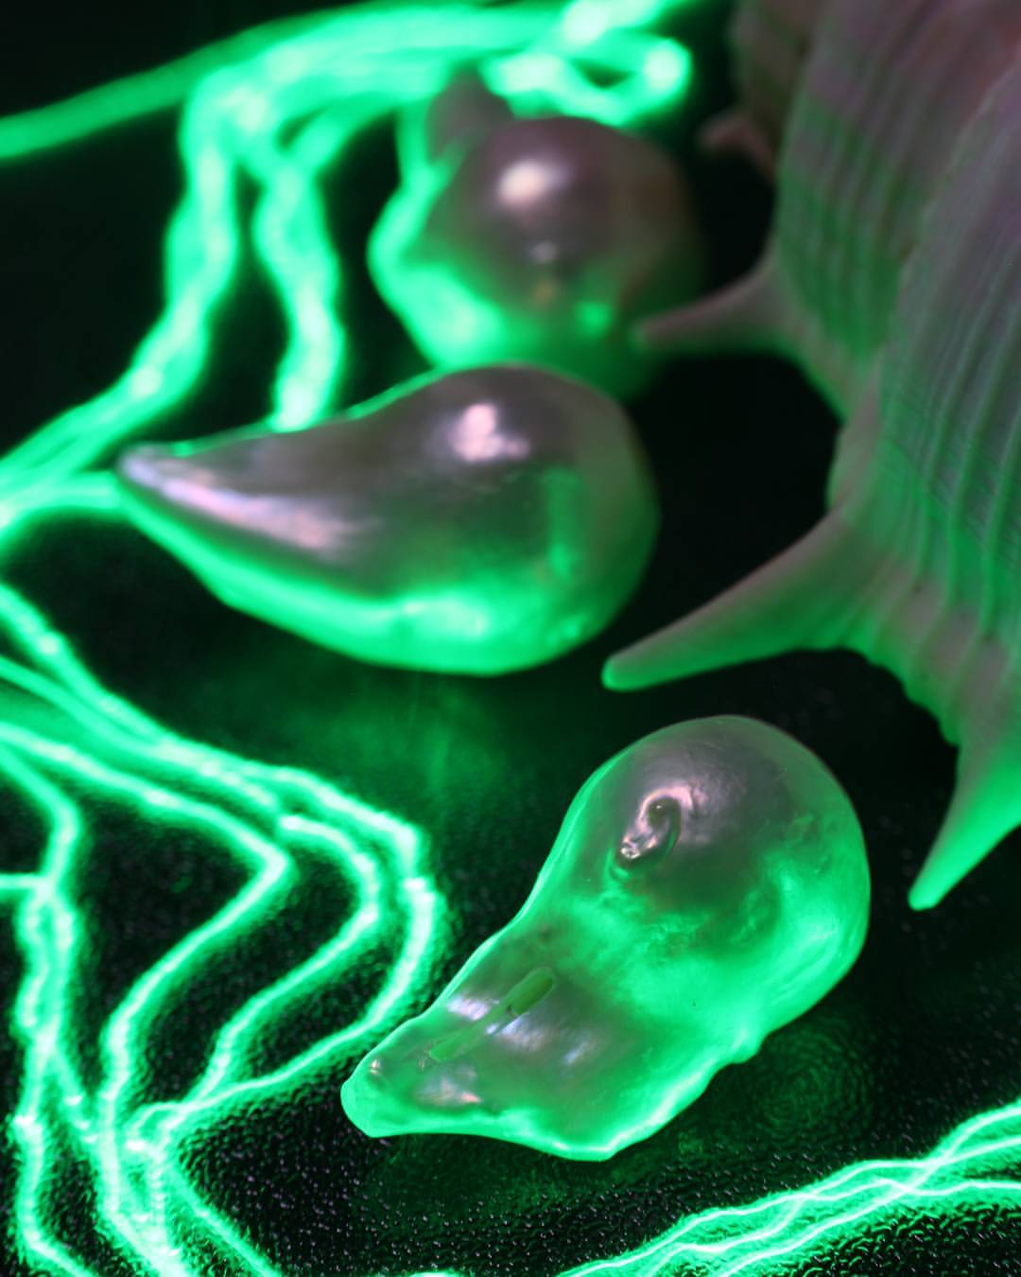
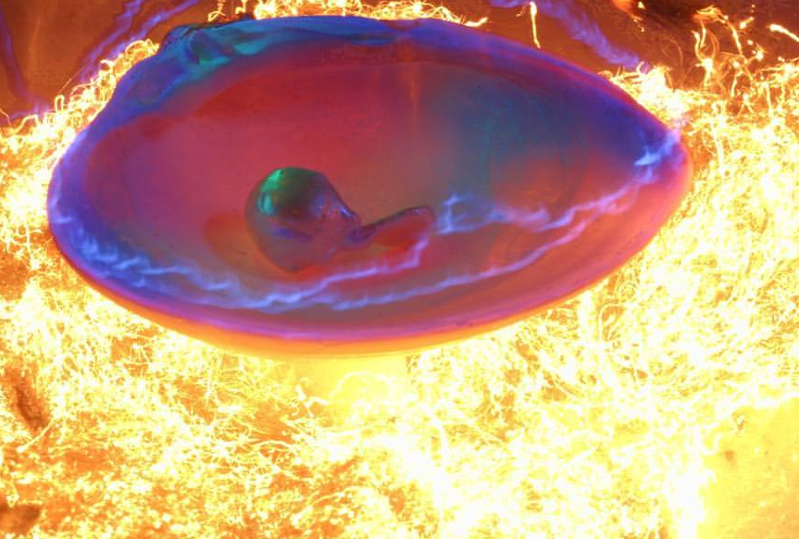
Results

Slide 14
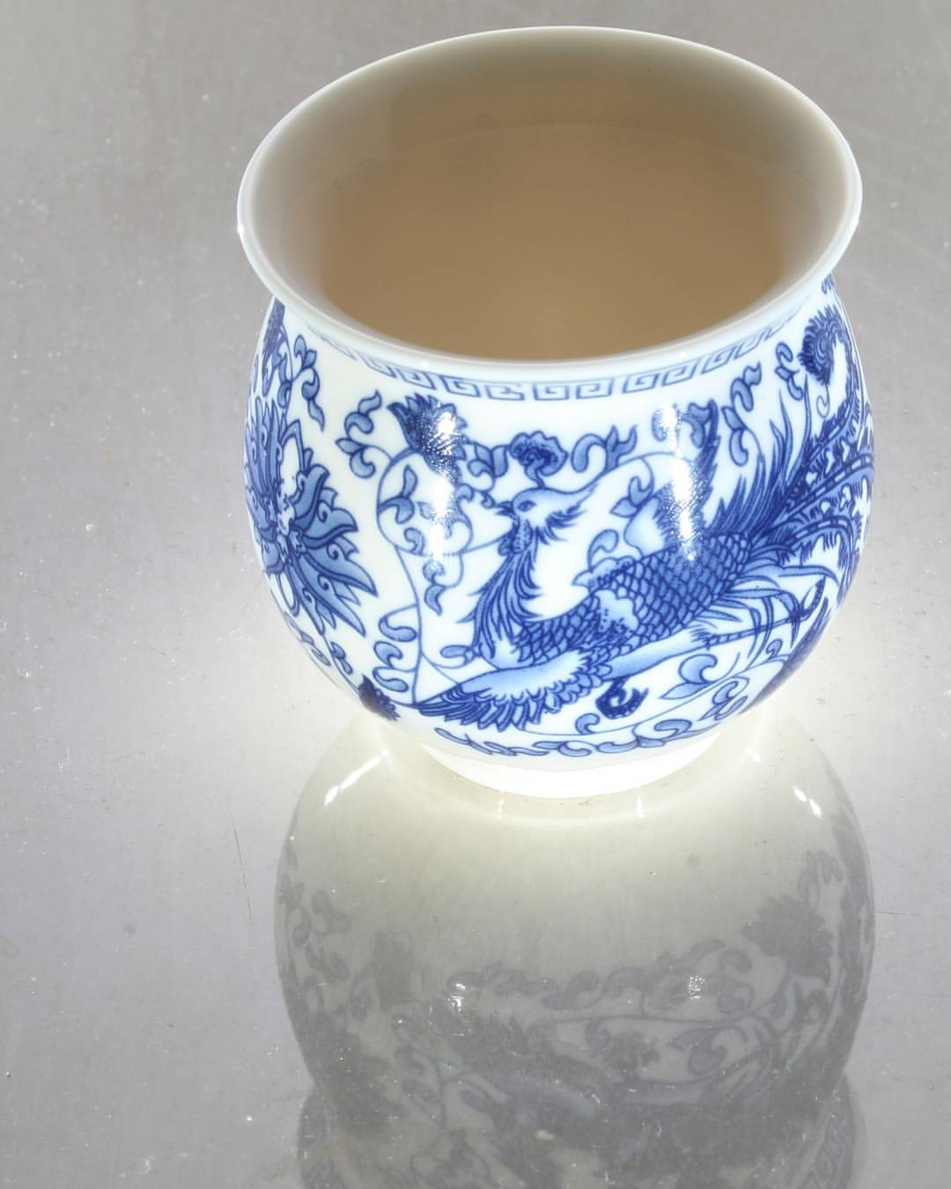
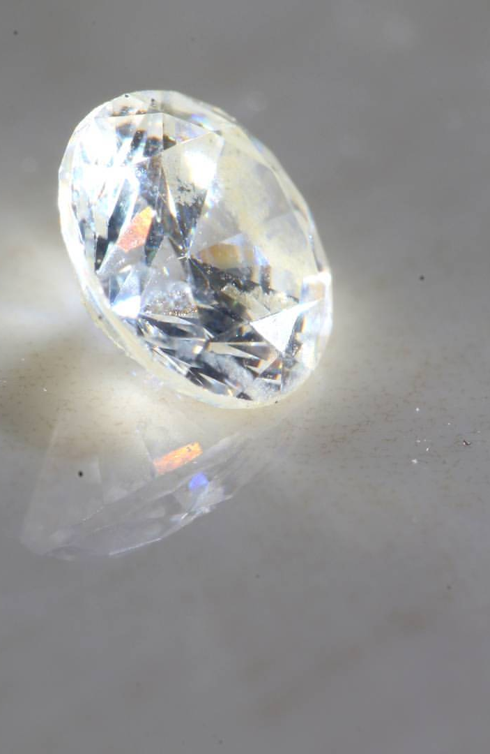
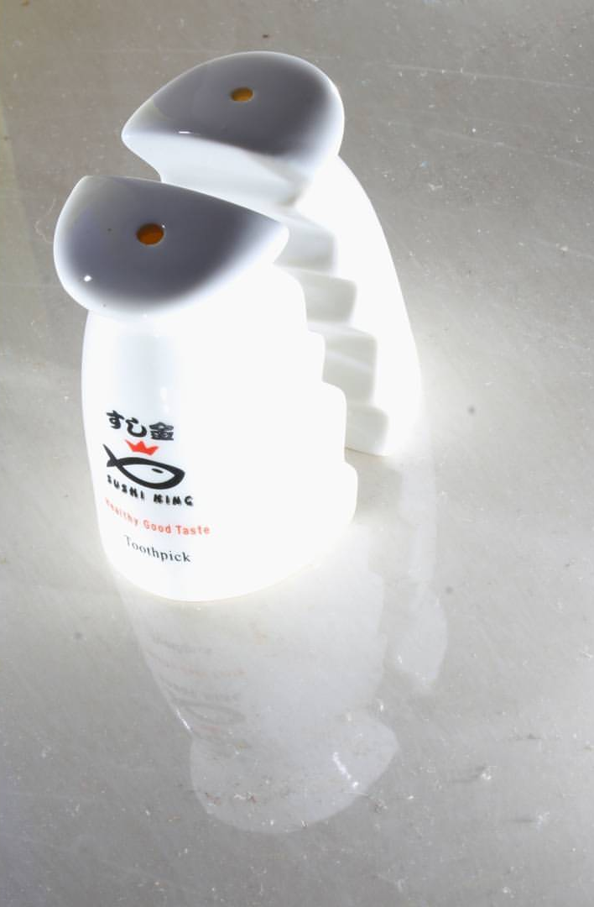
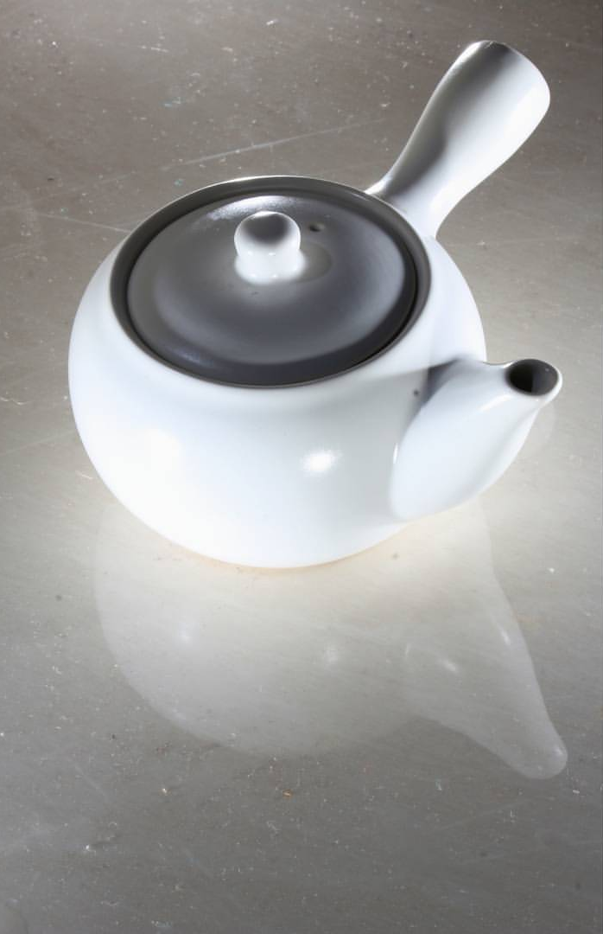
Results

Slide 15
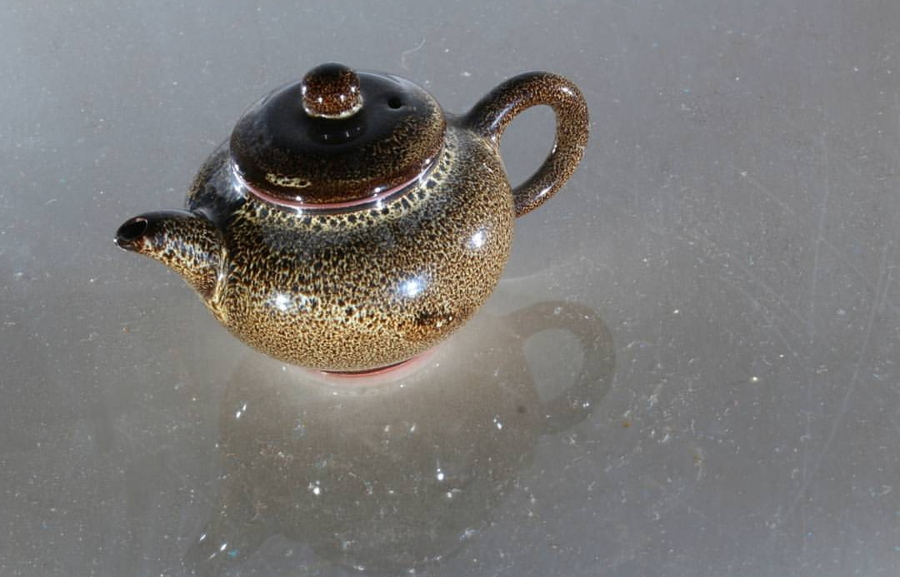
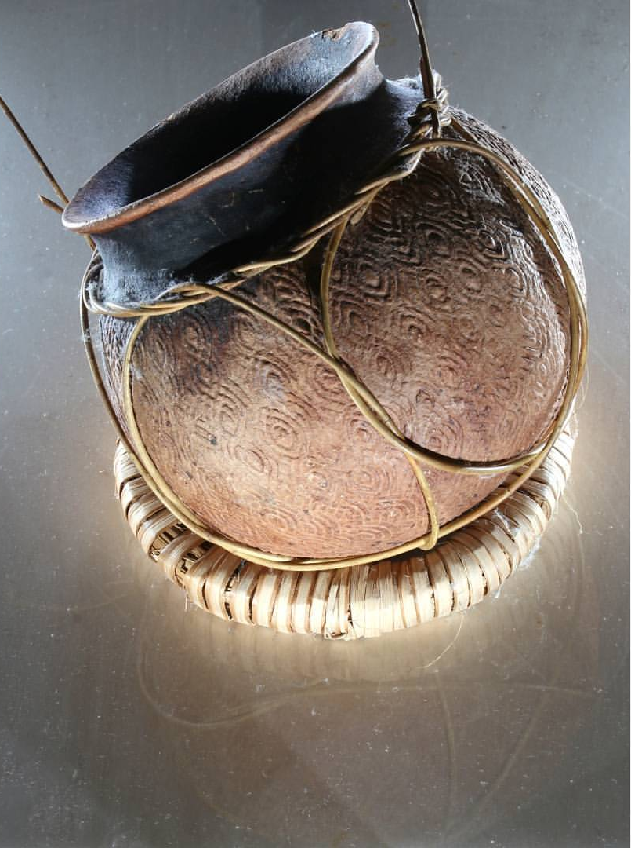
Results

Slide 16
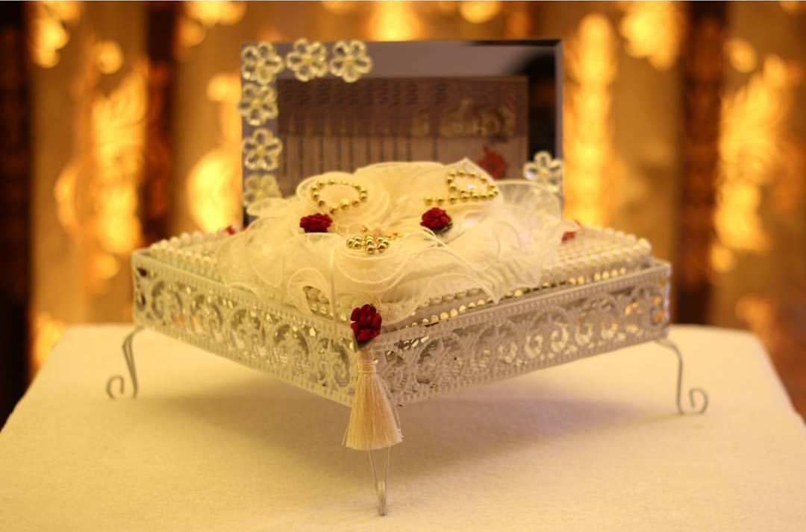
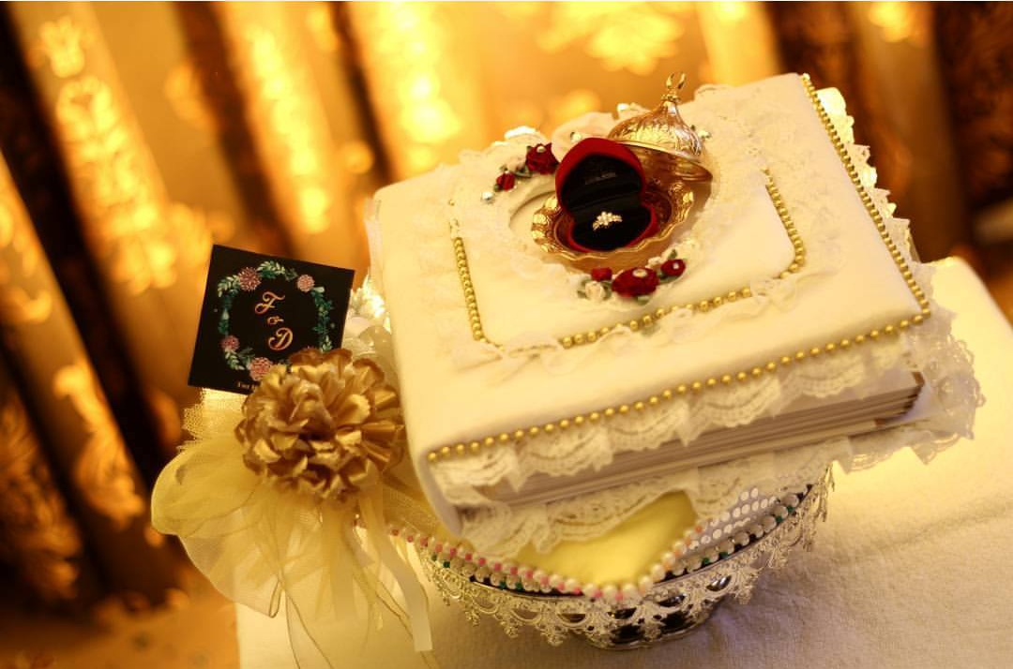
Results

Slide 17
Thank You
Digital Photography and Social Media Imaging

