Slide 1
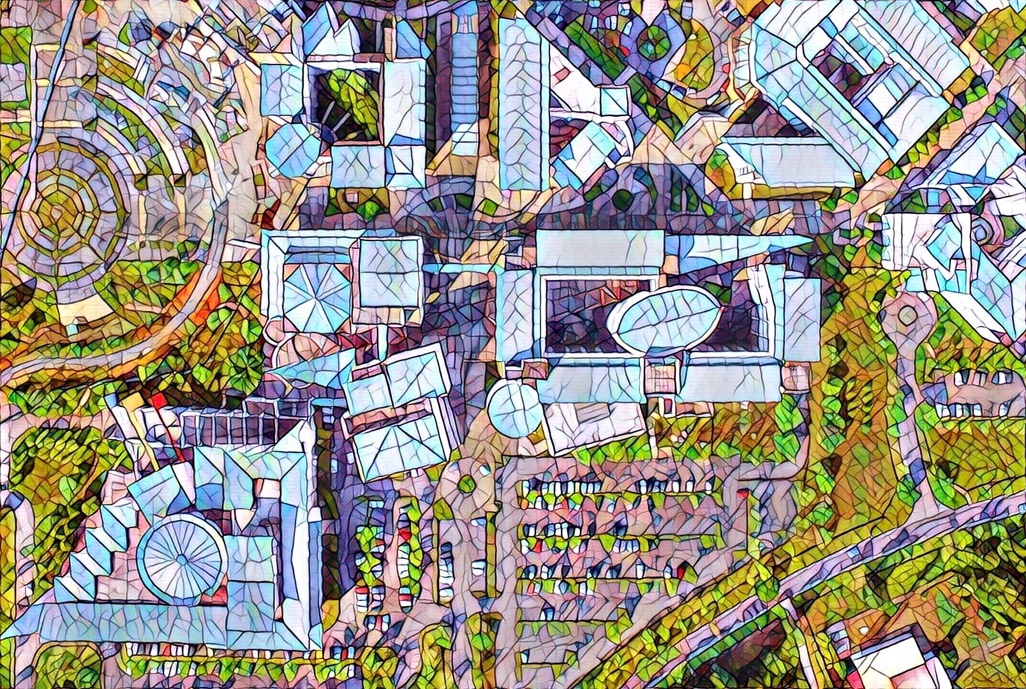


Social Media
Digital Photography and Social Media Imaging

Slide 2
Social Media
In this final chapter, social media, we will cover the platforms that can be useful for the taken images.
It is important to publish or post the images for recognition.
Some of the reasons of posting these images in these platforms can be for personal, visual digital portfolio and career development.
The platforms that can be used are Facebook, Instagram, Tumblr, Flickr, Pinterest, Twitter, Vero Social, YoupicDigital, Exposure.co, Steller Stories and Behance.

Slide 3
Social Media
For this chapter, we will cover selected platforms such as Facebook, Instagram, Tumblr, Flickr, Pinterest and Twitter.
Before posting to any social-media platform, some fine tuning, editing of the taken image can be done through various photo-editing apps or software.
Example of apps and software for photo-editing are Adobe Lightroom, Photoshop Express, PixlR, Snapseed, VSCO, Afterlight 2, PicsArt, Hypocam and many others which is free or in-app purchases.
(Google Play Store or Apple Store)

Slide 4
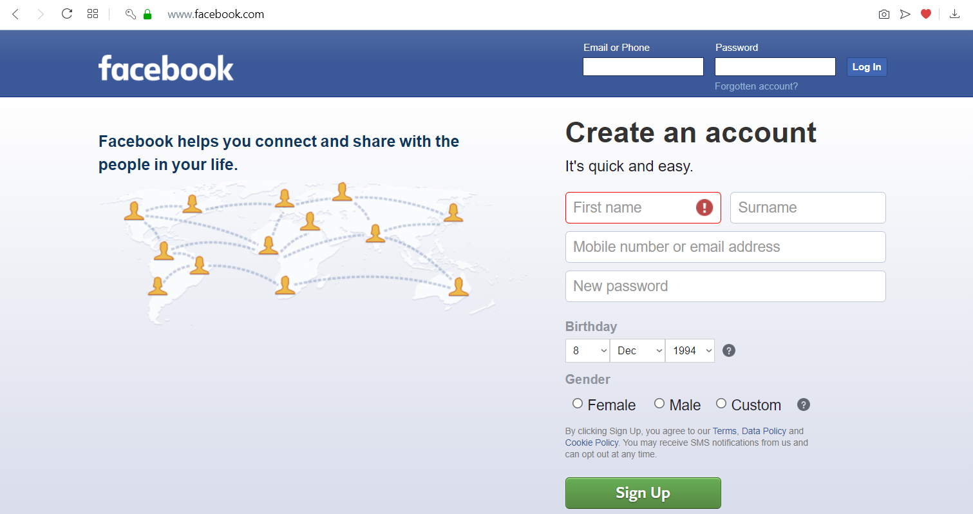
Facebook

Slide 5
Facebook
Customize Your Page.
Customize Your Profile and Cover Photos for Branding.
Create a Page Description.
Add a Facebook Call to Action.
Build Your Facebook Fan Base.
Post on Facebook.
Create Facebook Live.
Utilise Facebook Links.

Slide 6
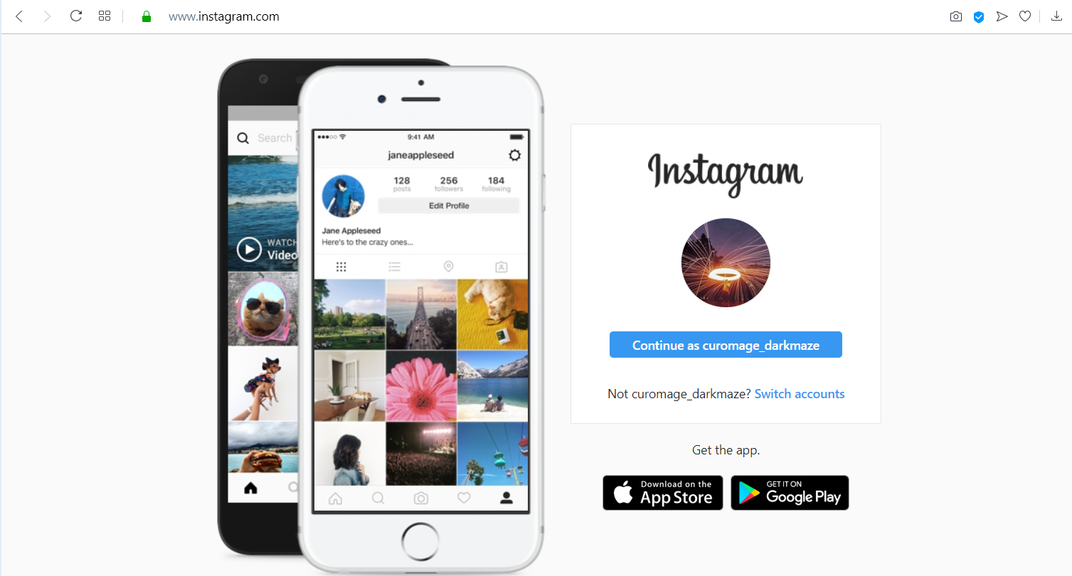
Instagram

Slide 7
Instagram
Post Your Pictures. (Single Picture or Multiple)
Get Ideas and Inspirations for Various Interesting Contents and Techniques.
Connect to Other Instagrammers and Photographers.
Tag various people, place, events and others.

Slide 8
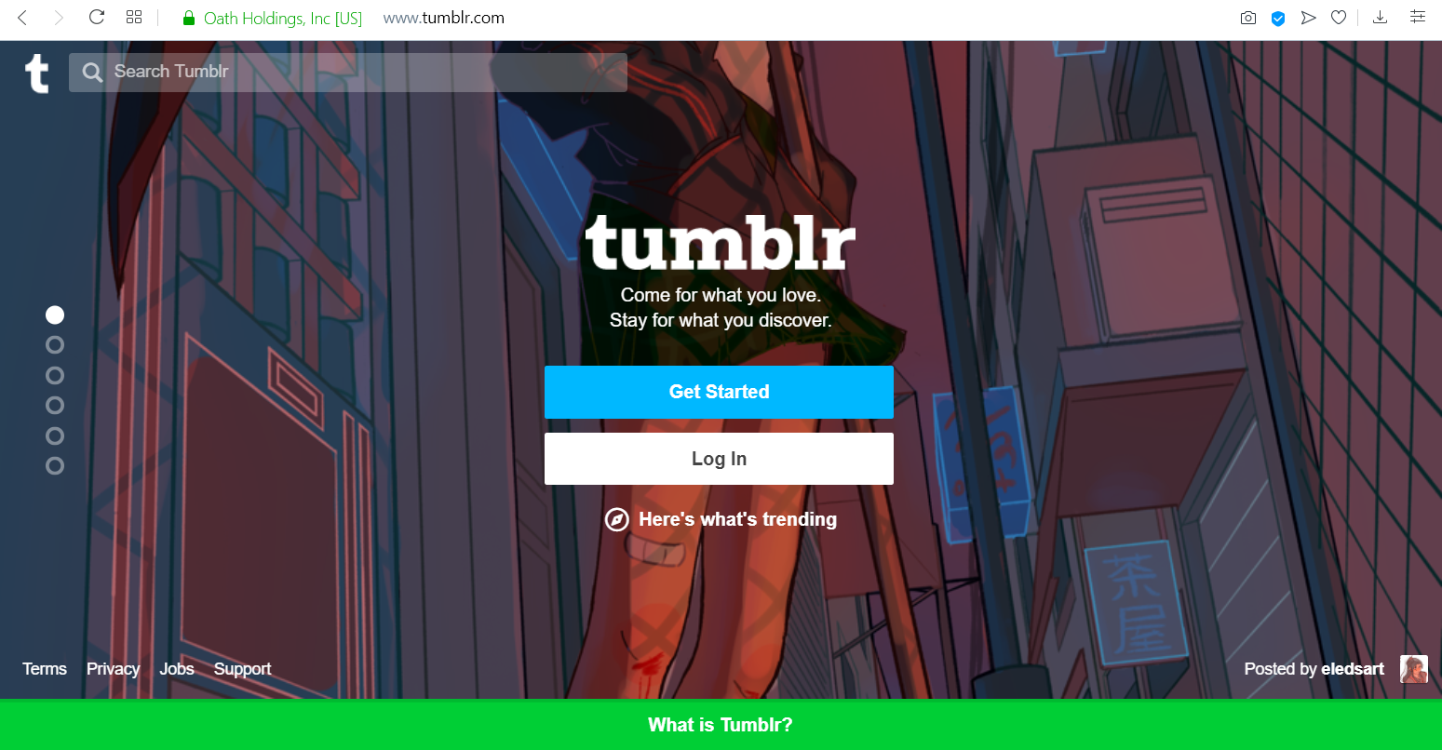
Tumblr

Slide 9
Tumblr
Show Only Original Posts.
Show Links.
Show The Number of Post Notes.
Appear in The Top Search Results. (with lot of post notes and reblogs)

Slide 10
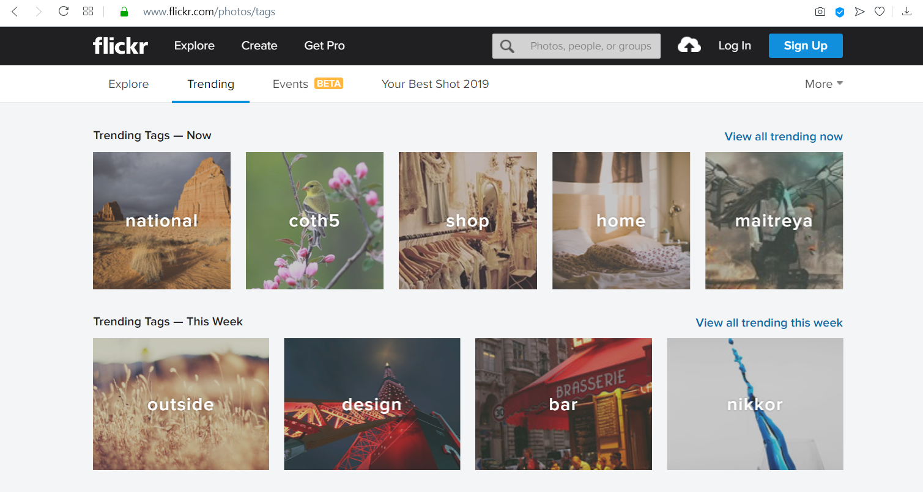
Flickr

Slide 11
Flickr
Encourage You to Publish More
Help You Get Organized
Focus on A Genre
Build Your Own Gallery
Encourage to Write More
Get To Know Other Photographers

Slide 12
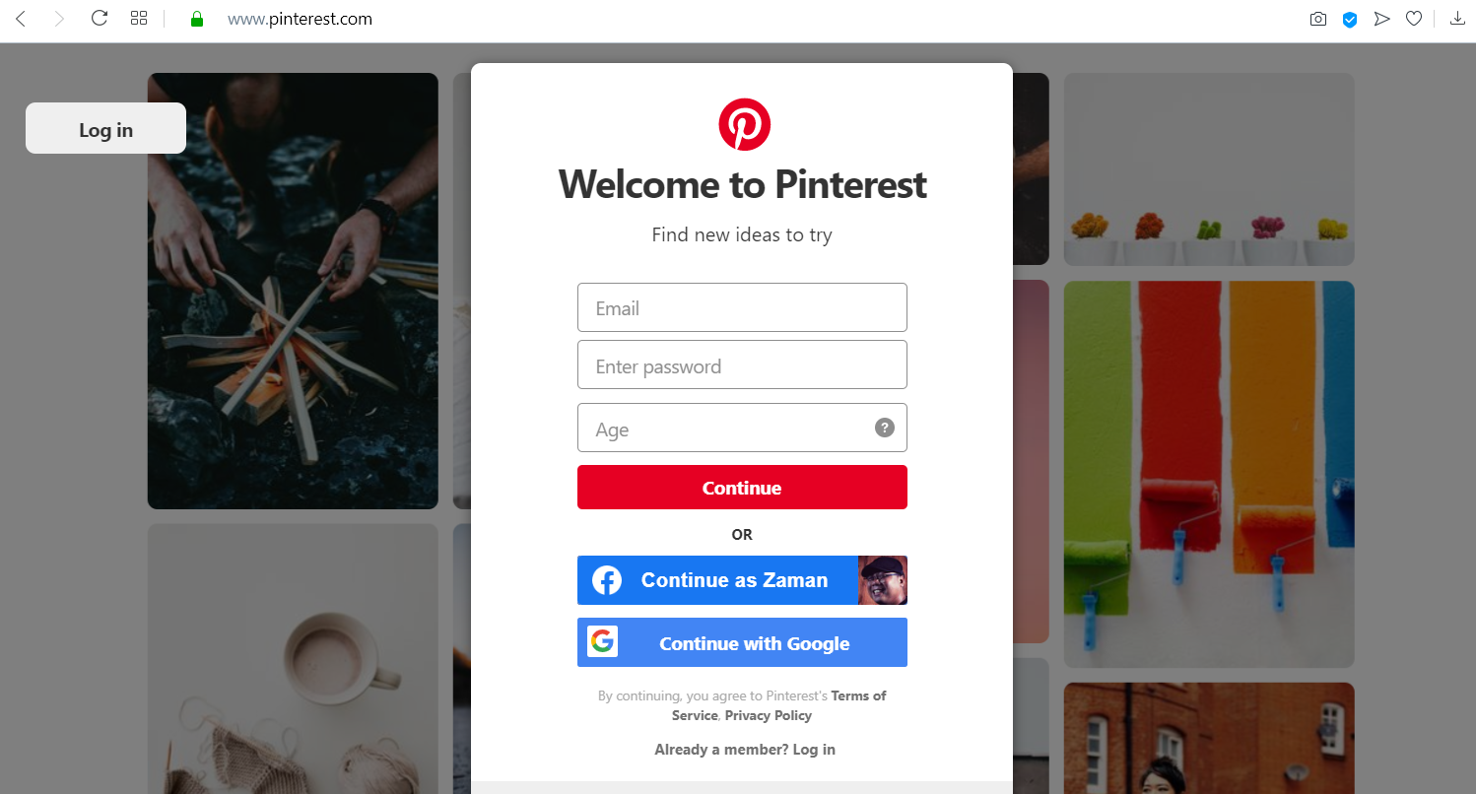
Pinterest

Slide 13
Pinterest
Organize Your Inspirations.
Create Boards to Audience.
Use Key Words & Descriptions for The Pins.
Make Working with Clients Easier using Boards.

Slide 14
Thank You
Digital Photography and Social Media Imaging

