Slide 1
Learning Unit 5 : Profit or Loss Statement and Statement of Financial Position
Damien Lee

Slide 2
Content Title
Profit or Loss Statement
Statement of Financial Position

Slide 3

Introduction
All business owners will vouch for profitability.
It is to ensure that the business will survive and is on-going.
Notes:
3

Slide 4
Introduction
Business profitability can motivate the owners to:
- maintain the existing business; or
- to make the business grow further; or
to end the business
Notes:
4

Slide 5
Introduction
If the profitability is under the expectation of the owner or the business is suffering a loss, it might motivate the owner to end the business.
Hence, a business owner will usually vouch for business profit or loss and its financial position to ensure that the business is in good financial shape to avoid any closure of business.
Notes:
5

Slide 6
Profit or Loss Statement
Profit or Loss (P/L) statement usually produced periodically, eg. monthly, quarterly or yearly
P/L statement is a summary of income/sales and expenses for your business
Notes:
6

Slide 7
Profit or Loss Statement
A P/L usually has five main components:
1. revenue (sales/turnover)
2. cost of goods sold (COGS)
3. gross profit (revenue minus COGS)
4. expenses
5. net profit (gross profit minus expenses)
Notes:
7

Slide 8
Profit or Loss Statement
Formula:
Sales – COGS = gross profit – expenses = net profit
Notes:
8

Slide 9
Profit or Loss Statement
If the revenue is more than the expenses, there will be a profit recorded for the business
On the other hand, if the revenue is less than the expenses, there will be a loss recorded for the business
Notes:
9

Slide 10
Profit or Loss Statement Example
Notes:
10

Slide 11
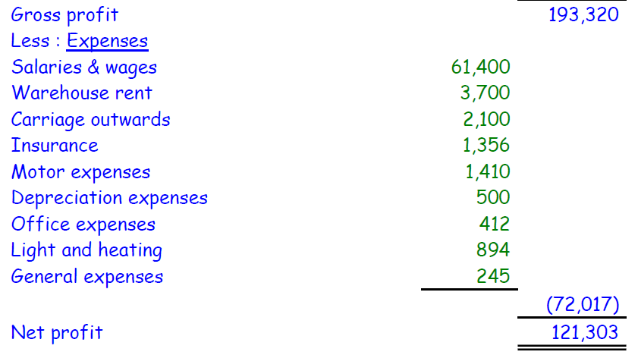
Profit or Loss Statement Example
Notes:
11

Slide 12
Statement of Financial Position
Statement of Financial Position (SFP) is also known as balance sheet.
SFP capture what a business owns (assets) and owes (liabilities) at a specific point in time.
Notes:
12

Slide 13
Statement of Financial Position
An asset is anything of value or a resource of value that can be converted into cash.
A liability, in general, is an obligation to, or something that you owe somebody else
Notes:
13

Slide 14
Statement of Financial Position
A SFP is usually prepared at the end of an accounting period, eg. at the end of a month or financial year.
SFP is an indicator of the financial health of your business
Notes:
14

Slide 15
Statement of Financial Position
A SFP has three components:
assets – including cash, stock, equipment, money owed to business, goodwill
liabilities – including loans, credit card debts, tax liabilities, money owed to suppliers
owner’s equity – the amount left after liabilities are deducted from assets
Notes:
15

Slide 16
Statement of Financial Position Eg
Notes:
16

Slide 17
Statement of Financial Position Eg
Notes:
17

Slide 18
Statement of Financial Position Eg
Notes:
18

