Slide 1
INTRODUCTION TO
ACCOUNTING INFORMATION SYSTEM (AIS)
For : Accounting for Beginners
By Suzila Mohamed Yusof
Faculty of Economics and Business, UNIMAS

Slide 2
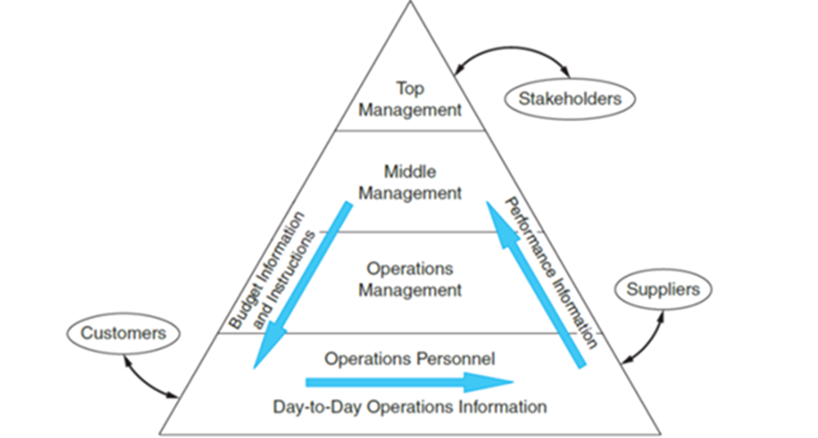
THE INFORMATION ENVIRONMENT
The internal and external flows of information
Information is essential resource for business
Day- to day operations is done by operations management
Short-term planning and coordinating activates is responsible by middle management to achieve organizational objectives.
Longer-term planning and setting organizational objectives is responsible by top management.
Two groups of external users: trading partners and stakeholders.

Slide 3
AN INFORMATION SYSTEMS FRAMEWORK
The information system is the set of formal procedures by which data are collected, processed into information, and distributed to users.
A transaction is an event that affects or is of interest to the organization and is processed by its information system as a unit of work.
A financial transaction is an economic event that affect the assets and equities of the organization, is reflected in its accounts and is measured in monetary terms.
A nonfinancial transaction is an event that doesn’t meet the definition of a financial transaction.

Slide 4
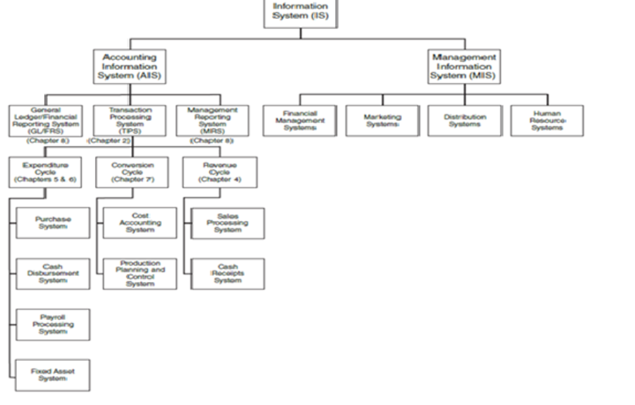
AN INFORMATION SYSTEMS FRAMEWORK

Slide 5
What is AIS?
Accounting information system (AIS) processes financial and some nonfinancial transactions. Three subsections:
The transaction processing system (TPS) which supports daily business operations.
The general ledger/financial reporting system (GL/FRS) which produces reports.
The management reporting system (MRS) which provides information for decision making.
Management information system (MIS) processes nonfinancial transactions not processed by the AIS.

Slide 6
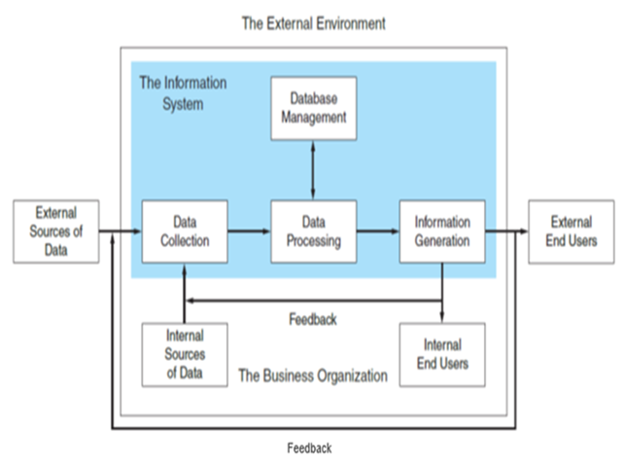
A General Model of AIS
End users fall into two groups :
External users include creditors, stockholders, government agencies, suppliers and customers.
Internal users include management and operations personnel.
Distributes essential financial information to support operations.
Data are facts which may or may not be processed and have no direct effect on a user’s actions.
Information causes a user to take an action that would otherwise not have been taken.
Data sources are financial transactions that enter the information system for internal or external sources.

Slide 7
A General Model of AIS (continued)
Data collection is the first operational stage in the information system:
Objective is to ensure data are valid, complete and free from material errors.
Only relevant data should be captured.
Efficient collection procedures designed to collect data only once.
Data processing tasks range from simple to complex.
The organization’s database is its physical repository for financial and nonfinancial data.
Term could apply to a filing cabinet or computer disk.

Slide 8
A General Model of AIS (continued)
Regardless of physical form, useful information has:
Relevance: Content must serve a purpose.
Timeliness: No older than time frame of supported action.
Timeliness: No older than time frame of supported action.
Accuracy: Free from material errors.
Completeness: All essential information is present.
Summarization: Aggregated for the user’s needs.

Slide 9

THE ACCOUNTING FUNCTION
Accounting manages the financial resource of the firm:
Captures and records transactions.
Distributes transaction information to operations personnel.
Value of information is determined by its reliability.
Relevance, accuracy, completeness, summarization and timeliness.
Unreliable information has no value.
Information reliability requires accounting independence.
Accounting activities must be separate and independent of the functional areas maintaining custody of resources.
Accounting supports these functions with information but does not participate in the physical activities

Slide 10

THE ROLE OF ACCOUNTANTS IN AIS
Accounts play a prominent role on system development teams as domain experts, responsible for many aspects of the conceptual system including specifying rules, reporting requirements and internal control objectives.
IT professionals determine the most economical and effective technologies for the physical system, including data storage.
Accountants perform audits which typically involve the AIS.
External audit is an independent attestation and opinion (audit report) regarding financial statement presentation.
Requires auditors (independent CPAs) to test internal controls and perform substantive tests of data.
Critical element is auditor independence, which means the auditor is free from factors that might influence the audit report.

Slide 11

THE ROLE OF ACCOUNTANTS IN AIS (continued)
Internal auditing is an independent appraisal function within an organization to examine and evaluate activities.
  External auditors represent outsiders and internal auditors represent the interests of the organization.
Fraud audits have increased in popularity as a corporate governance tool.
  May be initiated by managers to investigate employees or the board to investigate management.
Audit committees serves an independent “check and balance” for internal audit functions and a liaison with external auditors.
  Usually three people, one of which must be a “financial expert”.

Slide 12
THANK YOU

