Slide 1
Unit 2
Developing Marketing Strategies
Siti Aisyah

Slide 2
Learning Objectives
By the end of this unit, students will be able to:-
Define the basic concepts in marketing
Describe the customer-driven market strategy
Explain the elements of marketing mix

Slide 3
Learning Materials and Activities
Notes (PowerPoint slide)
Activity: Mind map
Quiz

Slide 4
Content
Definition of basic concepts in marketing
Steps in designing a customer-driven market strategy
Four elements of marketing mix

Slide 5
Basic Concepts in Marketing
Marketing
Needs
Wants
Demands
Offerings

Slide 6
Concept of Marketing
Generally, marketing is viewed as the function in business and a process that organization designs to create value for customers and build customer relationship that beneficial to organization’s stakeholders.
Source:
(1) Kotler, P. and Armstrong, G. (2014) Principles of Marketing, Global Edition. Essex, England: Pearson Education.

Slide 7
Concept of Marketing
Kotler
&
Armstrong
The process by which companies create value for customers and build strong customer relationships in order to capture value from customers in return. ⁽¹⁾
Hunt
&
Mello
An organizational function and set of processes for creating, communicating, and delivering value to customers and managing customers relationships in ways that benefit the organizations and its employees, customers, investors and society as a whole. ⁽²⁾

Slide 8

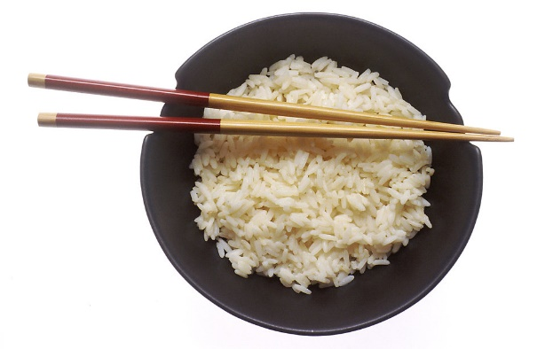
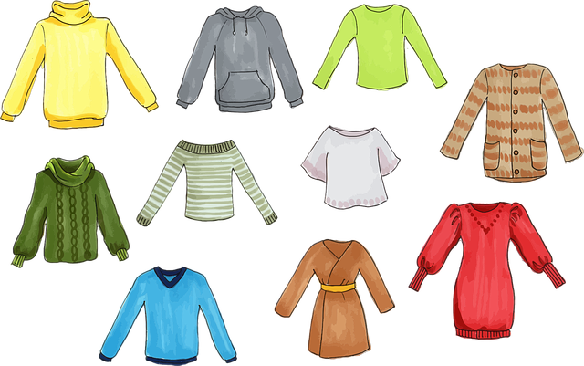
Concept of Needs and Wants
Needs: states of felt deprivation⁽¹⁾
Wants: objects that satisfy the need and shaped by culture and personality. ⁽¹⁾
Physical needs
Social needs
Individual needs

Slide 9

Concepts of Demands
Desire to own goods or services (wants)
Backed up buying power (resources)

Slide 10
Concept of Market Offerings
Physical products
Services
Experience
Information

Slide 11
Customer Driven Marketing Strategy
Market segmentation
Market targeting
Differentiation and positioning

Slide 12
Customer Driven Marketing Strategy
Market segmentation
  Market segmentation is a process of dividing a market into smaller segment of individuals or entities with similarities such as their characteristic, traits, or behavior.
  Segmenting of customers based on their similarities is a strategy to enable marketers or organizations to identify the different markets and develop effective marketing strategy tailored to each market.

Slide 13
Customer Driven Marketing Strategy
i. Market segmentation
  Organizations or marketers identify customers in several ways.
Geographic
Demographic
Psychographic
Behavioral
Business Market
International Market

Slide 14
Customer Driven Marketing Strategy
Market targeting
  Organizations or marketers select target market based on three general strategies which are undifferentiated, differentiated and concentrated marketing.
  In undifferentiated marketing strategy, organization assumes customers in one large market are having similar needs and wants and designs common marketing strategy to appeal customers.
  In differentiated marketing strategy, organization assumes customers in each market segment are having different needs and wants and designs marketing strategy tailored to each market segment.
  In concentrated marketing strategy, organization focuses on single market segment and designs its marketing strategy tailored to only one market.

Slide 15
Customer Driven Marketing Strategy
Differentiation and Positioning
To differentiate the organization and its competitor, marketers identify organization’s competitive advantage before communicate the strength and customer value to the market.
Communicating its competitive advantage can be done by developing value proposition (or positioning statement) to focus on the value or benefits customer gets from purchasing the product.
For example, an organization communicates its offering as the best quality needs to deliver its value as promised.

Slide 16
Elements of Marketing Mix
Product
Price
Place
Promotion

Slide 17
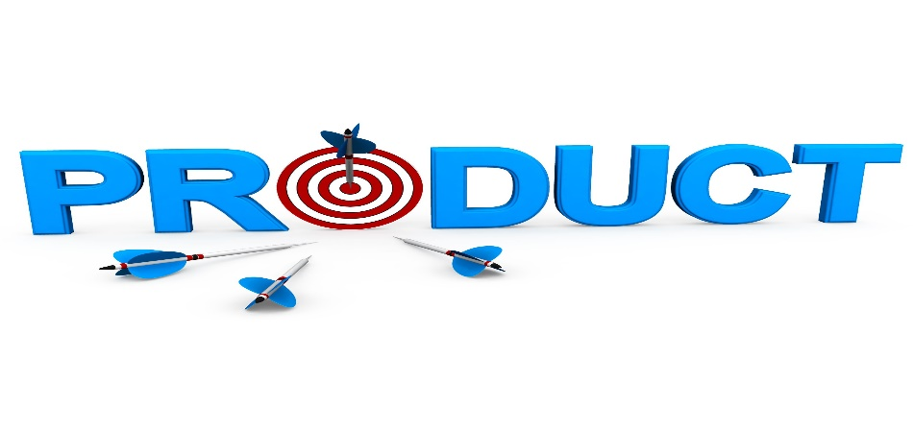

Elements of Marketing Mix (Product)
  Product is “anything that can be offered to a market for attention, acquisition, use, or consumption that might satisfy a want or need”. ⁽¹⁾
  Service is “a form of product that consists of activities, benefits, or satisfactions offered for sale that are essentially intangible and do not result in the ownership of anything”. ⁽¹⁾

Slide 18
Elements of Marketing Mix (Product)
Product can also be viewed as a combination of attributes.
Quality
Variety
Designs
Features
Branding
Packaging
Sizes
Warranties
Services
Return policy
After sales services

Slide 19
Elements of Marketing Mix (Product)
Product Classification
Consumer products
Industrial products
Convenience
Shopping
Specialty
Unsought
Capital items
Materials and parts
Supplies and services

Slide 20

Elements of Marketing Mix (Price)
  Price is a “quantity of money that is exchanged for goods or services offered in the market’. ⁽³⁾
  In general, there are five elements of pricing which are known as discounts, payment period, credit terms, allowances and list price.

Slide 21
Elements of Marketing Mix (Price)
  Organization needs to strategize the pricing decision to compete in the marketplace.
Organization also considers both external and internal factors to decide on pricing.
i.e. External factors – economic condition, competition, regulations, suppliers and distributors
i.e. Internal factors – market share, operating cost, profit, survival in competition, product quality, pricing, top management

Slide 22
Elements of Marketing Mix (Price)
Cost-oriented method
Competition-oriented method
Customer-oriented method

Slide 23
Elements of Marketing Mix (Price)
Pricing Tactics
Product line pricing
Psychological pricing
Segmented pricing
Discounts pricing
Product bundle pricing
Market skimming pricing
Market penetration pricing

Slide 24
Elements of Marketing Mix (Place)
Place in marketing mix functions as an activity to make the offerings available and accessible for use or consumption by users.
Place is known as marketing channel or distribution channel.
Organization may decide to distribute offerings via direct or indirect marketing channels.

Slide 25
Elements of Marketing Mix (Place)
Direct marketing channel
Indirect marketing channel
Producer
Producer
Producer
Wholesaler
Retailer
Retailer
Consumer
Consumer
Consumer

Slide 26
Elements of Marketing Mix (Promotion)
  Promotion is used to “create awareness and favorable attitude within the target market, community and among various groups of people that are connected to the business”. ⁽¹⁾
  The mixture of promotion tools used by organization to communicate customer value and build customer relationship is known as promotion mix.
  Organization delivers a clear and consistent message via coordination of its communication channels.

Slide 27
Elements of Marketing Mix (Promotion)
Personal Selling
Promotion Tools
Advertising
Sales promotion
Direct marketing
Publicity

Slide 28
References
Kotler, P. and Armstrong, G. (2014). Principles of Marketing, 15th Global Edition, England: Pearson Education.
Hunt, C. S. and Mello, J. E. (2015). Marketing, First Edition, United Sate of America: McGraw Hill.
Ariffin, S., Ab. Wahab, I. and Hambali, Z. (2013). Fundamentals of Entrepreneurship, Malaysia: Oxford Fajar.

Slide 29
Thank you

