Slide 1
Learning Unit 1
Introduction to Aquaculture
Faculty of Resource Science and Technology

Slide 2
Under this learning unit, you will learn the:
Definition of aquaculture
History of aquaculture and current status
Principle of aquaculture
Types of aquaculture

Slide 3
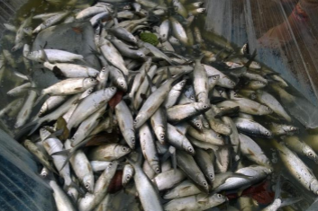
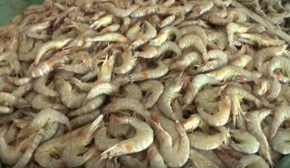
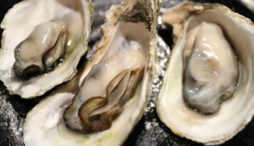
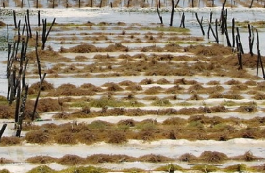
1. Definition of Aquaculture
*water farming / underwater agriculture
AQUACULTURE?
*science and technology of producing aquatic plants/animals
water
Seawater, freshwater or brackish water
to grow / to rear aquatic organisms
the culture of finfish, shellfish, other aquatic animals and aquatic plants in either freshwater or salt water
finfish
crustaceans
molluscs
aquatic plants
other aquatic animals

Slide 4
1. Definition of Aquaculture
Food and Agriculture Organization (FAO) defined aquaculture as “ it is the farming of aquatic organisms, including fish, molluscs, crustaceans and aquatic plants.”
Here FAO used the word ‘farming’ which implies some form of intervention in the rearing process to enhance production, such as regular stocking, feeding, protection from predators, etc.
It also implies individual or corporate ownership of the stock being cultivated
National Oceanic and Atmospheric Administration (NOAA, US) defined aquaculture as “it is the breeding, rearing, and harvesting of fish, shellfish, plants, algae and other organisms in all types of water environments.”
https://oceanservice.noaa.gov/facts/aquaculture-of.mp4
My definition of aquaculture is as an art of science or technology that can help the growing of aquatic organisms in controlled environments for any commercial, recreational, or public purpose; sector of fisheries that includes the rearing or raising under controlled conditions of aquatic products such as fishes, mollusks, crustaceans, sea weeds and other aquatic resources in sea, lakes and rivers.
Examples are fish ponds, fish pens, and fish cages.

Slide 5
2. History of Aquaculture and Current Status
The first fish pond:
4000 years ago first identifiable fish ponds were built by Sumerians in their temples followed by Assyrians and other races. Ancient Sumerians kept wild-caught fish in ponds, before preparing them for meals
Period | Aquaculture development
2000-1000 BC | Aquaculture started in China through stocking fish in the pond and paddy field during monsoon season helped to provide family foods; Polyculture was adopted by Chinese rice farmer with the recruitment of different fishes during monsoon
500 BC | Recognized as the classic of fish aquaculture with starting detailed study of fish culture describing the pond structure and function on carp aquaculture.
500 BC – 500 AD | Considered as gloden age of common carp aquaculture in China
618-906 | China started other fish culture because of the rule of Tang Dynasty (i.e.Prohibited the cultivation of carp) China started the polyculture in same pond with stocking different habitat fish.
906-1120 | Fry collection was started from the natural waterbody and stocked in reservoir and bamboo basket for fattening

Slide 6
2. History of Aquaculture and Current Status
Cont’d…..
Period | Aquaculture development
1360-1640 | 1. Concerned about the complete aquaculture process with practicing followings: Methods of raising fish fry to adult Develop structure of ideal pond Fish feeding Disease control 2. Brackish water aquaculture was started in Indonesia 3. China published “Complete Book of Agriculture” where included the pond cultivation
1640-1900 | Information system introduced in the aquaculture sector Further fish culture methods to be developed with fry production, seasonal occurrence of fish fry, transportation technique of fish fry American Universities began to develop aquaculture courses
1900-1950 | First fish hatchery was established in America Started to making Fish Feed and dry pellet fish diet was introduced by America on 1940-50 Aquaculture works are boosted up throughout the world
1950-Now | Modern aquaculture started with introducing different culture methods Use of antibiotics were prohibited by FAO The fish nutrition was more focused for controlling disease by enhancement of fish immunology using antibiotic-free supplements.

Slide 7
History of Aquaculture in Malaysia
Began in the 1920’s with extensive polyculture in ex-mining pools of introduced Chinese carps, mainly the bighead carp, silver carp and grass carp
In the mid 1930’s, marine shrimp trapping ponds were first developed in Johore
In the early 1940’s, the culture of blood cockles (Anadara granosa) began.
This was followed in the mid 1950’s by the extensive culture of freshwater fish in earthen ponds.
Most of the carps which are cultured, such as the Chinese carps, Javanese carps and the Indian carps, were introduced by the British in the early 1950’s.

Slide 8
History of Aquaculture in Malaysia
However, Indian carps did not last long as they compete with the Chinese carps and their appearance is inferior to that of the Chinese carps.
In the early 1970’s, great changes in aquaculture began to take place, when the semi-intensive culture of shrimp was developed in Johore.
Shrimp culture was characterized by very low stocking density combined with pond fertilization.
During the same period, floating net cage culture of marine fish, mainly the green grouper (Epinephelus coioides), began to take place, followed by the raft culture of green mussels
By the early 1990’s, aquaculture activities were further enhanced with the introduction of intensive commercial aquaculture with very high stocking density and complete dependence on supplementary feeding.

Slide 9
History of Aquaculture in Malaysia
Commercial aquaculture was made possible through the establishment of government and privately owned fish and shrimp hatcheries, which started in the 1980’s.
The setting up of private feed mills in the 1980’s also contributed to the commercialization of aquaculture.

Slide 10
Current status of world aquaculture
Category | Production (million tonnes)
Food products (finfish, crustaceans, molluscs etc.) | 80.0
Aquatic plants (seaweeds, microalga) | 30.1
Non-food products (ornamental shells, pearls) | 0.03
Total | 110.13
(FAO, 2018)

Slide 11
Region-wise aquaculture production of food products
Country | Production (thousand tonnes)
Asia (China, India, Indonesia, Viet Nam, Bangladesh) | 71,546
America (Chile, rest of Latin America, Caribbean, North America) | 3,348
Africa (Egypt, rest of Northern Africa, Nigeria, sub Saharan | 1,982
Europe (Norway, EU-28, rest of Europe) | 2,945
Oceania | 210
(FAO, 2018)

Slide 12
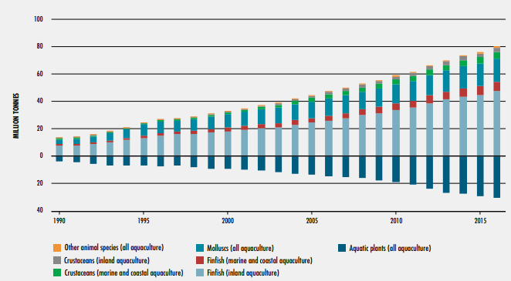
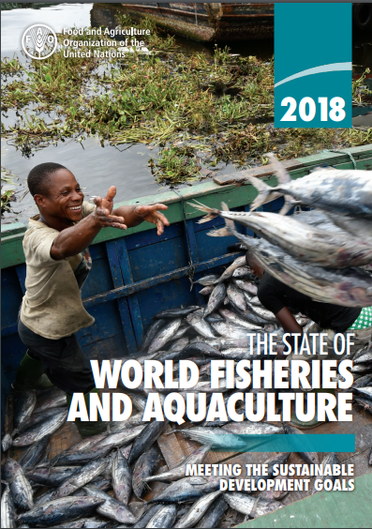
World aquaculture production of food fish and aquatic plants, 1990-2016
(FAO, 2018)

Slide 13
Aquaculture - Malaysia
Target – 662,000 tonnes

Slide 17
3. Principle of Aquaculture
The fastest growing of world aquaculture is expanding into new directions, intensifying and diversifying.
The persistent goal of new world aquaculture is maximizing the efficacy of fish production optimizing the profitability.
Therefore, both commercial and artisal aquaculture farmers make attention more in fish production through adopting the new technologies like super-intensive, intensive and semi-intensive which make this sector as risk.
HOWEVER,
The farmers can not able to follow the standard hygienic procedure for the aquaculture production. As a result, water quality is deteriorating which causes for out-breaking the disease. Farmers use the antibiotics to get rid of the disease These antibiotics develop the antimicrobial resistant pathogens, inhibit or kill the beneficial microbiota in the gastrointestinal (GI) ecosystem, and finally making antibiotic residue into fish body that accumulated in fish product to be harmful for human consumption
Thus the present principle of aquaculture is to explore new alternative technology and new strategies in sustainable feeding and health management of aquaculture

Slide 18
4. Types of Aquaculture
Aquaculture is broadly classified into two categories:
1. Extensive Aquaculture
2. Intensive Aquaculture
1. Extensive culture: low intensity aquaculture providing only small increases over natural productivity. Extensive fish culture systems have low stocking densities, don’t use rearing units specifically engineered for aquaculture, and don’t involve artificial diets
2. Intensive culture: fish culture methods yielding far in excess of natural productivity levels. Intensive systems utilize high stocking rates, man-made rearing units and artificial diets.

Slide 19
4. Types of Aquaculture
There are four types of intensive aquaculture systems:
1.) Pond culture: system based on earthen ponds, where some or all of the food consumed is from natural production and there is minimal water flow.
2.) Raceway Culture: system based on circular or straight raceways (tanks) with high water flow and minimal water reuse.
3.) Cage Culture: system in which fish are confined to net pens or cages placed in ponds, rivers, lakes, or ocean.
4.) Tank Culture Utilizing Water Recirculation: tank culture system where nearly 100% of the water is reused and cleansed by sophisticated filtration systems.

Slide 20
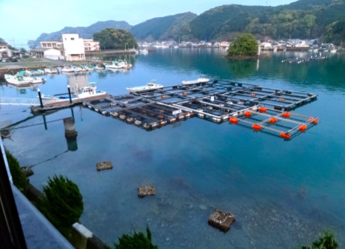
Aquaculture production systems
a) Open systems (cages, pens and enclosures)

Slide 21
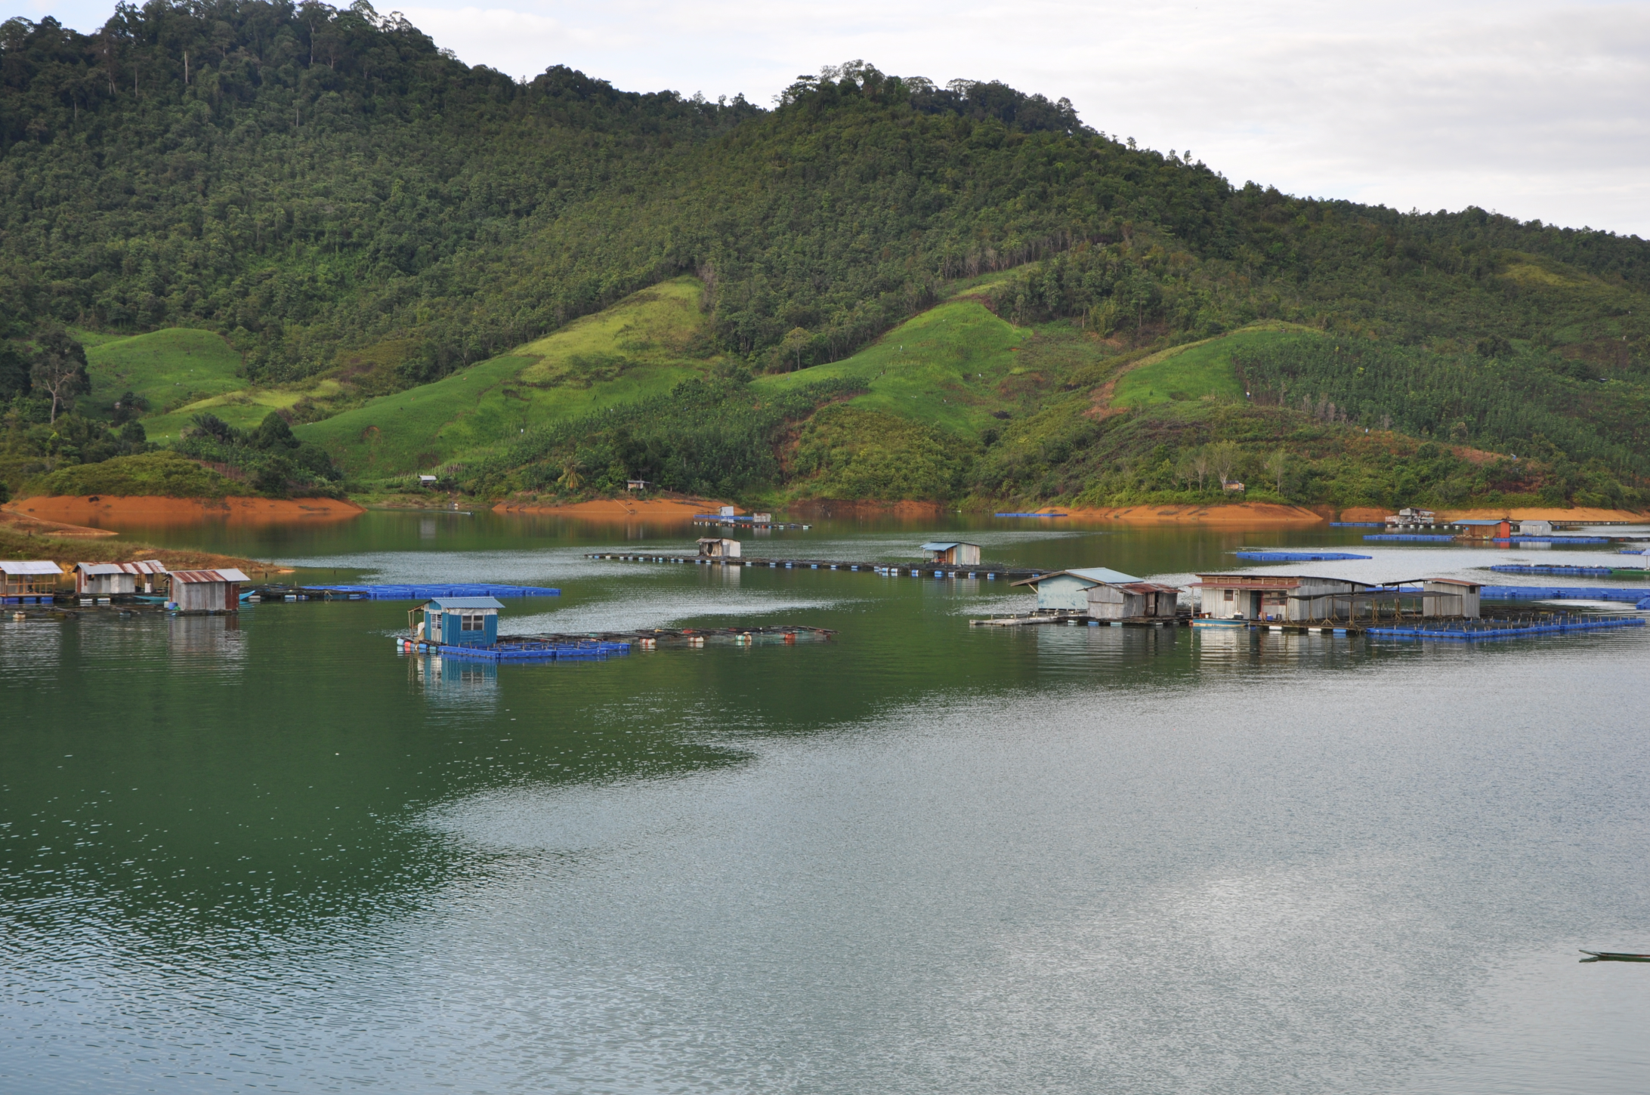
Cage Culture in Batang Ai

Slide 22
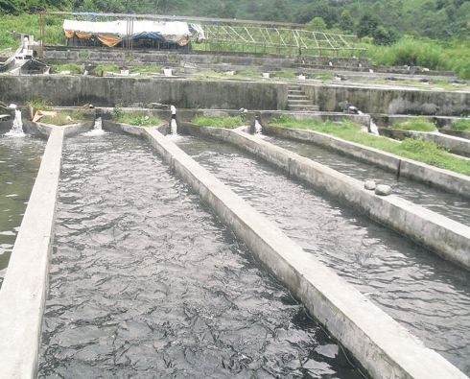
Aquaculture production systems
b) Raceways

Slide 23
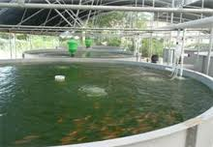
Aquaculture production systems
c) Recirculating systems

Slide 24
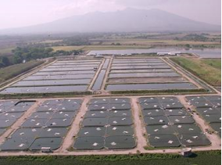
Aquaculture production systems
d) Earthen ponds

Slide 25
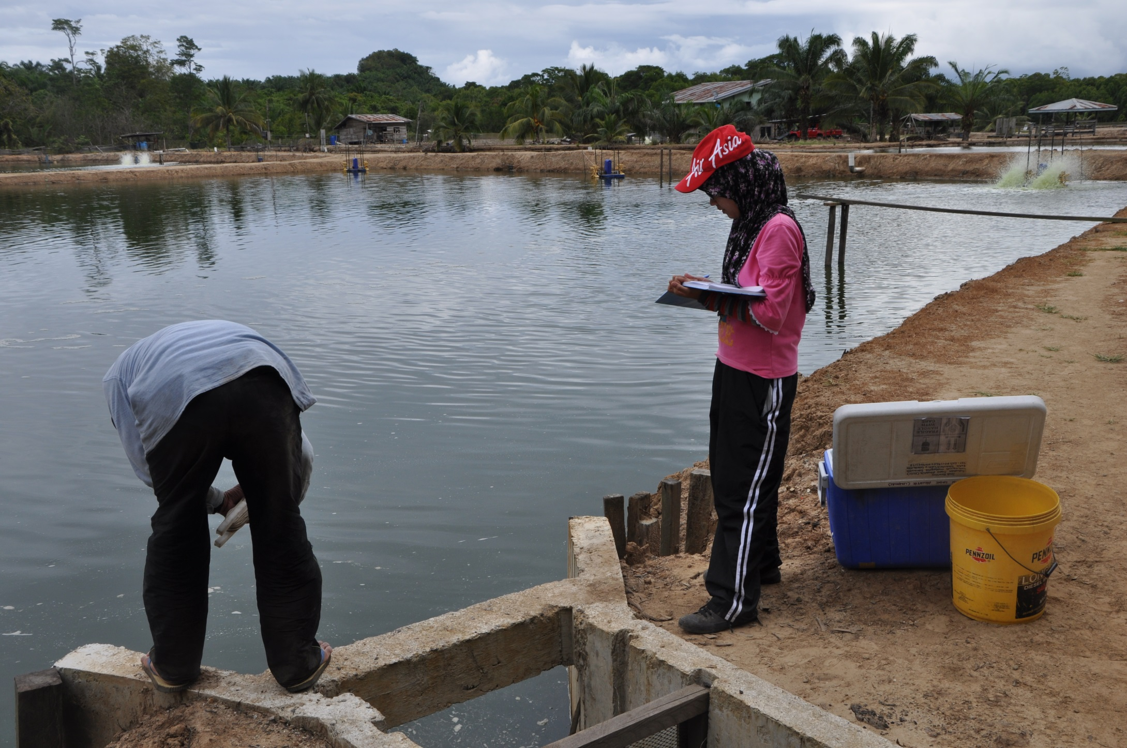
Shrimp Pond in Kunak, Sabah

Slide 26
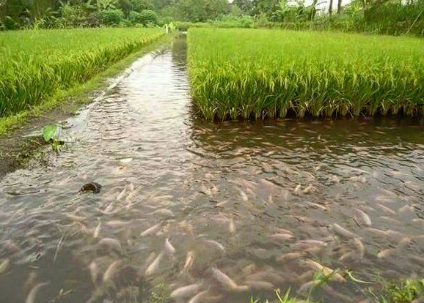
Aquaculture production systems
e) Integrated culture

Slide 27
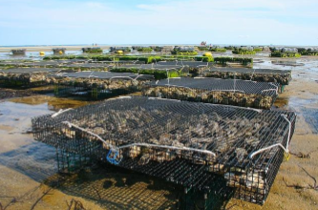
Aquaculture production systems
f) Hanging, 'on bottom' or stick methods

Slide 28
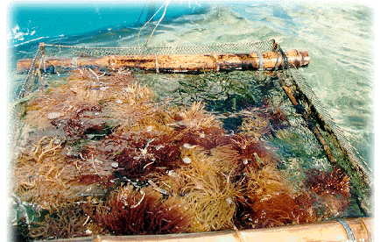
Seaweed Culture

Slide 29
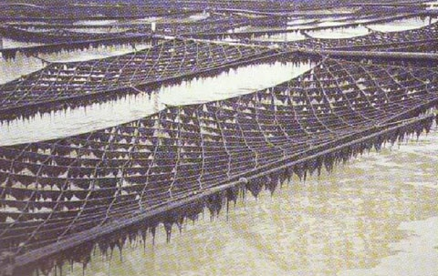
Seaweed Culture

Slide 30
Common practices in Aquaculture
1) Site selection
2) Species selection
3) Seed production and larval rearing
4) Hatchery and farm management
5) Nutrition and feeding management
6) Fish health and diseases
7) Postharvest and processing
8) Marketing
9) Environmental management and sustainable aquaculture

Slide 31
Thank you!

