Slide 1
Learning Unit 2
Site and species selection and hatchery design
Faculty of Resource Science and Technology

Slide 2
Under this learning unit, you will learn the:
Site selection
Water quality
Species selection
Hatchery design

Slide 3
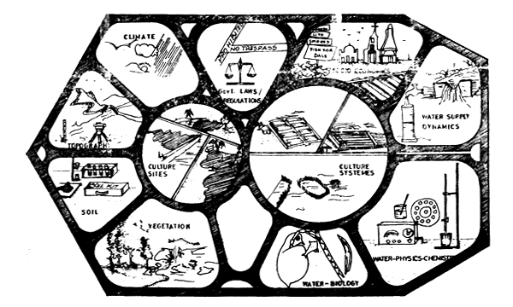
1) Site selection for aquaculture
Food and Agriculture Organization (FAO) state that the success of an aquaculture project depends to a large extent on the proper selection of the site to be developed into a fish farm or hatchery.
The principal three factors are:
1.1) Ecological factors
1.2) Biological and operational factors
1.3) Economic and social factors
African regional aquaculture centre describes about the considerable factors for aquaculture site through a picture:
Which are very similar to the three factors described by FAO.

Slide 4
1) Site selection for aquaculture
1.1 Ecological factors
A prerequisite for good practices in aquaculture site selection. It includes:
Ecological factors | Facts
Water supply | Sufficient quantity and adequate quality of water Source of water e.g. canal, river, creek, reservoir, lake, spring, rainfall run-off, dug or deep well, mountain stream etc. Rainfall and mountain stream needed a reservoir during dry seasons particularly in tropical countries
Water quality | Physical properties - temperature, colour, odour, turbidity, transparency, suspended solids Chemical properties - pH, dissolved oxygen, biochemical oxygen demand, free carbon dioxide, alkalinity, salinity, dissolved solids, ammonia etc. Biological properties - quality and density of plankton. (iv) micro-biological properties - species and quantity of parasites
Climate | Mean monthly temperature, evaporation, rainfall, humidity, sunshine, wind speed and direction etc.
Hydrological characteristics | Data for discharge, yield, floods and water elevations of existing water sources (rivers, irrigation channels, reservoirs, springs, etc.)
Soil characteristics | Type, Texture, Color, OM Content, pH, N-P-K content, soil erosion etc.
Land | Slope, Elevation, Land type, Land vegetation, Underground utilities etc.
a. Water supply
b. Water quality
c. Climate
d. Hydrological characteristics
e. Soil characteristics
f. Land

Slide 5
Formula to assess the water requirement annually for aquaculture
Q_{r} = V_{f} + V_{rf} + L_{e} + L_{s} + L_{c} – V_{ra} (m³)
where as:
Q_{r} = annual water requirement (m³)
V_{f} = A x h = the pond volume to be filled (m³)
A = average water surface area of the pond (m²)
h = average water depth of the pond (m)
V_{rf} = N_{o} x V_{f} = the pond volume to be refilled
N_{o} = number of refilling a year (no. of culture cycle-1)
L_{e} = A x E = water loss from evaporation (m³)
E = mean annual evaporation (m)
L_{s} = A x T x S = seepage loss in the pond (m³)
A = average water surface area of the pond (m²)
T = operational time in days
S = seepage coefficient (m/day)
L_{c} = A_{c} x 1.2 x E = transmission loss in earthen canal (m³)
A_{c} = water surface area of feeder canal (m²)
E = evaporation rate (m /day)
V_{ra} = A_{eff} x R_{a} = water inflow from rainfall to pond (m³)
A_{eff} = total area of pond including dikes exposed to rain (m²)
R_{a} = mean annual rainfall (m)

Slide 6
Practice 1:
Nora wants to start an aquaculture farm with 12 ponds. Each pond has a water surface area of 0.4 hectare and a depth of 120 cm. Each culture period will be 3 months and there will be 3 cultures a year. Drying and pond preparation will be carried out in between every culture. Other information including weather and soil of the area are as follows:
daily evaporation rate is 2.0 cm;
monthly rainfall is 33 mm;
total area of pond including dikes exposed to rain is 25 hectares;
soil seepage coefficient is 0.15 cm/day;
water for the ponds is obtained from a dam 150 m away using a feeder canal with width of 0.7 m.
Using the information and formulae given, calculate the volume of water in cubic meters (m³) needed in one year when all the ponds are operational.
SOLUTION

Slide 7
Practice 2:
You have 4 ponds and each pond has different water surface area. Pond 1 has a water surface area of 0.1 ha and depth of 90 cm, pond 2 has an area of 0.2 ha and depth of 110 cm, pond 3 has an area of 0.4 ha and depth of 120 cm, and pond 4 has an area of 1.0 ha and depth of 130 cm. Each culture period will be 4 months and there will be 2 cultures a year. Drying and pond preparation will be carried out in between every culture. Other information including weather and soil of the area are as follows:
(i) daily evaporation rate is 2.5 cm
(ii) monthly rainfall is 35 mm
(iii) total area of pond including dikes exposed to rain is 3 hectares
(iv) soil seepage coefficient is 0.3 cm/day
(v) water for the ponds is obtained from a dam 150 m away using a feeder canal with width of 0.6 m
Using the information and formulae given, calculate the volume of water in cubic meters (m³) needed in one year when all the ponds are operational.

Slide 8
1) Site selection for aquaculture
1.2 Biological and operational factors
There are 7 (SEVEN) biological and operation factors approved by FAO, which are:
a. Species to be cultured
b. Resources and availability of stocking materials (spawners, fry or fingerlings)
c. Project type i.e. Small-scale or Large scale
d. Culture system i.e. Traditional or Modern. If modern, it might be semi-intensive, intensive or super intensive
e. Opertaion method i.e. Monoculture, Polyculture or Integrated culture
f. Production target
g. Estimated size of required area

Slide 9
1) Site selection for aquaculture
1.3 Economic and social factors
There are 17 (SEVENTEEN) economic and social factors approved by FAO, which are:
- development plans for the project area
- ownership, availability of land and land values, land regulations and rights, as well as any legal restrictions relating to land
- proximity to all-weather road connections
- availability of electricity, telephone or radio connections, as well as unit power cost
- availability of equipment, services and supplies needed for running the project
- availability of construction materials
- location of markets for the produce and determination of demand
- availability of organic and artificial fertilizers, drugs and chemical materials
PLEASE EXPLAIN YOURSELF BY FACTOR-WISE; WE MAY ASK YOU THE EXPLANATION OF SOME FACTORS
- availability of supplementary feeds
- costs of equipment, materials, feeds, etc. needed for running the project
- availability of suitable transport facilities
- availability of ice for marketing
- availability of staff with adequate experience of pond management
- availability of skilled and semi-skilled labourers
- reasonable amenities for permanent staff, for example, schools, shopping facilities, hospital, etc
- information on the local financing methods or credits
- political realities

Slide 10
2) Water quality for aquaculture
Culture of fish and other aquatic organisms depend on some water qualities parameters
In turn, the quality of the aquatic environment depends on the quality of the aquatic environment
Quality of aquatic environment generally depends on four kinds of factors which are:
1. Physical factors
2. Chemical factors
3. Biological factors
4. Meteorological factors
OPTIMUM CONDITIONS OF ALL THE FACTORS COMBINEDLY CONTROL AND DETERMINE THE BEST RESULTS IN AQUACULTURE.

Slide 11
2) Water quality for aquaculture
Components of the four factors
FACTORS | COMPONENTS | Description
Physical | 1. Pond bottom and productivity | Link with the soil substrate. e.g Loamy and alkaline soil
 | 2. Depth | Should not be shallower than 1m and deeper than 5m
 | 3. Light | Sufficient quantity and intensity of light needed
 | 4. Temperature | Fish is poikilothermous. So biological activities are controlled
 | 5. Turbidity | Intensity of turbidity. Over than 20K ppm or more is lethal
Chemical | 1. Dissolved oxygen | Most important factors. Optimum is 5.5 to 6.5 ppp
 | 2. Carbon dioxide | Need for maintain the primary productivities
 | 3.Other dissolved gases H₂S, NH₃, CH₄, N₂, SO₂ and CO | Maintain the optimum level
 | 4. pH | Alkaline is preferred. Optimum 6.5-8.5
 | 5 Total alkalinity | Essential nutrients but not directly help aquatic biotic production
 | 6. Total hardness | Less important than alkalinity. 15ppm is suitable for aquaculture

Slide 12
2) Water quality for aquaculture
Components of the four factors
FACTORS | COMPONENTS | Description
Biological | 1. Diversity of organisms | Phytoplankton, Zooplankton, Nekton, Microbes, Plants etc.
 | 2. Nutrient cycle | Known as bio-geochemical cycle Bacterial decomposition of dead phytoplankton, zooplankton and other aquatic plants and animals leads the nutrient cycle Bacteria play the key role Example: Nitrogen cycle, Phosphorus cycle, Carbon cycle etc.
 | 3. Eutrophication | High concentration nitrogen and phosphorus
Meteorological | 1. Mean monthly rainfall | For regular biological activities
 | 2. Mean monthly evaporation | For determining the water requirement
 | 3. Air temperature | For regular biological activities and bio-geochemical cycle
 | 4. Light | Photosynthesis of primary producer
 | 5 Humidity | For regular biological activities
 | 6. Precipitation | For determining the external threat like storm

Slide 13
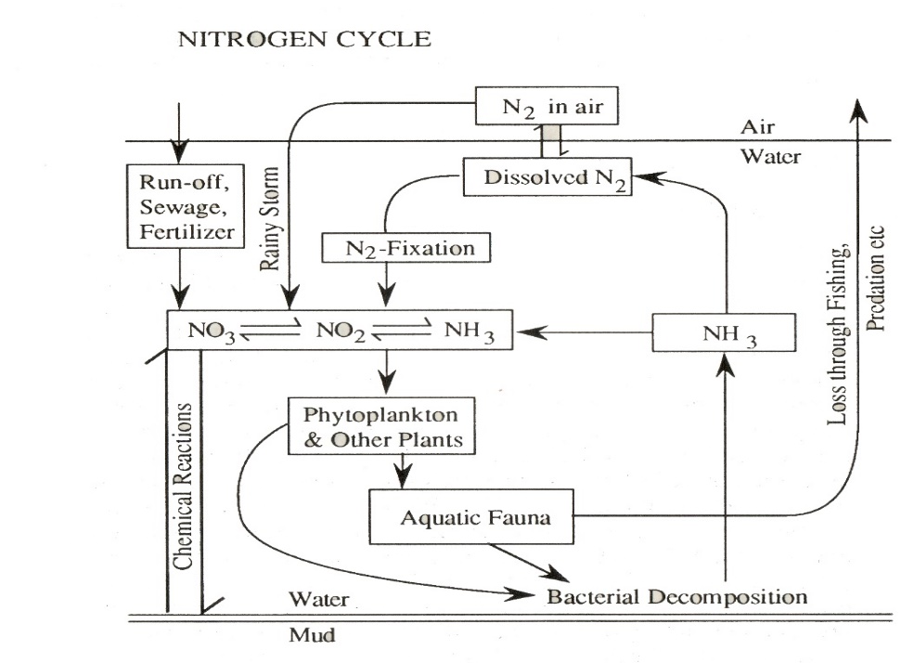
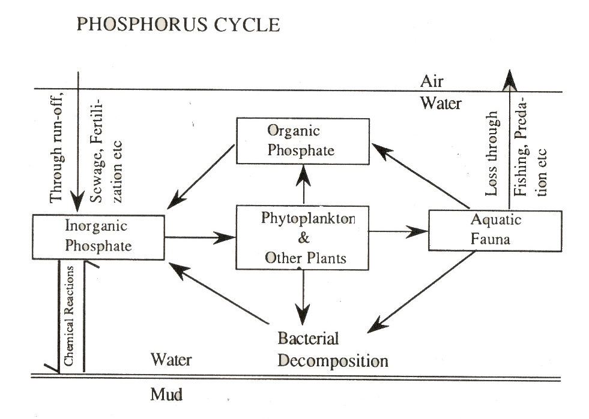
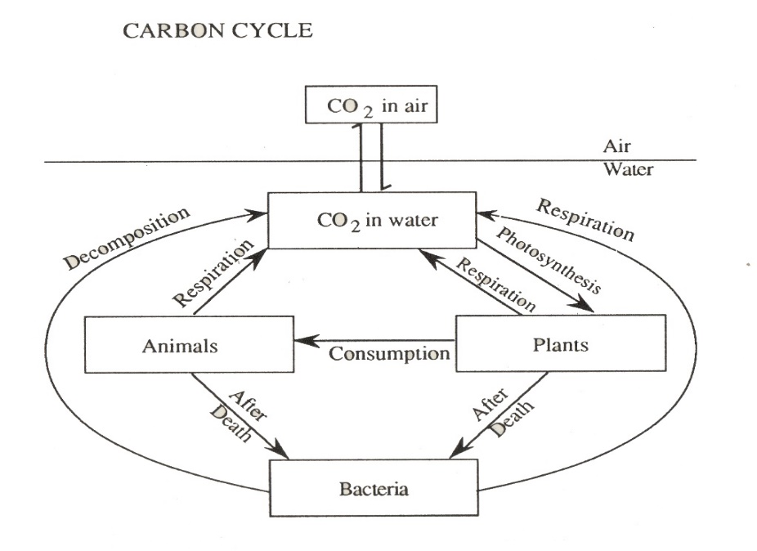
2) Water quality for aquaculture
Important Nutrient cycle
Phosphorus is also a limiting factor and very important for plants.
Source: Soil, run-off, sewage
Fixation: Bottom mud under different physico-chemical circumstances
Significant products: Phosphate, Phosphorus penta oxide
Nitrogen is a limiting factor and very important for plants.
Source: Lightning of rainy season
Fixation: Nitrogen-fixing bacteria and molds, blue green algae
Significant products: Nitrate, Nitrite and ammonia
Carbon dioxide is considered as the basis of life
Source: Animal respiration, dissolved in water as carbonic acid, bi-carbonate and carbonate form
Fixation: Air-water
Significant products: Free carbon (harmful), carbon dioxide

Slide 14

2) Water quality for aquaculture
Eutrophication
In general refers to ALGAL BLOOM. Broadly,
A state of a waterbody when the concentration of essential nutrients, especially the limiting nitrogen and phosphorus are high and having heavy density of phytoplankton for which dangerous to lethal conditions may occur in extreme situation.
How to control:
1. To ban the use of phosphorus in the preparation of synthetic detergent
2. To stop the inflow of domestic sewage, industrial effluents into a waterbody
3. For small waterbody, reclamation through complete drying and reducing bottom-mud
4. To stop fertilization and artificial feeding of fish in troubled waterbody
5. To keep output of nutrients higher than their input through scientific fish culture and regular yearly catching
Two types which are:
1. Natural
2. Cultural or artificial

Slide 15
3) Species selection for aquaculture
Criteria in selecting a species for culture are:
1. Existence of either suitable techniques for controlled breeding
2. Easy availability of larvae or juveniles from natural breeding ground
3. Rate of growth and production under culture conditions: Faster growth rate and grow to marketable size in a shorter time and more frequent harvests
4. Size and age at first maturity: Reach marketable size before they attain first maturity is ideal as most of the feed and energy are used for somatic growth instead of for reproduction
5. Breed easily under captive conditions: Allow hatchery production of seed in adequate quantities
6. High fecundity and high frequency of spawning: Small-sized eggs and small larvae make hatching operations difficult

Slide 16
3) Species selection for aquaculture
Criteria in selecting a species for culture are:
7. Shorter incubation period and larval cycle: Greater survival in hatcheries
8. Larvae accept artificial feeds: Easier to rear in hatcheries as live foods is difficult and often expensive
9. Does not depend on seed available from the wild: Seed from the wild is an unreliable source in large-scale farming
10. Does not conflicts with commercial fishermen: Species cultured is either different from those that caught by commercial fishermen or seed of species are not caught from the wild
11. Hardy and tolerate unfavourable conditions: Better survival in relatively poor environmental conditions

Slide 17
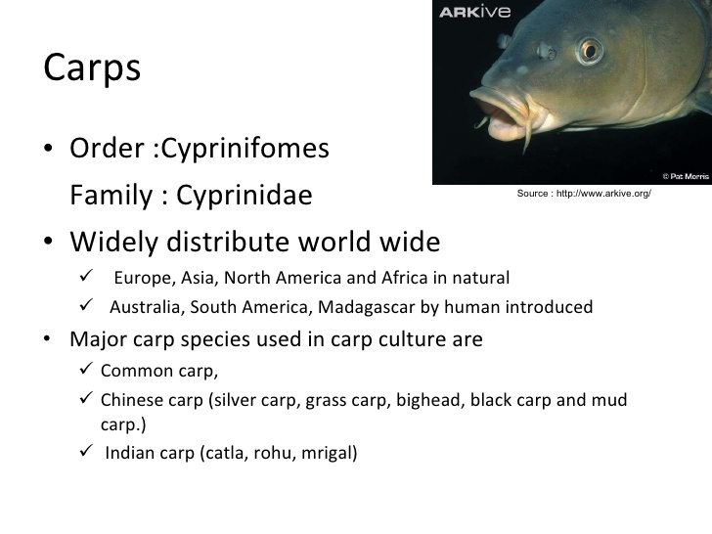
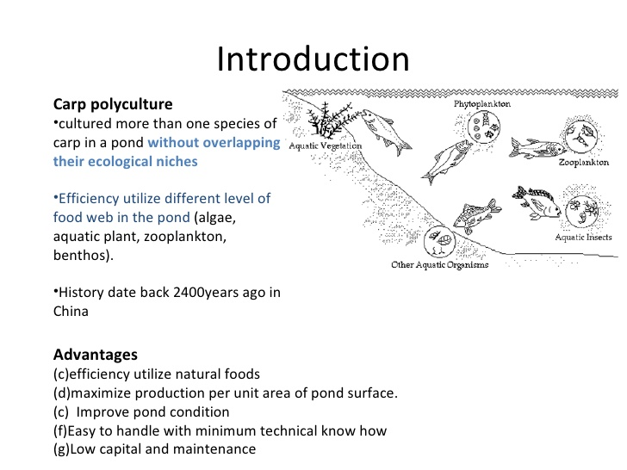
3) Species selection for aquaculture
Carp Polyculture

Slide 18
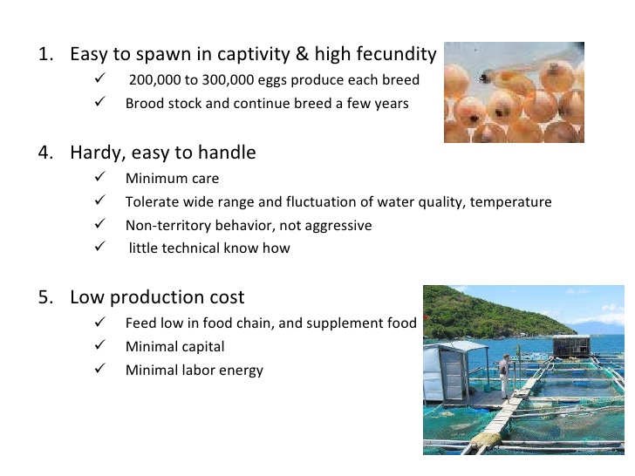
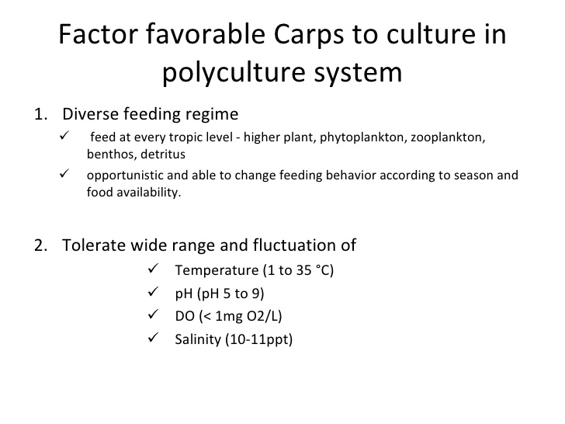
3) Species selection for aquaculture
Carp Polyculture

Slide 19
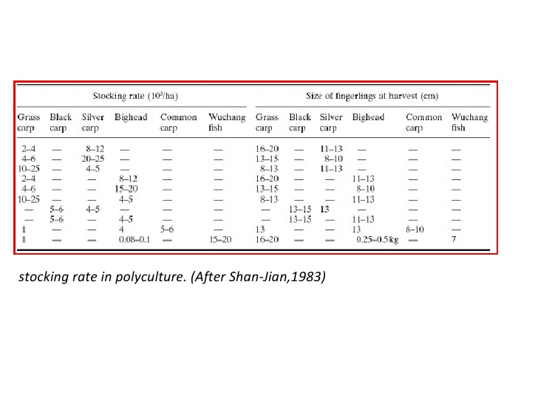
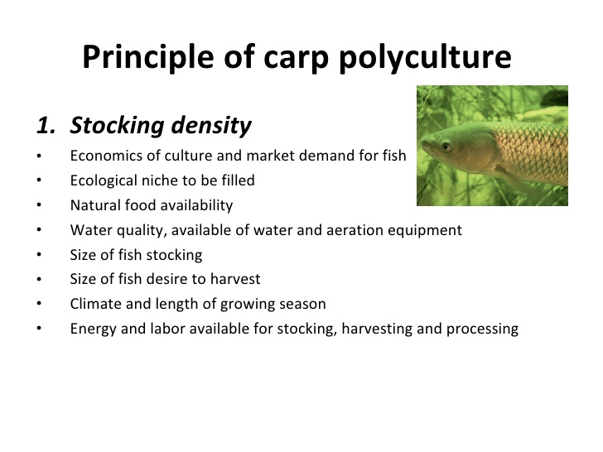
3) Species selection for aquaculture
Carp Polyculture

Slide 20
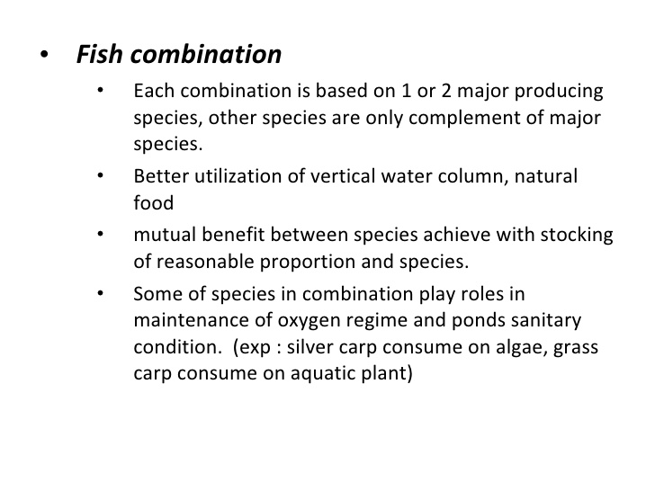
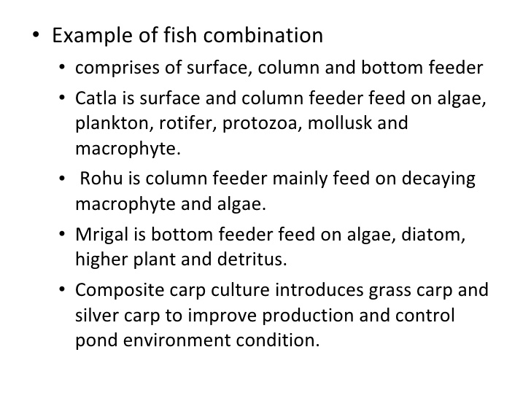
3) Species selection for aquaculture
Carp Polyculture

Slide 21
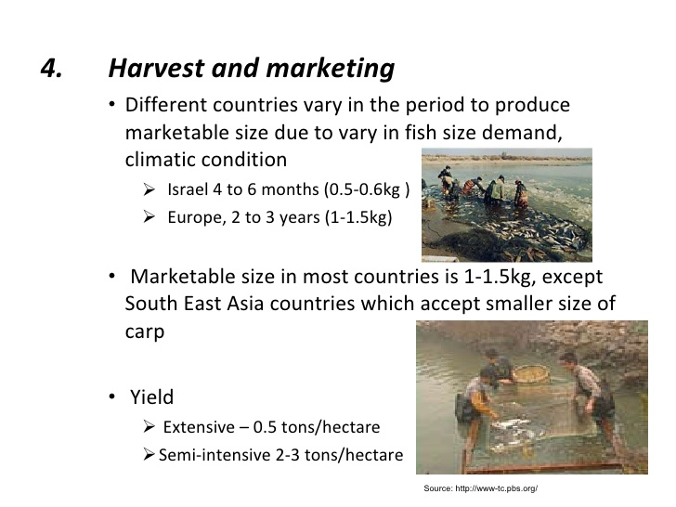
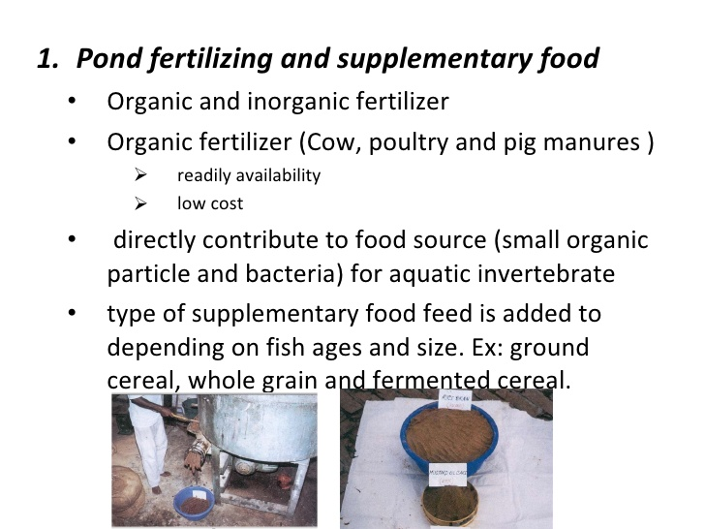
3) Species selection for aquaculture
Carp Polyculture

Slide 22
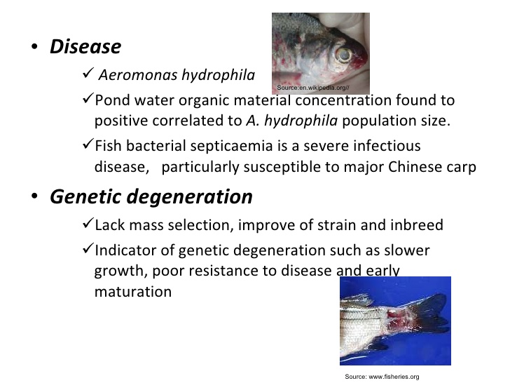
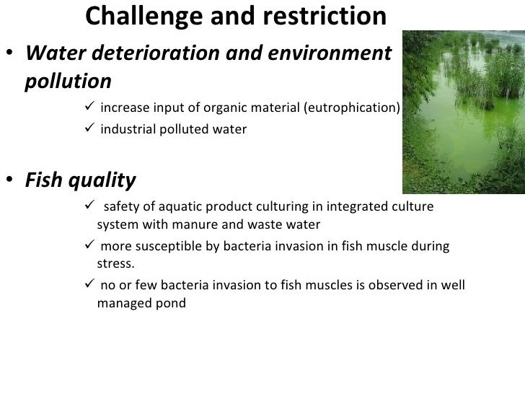
3) Species selection for aquaculture
Carp Polyculture

Slide 23
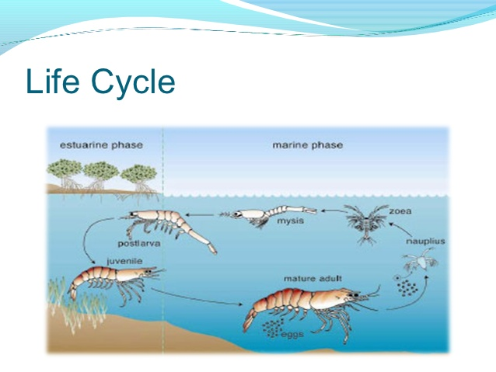
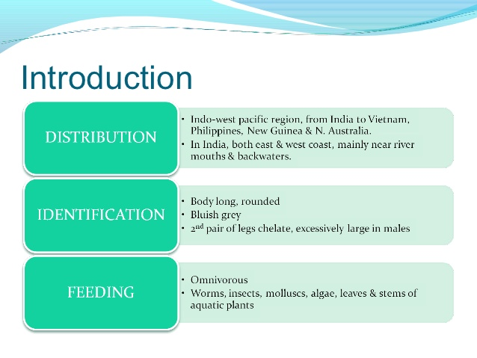
3) Species selection for aquaculture
Prawn culture (Macrobrachium rosenbergii)

Slide 24
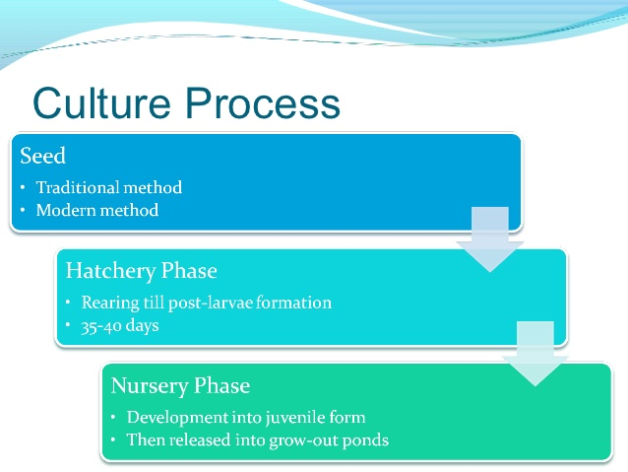
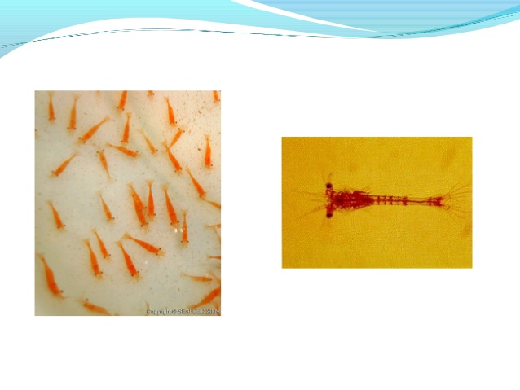
3) Species selection for aquaculture
Prawn culture (Macrobrachium rosenbergii)

Slide 25
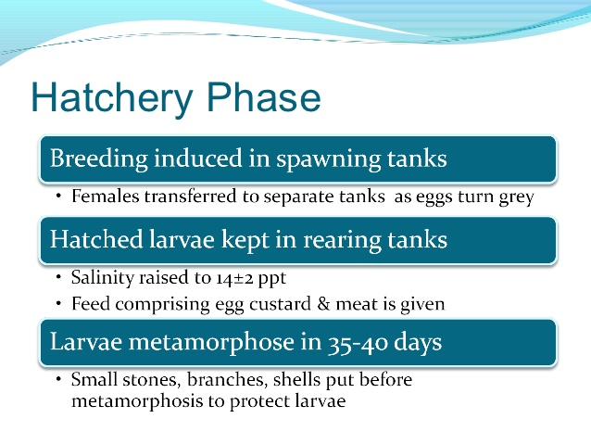
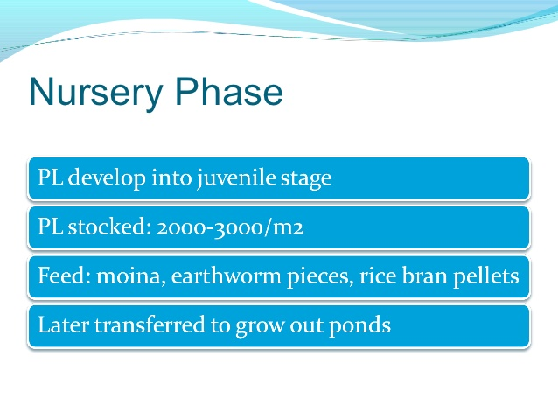
3) Species selection for aquaculture
Prawn culture (Macrobrachium rosenbergii)

Slide 26
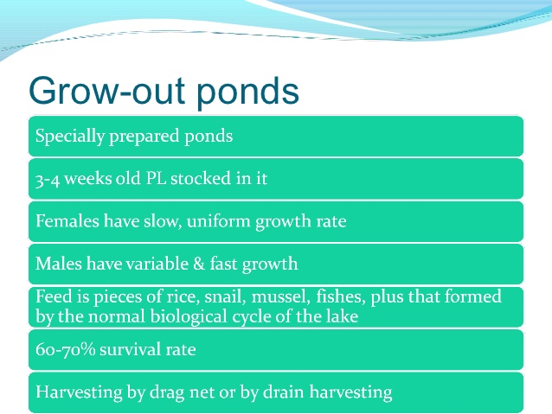
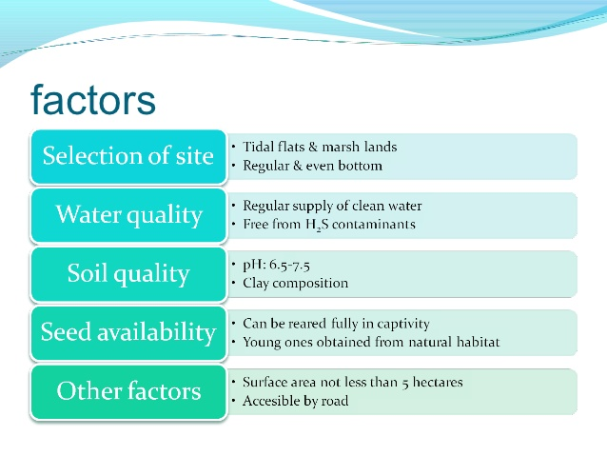
3) Species selection for aquaculture
Prawn culture (Macrobrachium rosenbergii)

Slide 27
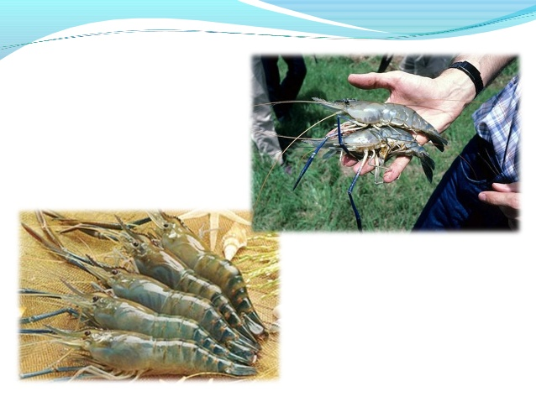
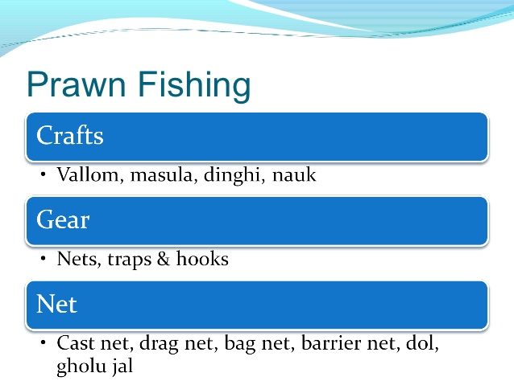
3) Species selection for aquaculture
Prawn culture (Macrobrachium rosenbergii)

Slide 28
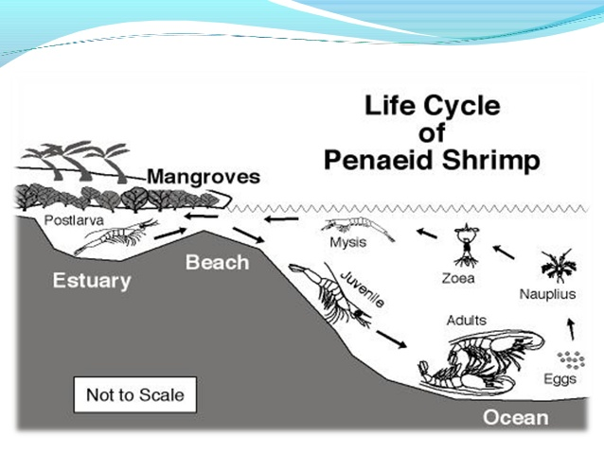
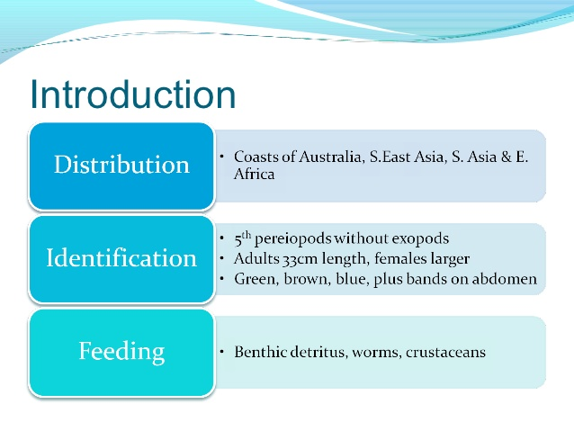
3) Species selection for aquaculture
Shrimp culture (Penaeus monodon)

Slide 29
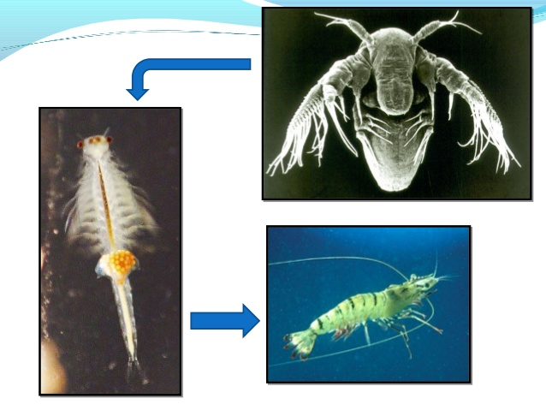
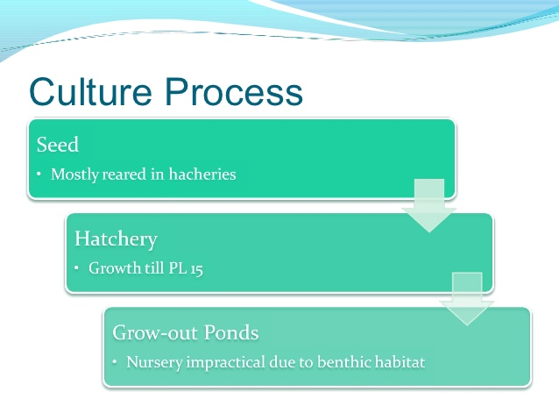
3) Species selection for aquaculture
Shrimp culture (Penaeus monodon)

Slide 30
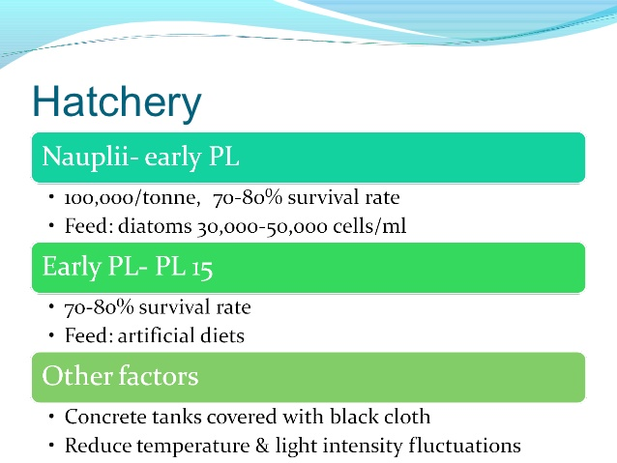
3) Species selection for aquaculture
Shrimp culture (Penaeus monodon)

Slide 31
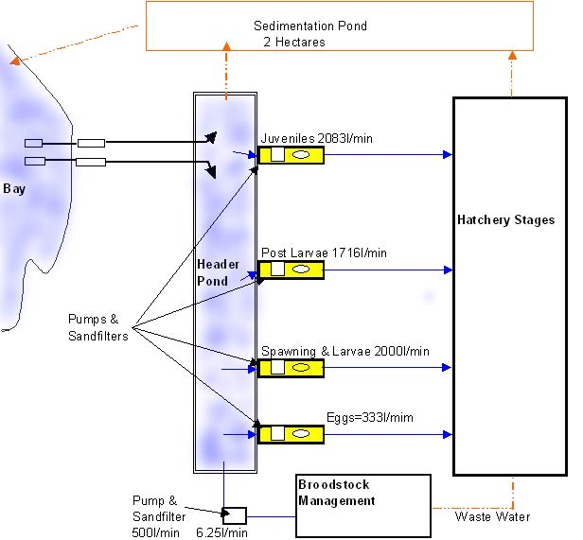
4) Hatchery design and farm management
ESSENTIAL COMPONENTS of A FISH HATCHERY
The various essential components of a hatchery are:
1. Sufficient number of male and female brood stock ponds
2. Nursery ponds
3. A hatchery complex of facilities for fish spawning, hatching and care of hatchlings to raise them up to post larval stage.

Slide 32
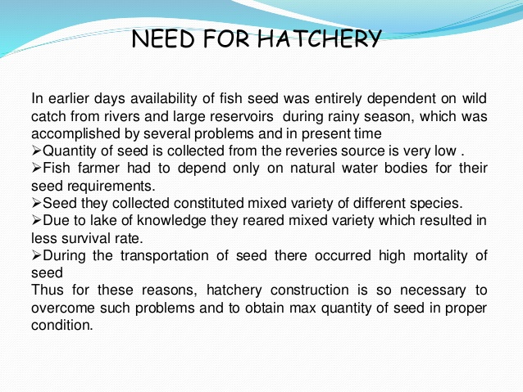
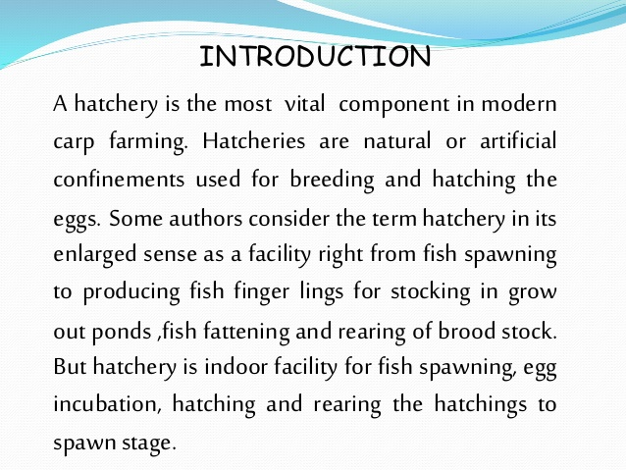
4) Hatchery design and farm management

Slide 33
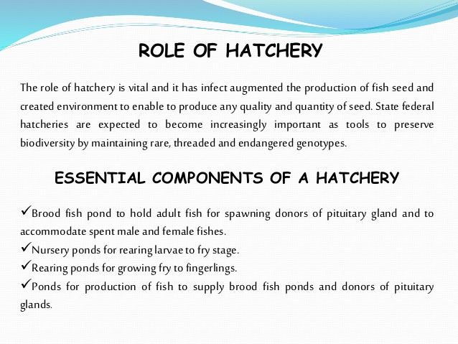
4) Hatchery design and farm management

Slide 34
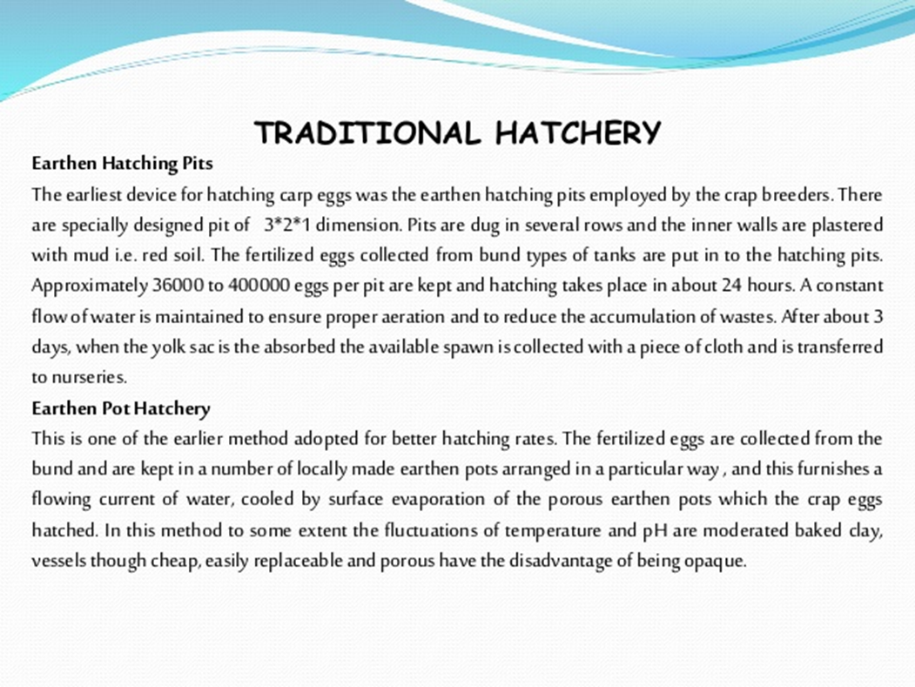
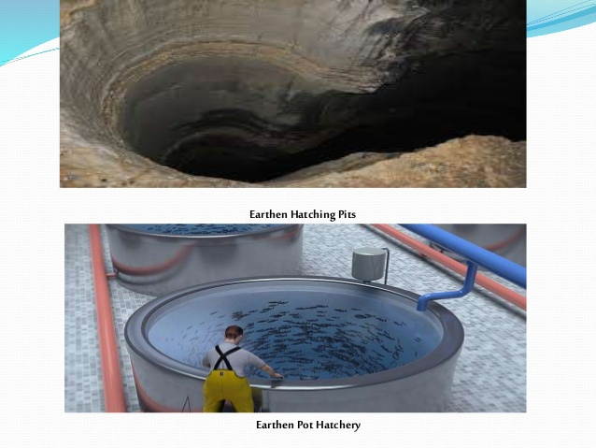
4) Hatchery design and farm management

Slide 35
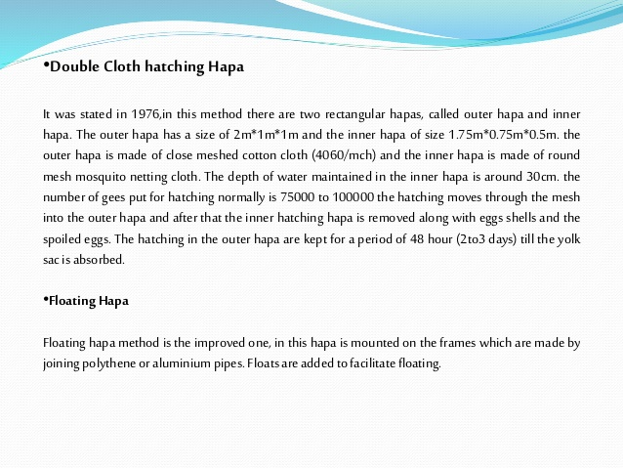
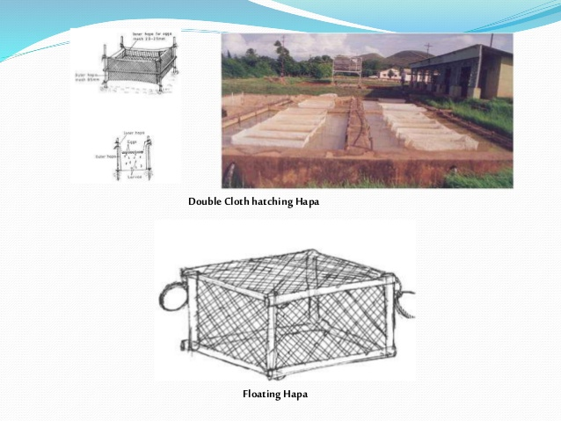
4) Hatchery design and farm management

Slide 36
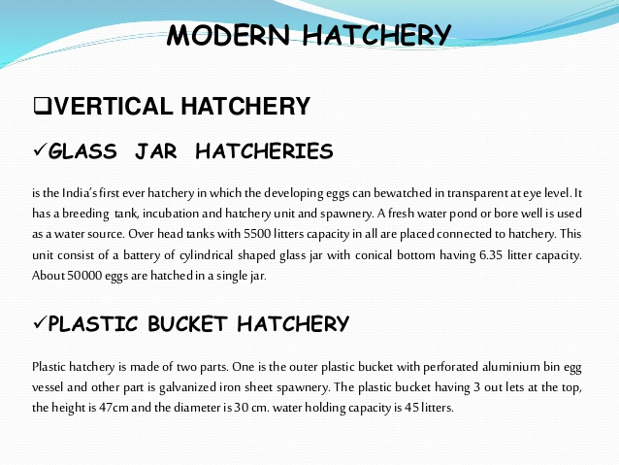
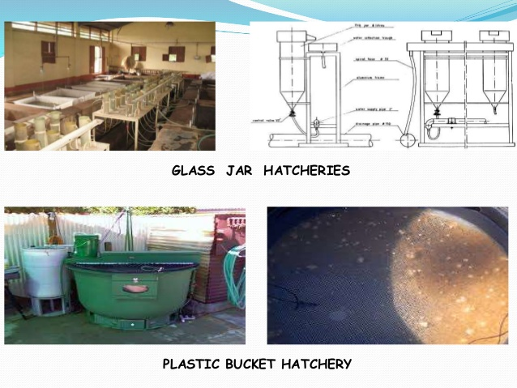
4) Hatchery design and farm management

Slide 37
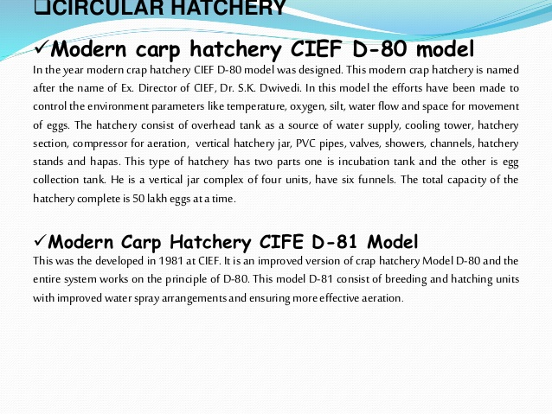
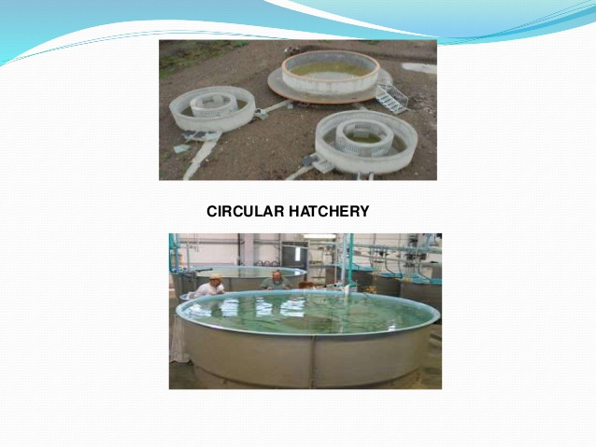
4) Hatchery design and farm management

Slide 38
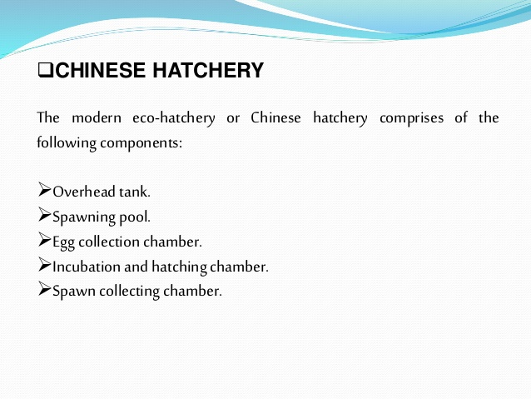
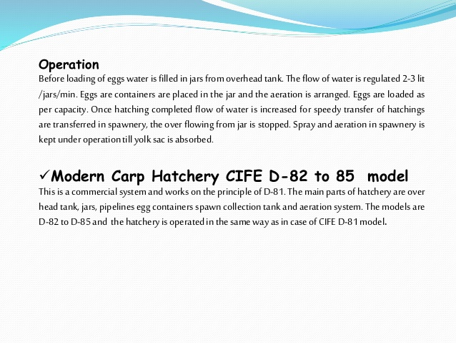
4) Hatchery design and farm management

Slide 39
4) Hatchery design and farm management

Slide 40
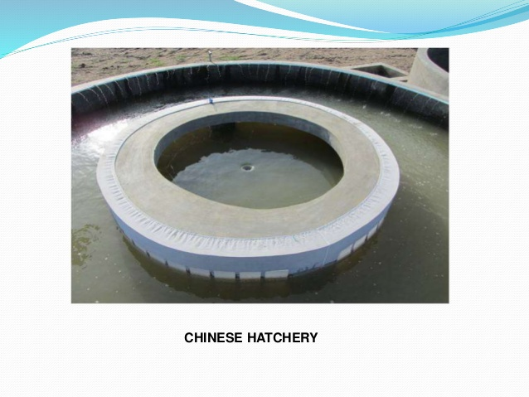
4) Hatchery design and farm management

Slide 41
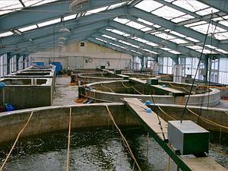
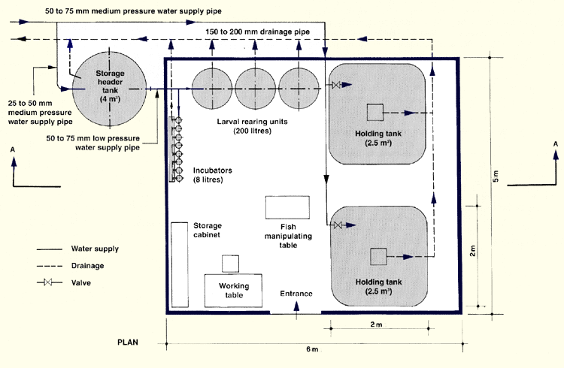
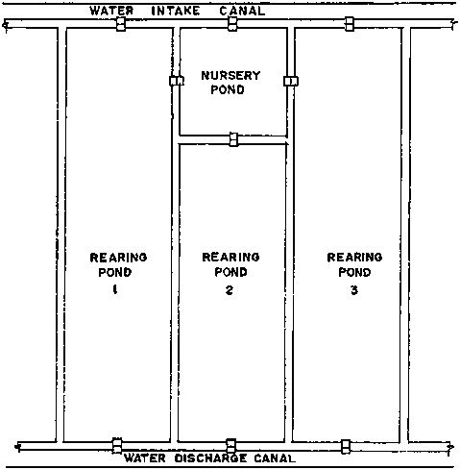
4) Hatchery design and farm management
A Carp hatchery layout

Slide 42
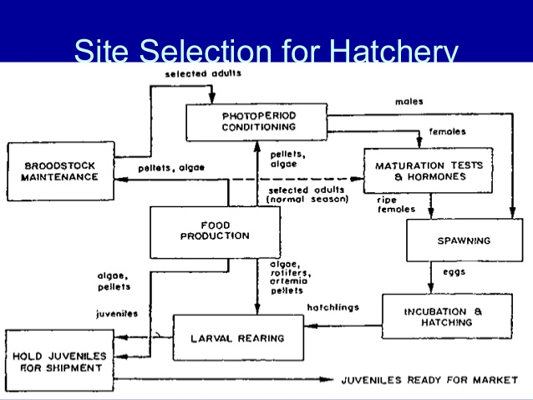

4) Hatchery design and farm management

Slide 43
Thank you!

