Slide 1
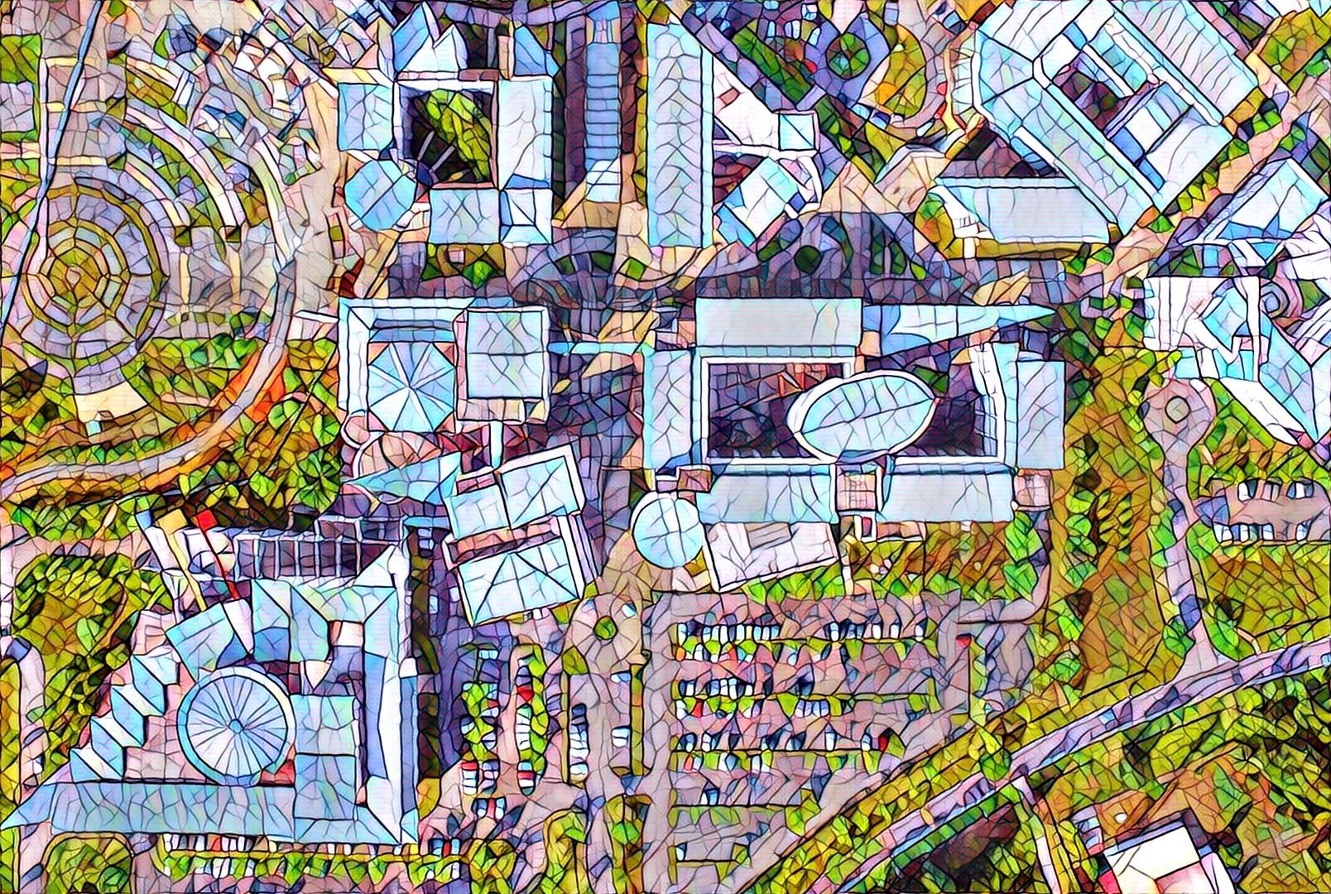


Elements and Principles of Photography
Digital Photography and Social Media Imaging

Slide 2
Elements of Photography
Arrangement of the elements in photography and composing them to create visually impactful image.
Below is the list of elements in photography:
Line
Shape
Form
Texture
Pattern
Colour
Space

Slide 3
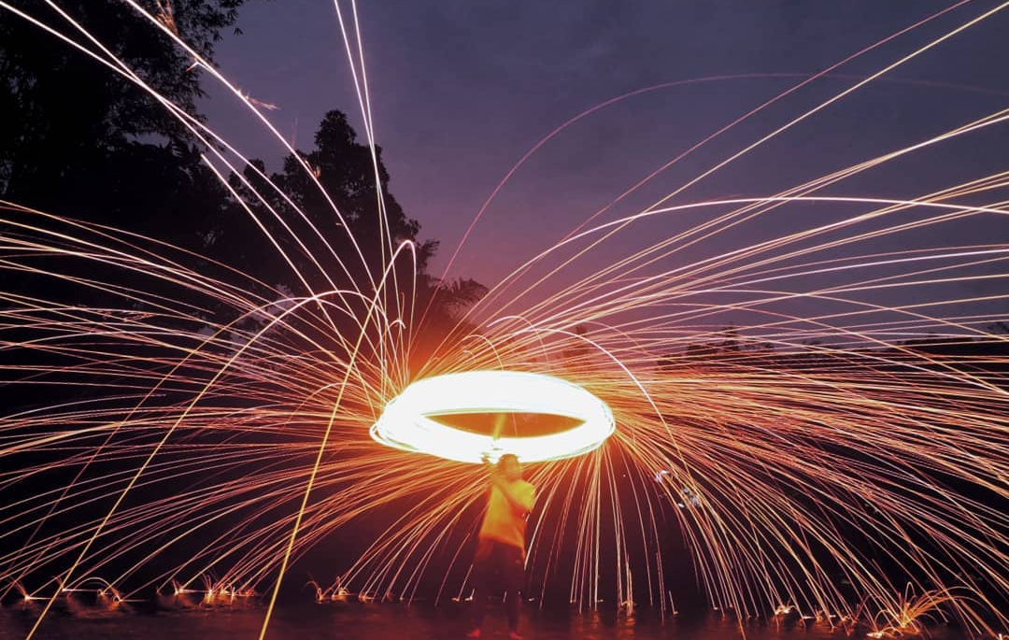


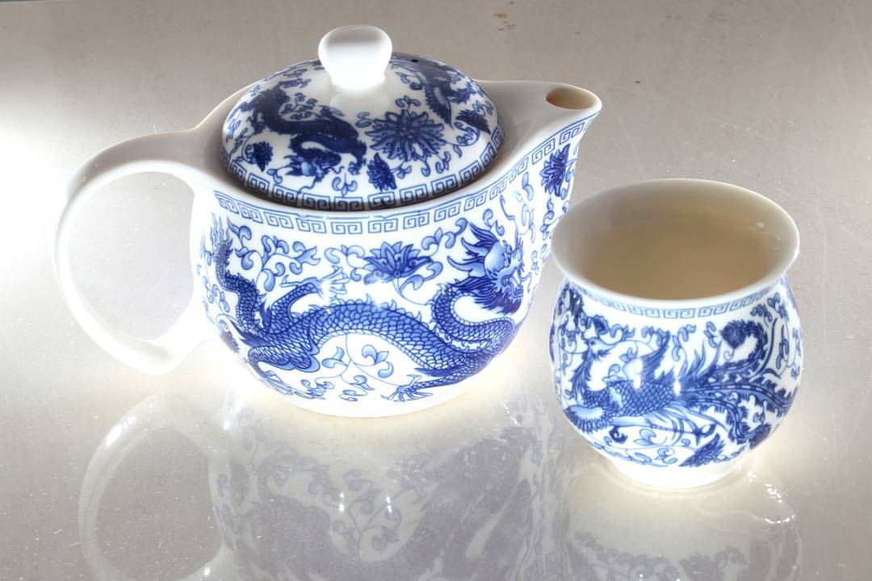

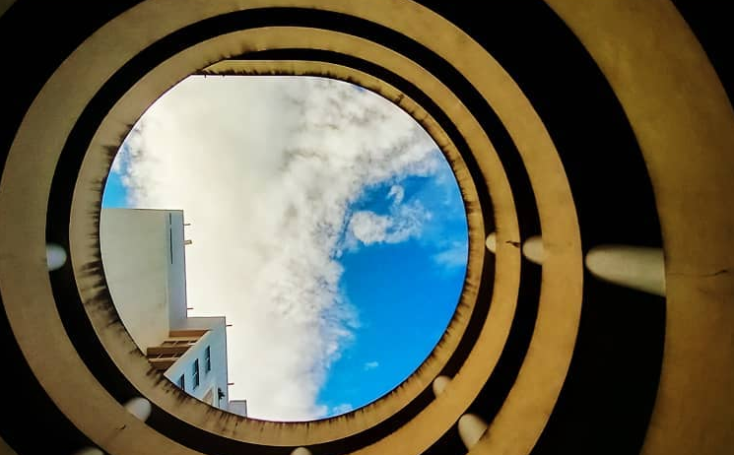
Elements of Photography
Guess, which element does the picture portrays?

Slide 4
Principles of Photography
Arrangement of the elements in photography and composing them to create visually impactful image.
Below is the list of principles in photography:
Unity or Harmony
Balance
Emphasis
Proportion
Contrast
Rhythm or Repetition
Movement

Slide 5
Principles of Photography
Guess, which principle does the picture portrays?

Slide 6
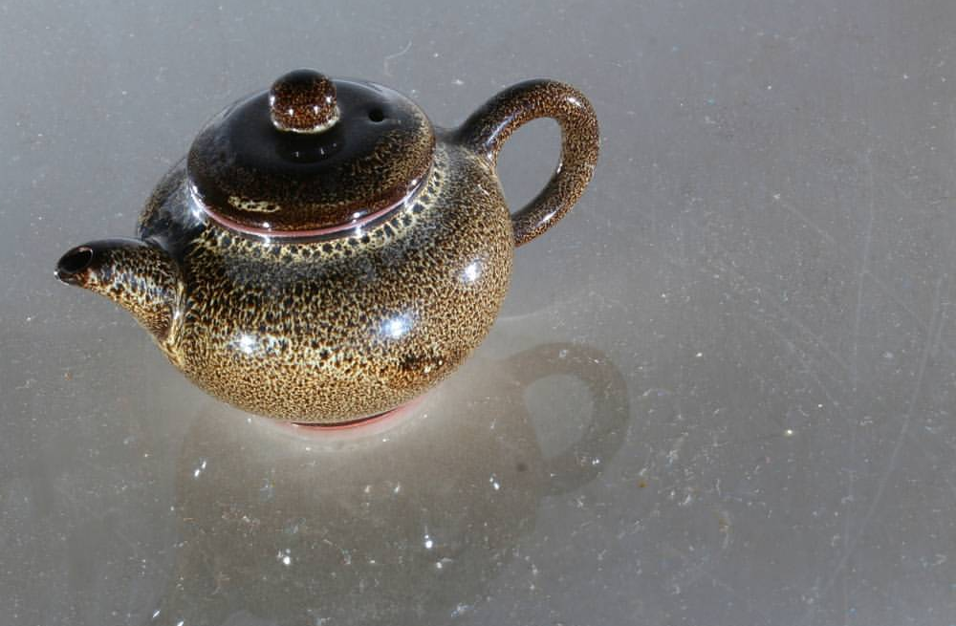
Rule of Third
The subject matter is placed in the intersections that occupied a third or place things along the imaginary lines.
The placement are on the third of the way up, third of the way in from the left or in any of the invert arrangements.

Slide 7
Thank You
Digital Photography and Social Media Imaging

