Slide 1
Accounting for Beginners UNIT 1: Introduction to Accounting Part 2
Sharifah Sabrina Sy. Ali

Slide 2
Learning Outcome
Identify Different Types of Business Organization
Categorize Different Users of Accounting Information
Name the types of accounting software.

Slide 3
Content
Types or Forms of Business/ Organization
Users of Accounting Information
Accounting Tools and Software

Slide 4
1. Forms of Business

Slide 5
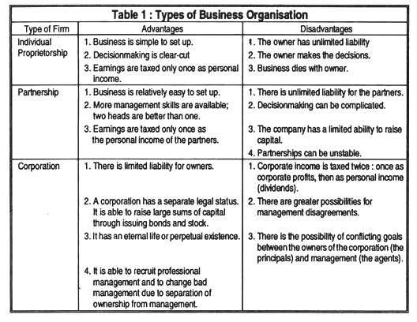
Types or Forms of Business Organisation

Slide 6
2. Users of Accounting Information

Slide 7
Users of Accounting Information
Users of accounting information
Internal users
External users

Slide 8
Internal Users
Internal Users | Possible Reason(s) for using Accounting Information
Management | They need accounting information to help them make decisions, such as whether there is enough profit to pay out dividends, whether the business should introduce a new product line, whether opening a new sales outlet is feasible, and so on.
Employees | Does the company able to increased salary or pay bonus?

Slide 9
External Users
External Users | Possible Reason(s) for using Accounting Information
Creditors and lenders | Should a loan be granted to the company? Will the company be able to pay its debts as they become due?
Customers | Does the company offer useful products at fair prices? Will the company survive long enough to honor its product warranties?
Governmental/ regulatory bodies | For filing tax returns
General public | Is the company providing useful products and gainful employment for citizens without causing serious environmental problems?
Investors | They will also use accounting information to guide investment decisions
Banks or lending institutions | They may use accounting information to guide decisions such as whether to lend or how much to lend a business.

Slide 10
3. Accounting Tools & Software

Slide 11
Accounting Tools & Software
1. Accounting software is used to collect information about and report on the financial viability of a business. This software is critical to the proper administration of an organization.
2. Before deciding upon which software package to use, it is important to understand the different types of accounting software, and under what circumstances each one should be used.

Slide 12
Accounting Tools & Software
3. Types of Accounting software:
QuickBooks, MYOB, SQL, Xero, Sage Accounting, Cloud accounting
Enterprise resource planning software (ERP). ERP software integrates information from all parts of a business into a single database. This approach eliminates the problems associated with having independent department-specific software that does not share information. However, it is also painfully expensive and may require more than a year to install. This software is usually only needed by the largest and most complex organizations.
Custom accounting software. This software is custom developed for an organization. This approach is usually only taken when an entity's needs are so specific that they cannot be met by a COTS or ERP package. However, this approach is rarely taken, since custom software tends to be buggy and requires more maintenance than commercially-available packages.

Slide 13
Thank you
and
Best Wishes

